Slide 1
Pulmonary Arterial Hypertension
Maria Hymon, MSN, ACNP-BC

Slide 2
Definition
Increased blood pressure in the pulmonary artery, veins, or capillaries
Progressive disease leading to Right ventricular failure and eventual death
Right Heart Catheterization Findings
  Mean Pulmonary Arterial Pressure ≥ 25
  Pulmonary Capillary Wedge Pressure ≤ 15
  Pulmonary Vascular Resistance > 3 wood units

Slide 3
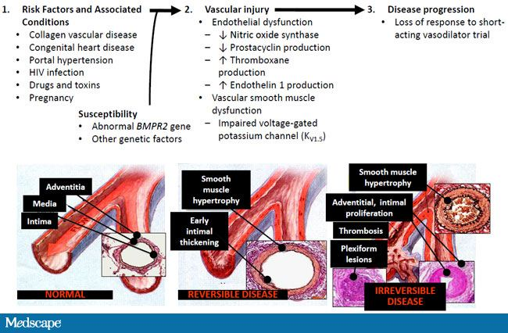
Pathophysiology

Slide 4
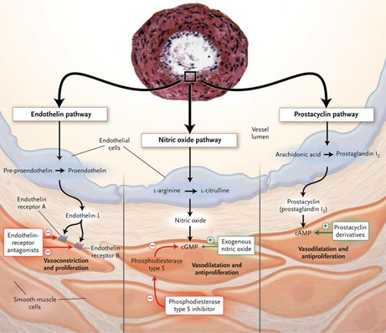
Disease Pathways

Slide 5
Classification of Causes
Group 1
  Idiopathic & Heritable
  Autoimmune disease/ Connective Tissue disease
  HIV
  Drugs and toxins
  Portal Hypertension
  Congenital Heart Disease
  Schistosomiasis (parasitic infection)
Group 2 (Left heart disease)
Group 3 (lung disease)
  COPD
  Interstitial Lung disease
  OSA
Group 4
  Chronic Thromboembolic Disease (chronic pulmonary emboli)
Group 5 (Miscellaneous)

Slide 6
WHO Group 1 PAH
Epidemiology (1)
Prevalence
  12 of every 1 million Americans
Incidence
  Approximately 2 new cases per million are diagnosed yearly in US
Patient Population
Primarily Female (78%) (1)
Mean age at diagnosis is 47 years (1)
Mean time from first symptoms to diagnosis of 31 months (2)
Common Risk Factors
Family History
Genetic Mutations (BMPR2)
HIV
Connective Tissue Disease
Anorexigen use
Portal Hypertension
Illicit Drug Use
Congenital Heart Disease

Slide 7
Who Group 1 Subtypes (REVEAL Registry)

Slide 8
Associated PAH Etiologies

Slide 9
Symptoms
Dyspnea
Fatigue
Exertional intolerance
Chest Pain (late)
Syncope/ Dizziness (late)
Palpitations
Abdominal Distention

Slide 10
Physical Findings
Peripheral Edema
Ascites
Loud P2
Pansystolic Murmur
* Lung sounds often normal

Slide 11
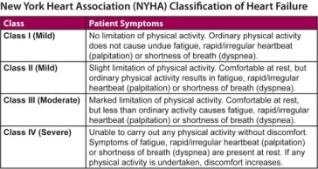
NYHA Functional Class

Slide 12
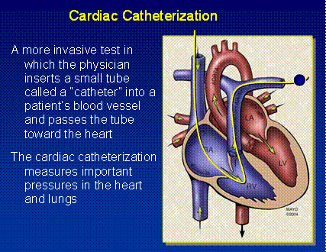
Diagnosis
Right heart catheterization is required to accurately diagnose PAH
Echocardiogram is used as screening tool and to monitor treatment efficacy

Slide 13
Diagnosis Cont’d
Extensive work-up completed to evaluate for all possible underlying causes
  PFTS, CT of Chest to r/o lung disease
  VQ scan to r/o chronic pulmonary embolism
  Blood serologies to check for autoimmune disease & HIV
  Nocturnal Polysomnogram (if patient has symptoms of sleep apnea)

Slide 14
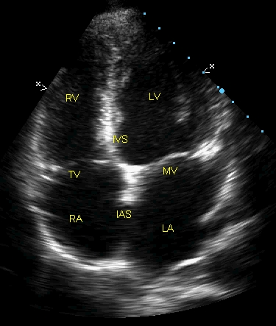
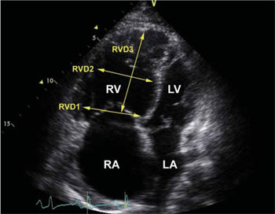
Echocardiogram
(Apical 4- chamber view)
Normal
PAH

Slide 15
Treatment
Modalities targeting 3 separate pathways

Slide 16
Treatment Cont’d
Phosphodiesterase Type 5 Inhibitors (PDE5 Inhibitors)
  Revatio (Sildenafil)- oral
  Adcirca (Tadalafil) - oral
Endothelin Receptor Antagonists (ERAs)
  Letairis (Ambrisentan)- oral
  Opsumit (Macitentan) - oral
  Tracleer (Bosentan)- oral (rarely used anymore)
Prostacyclins
  Oral
    Orenitram (Treprostinil)
    Uptravi (Selexipag)
  Inhaled
    Tyvaso (Treprostinil)
    Ventavis (Iloprost)
  IV
    Remodulin (Treprostinil) – also available in SC (subcutaneous) form
    Veletri (epoprostenol)
    Flolan (epoprostenol)

Slide 17
Treatment Cont’d
Soluble Guanylate Cyclase stimulator
  Adempas (Riociquat)

Slide 18
Monitoring
Echocardiogram
6 minute walk test
Laboratory data
Repeat RHC if not clinically improved or declining

Slide 19
Question
Pulmonary Arterial Hypertension is usually diagnosed within 6 months of onset of symptoms
  A. True
  B. False

Slide 20
Question
Pulmonary Arterial Hypertension affects mostly women.
  A. True
  B. False

Slide 21
Question
Which of the following is a late sign/symptom of PAH?
  A. Dyspnea
  B. Edema
  C. Syncope/dizziness
  D. Fatigue

Slide 22
Case Study #1
55 year old Caucasian female with acute onset of dyspnea. Cough, wheezing
No prior past medical history except Morbid Obesity
Long time smoker ( 30 years) of 2 packs cigarettes per day
Denies edema, chest pain, dizziness
Referred by Cardiology for Pulmonary hypertension on Echocardiogram

Slide 23
Case Study #1 – Physical exam
No JVD
Diffuse wheezing in lung fields
Heart regular with no murmur, rub, or gallop
Abdominal exam benign
No edema

Slide 24
Case Study #1 - Diagnostics
Echo with slightly elevated RVSP (right ventricular systolic pressure) and RVID (right ventricular interdiameter) – normal Ejection fraction
PFTS with severe Obstruction (COPD)
VQ negative for PE
CT of Chest with emphysematous changes but otherwise negative
Autoimmune disease work-up and HIV negative
Sleep study with severe sleep apnea

Slide 25
Case Study #1 - Question
Should patient have a right heart catheterization ?
  A. Yes
  B. No

Slide 26
Case Study #1 – RHC results
PA Mean 22
PCWP 10
PVR 1.5 wood units
Cardiac output 6 liters

Slide 27
Case Study #1 - Question
Does this patient have PAH (pulmonary arterial hypertension) ?
  A. Yes
  B. No

Slide 28
Case Study #1 – Question
What is most likely the reason for Mrs. Piggy’s dyspnea?
  A. Overweight
  B. COPD
  C. Untreated Sleep Apnea
  D. None of the above

Slide 29
Case Study #2
48 year old African American female with progressive dyspnea over 6 months, LE edema, dizziness with ambulation, and palpitations
PMH of Scleroderma (diagnosed 2 years ago)
No prior tobacco use

Slide 30
Case Study #2 – Physical Exam
Mild JVD
Heart Regular, no murmur, rub, gallop
Lungs with scant dry crackles to bases
Abdomen mildy distended with some ascites
BLE with 3+ edema
Taut skin

Slide 31
Case Study #2 - Diagnostics
Echo with significantly elevated RVSP of 80 and RVID of 4.5.
PFTS with moderate restriction
VQ negative for PE
CT Chest with early pulmonary fibrosis changes
Autoimmune work-up and HIV negative except for known Scleroderma
Sleep study not done due to normal BMI and no risk factors

Slide 32
Case Study #2 – Question
Should this patient have a RHC?
  A. Yes
  B. No

Slide 33
Case Study #2 – RHC results
PA Mean 65
PCWP 10
PVR 8 wood units
Cardiac output 4.0 liters

Slide 34
Case Study #2 – Question
Does this patient have PAH?
  A. Yes
  B. No

Slide 35
Case Study #2 - Treatment
What medications would you start with to treat this patient?
  A. Endothelin receptor antagonist (ERA)
  B. Phosphodiesterase Inhibitor (PDE5)
  C. Prostacyclin
  D. All of the above
  E. None of the Above

Slide 36
Case Study #2 - Question
What would you use to monitor this patient’s progress?
  Echo
  6MWT
  Pulse Oximetry
  PFTS
  All of the above

Slide 40
Case Study
57 yr old AA female
Comorbidities: Scleroderma
Diagnosed with PAH April 2014 by RHC
Symptoms
  Fatigue
  Dyspnea
  Peripheral edema
Diagnostics
  CT of Chest with minimal scarring left base, small pericardial effusion
  VQ low probability PE
  Autoimmune serologies negative except highly positive ANA
  PFTS with Restrictive Lung disease

Slide 41
Case Study
Before Treatment
  Echocardiogram - RVSP 80-85 mmHg, RVID 4.1 cm
  RHC – PA Mean 53, PCWP 8, LVEDP 8, CO 2.3 liters
  6MWT - 54 meters
Patient started on Adcirca & Letairis
Repeat Testing May 2014
  Echo - RVSP 105-100 mmHg, RVID 3.3 cm, TAPSE 1.6 cm
  RHC – PA Mean 50, PCWP 7, CO 3.1 liters
  6MWT – 162 meters

Slide 42
Case Study
IV Remodulin intitiated
  Repeat Echo - RVSP 80-85 mmHg, RVID 2.8 cm, TAPSE 2.3
  6MWT – 54 meters
Symptoms after IV Remodulin
  Less peripheral edema
  Dyspnea improved, but still present
  Fatigue resolving

Slide 44
Role of Pulmonary Rehab in PAH
Research studies show that pulmonary rehab increases 6MWT distance and increases peak Vo2
Gives patients ability to network with other patients like them
Aids in weight loss for some

Slide 47
What is important for you to know??
All PAH medications come from a specialty pharmacy and are shipped to the patient’s home
They are VERY expensive
The only PAH medications that are on Providence hospital formulary are Remodulin % Veletri
All other meds (PO & inhaled) must be brought from home
Inhaled medications are delivered using special nebulizer machine that patient must bring from home

Slide 48
What is important for you to know??
Patients with SC or IV Remodulin cannot have their infusions disrupted
Nothing else can be given through a Remodulin dedicated line
SC/IV pumps should be checked on admission and daily with dose verified with pharmacy to ensure correct infusion rates
  There is always a number on the specialized home pump to call for any questions on what the patient’s rate should be

Slide 49
Center for Excellence
Providence Hospital will be applying to become a Center for Excellence for diagnosis and treatment of PAH in January 2015
This designation will bring nationwide recognition
It is imperative that all our staff be familiar with the PAH diagnosis and all treatment modalities

