Slide 1
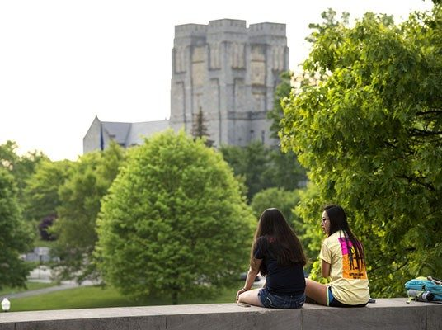
Implementing the Group Interview Process for Peer Mentor Selection
University Studies/Explore Technology
university.studies@vt.edu
Janice Chatham
Cindy Crawford
Karlyn Chen

Slide 2
Peer Mentor History
Prior to implementing the group interview, the following traditional process was used from 2014-2017.
Notes:
USED A TRADITONAL MODEL FOR OUR INTERVIEW AND SELECTION PROCESS.
WE KNEW OTHER OFFICES ACROSS CAMPUS WERE USING A GROUP INTERVIEW MODEL AND WE THOUGHT THIS MIGHT AN OPTION TO EXPLORE.

Slide 3
2014 - 2017
Applications:
Recruited students from FYE classes only.
On average 80 expressed interest.
Approximately 40 students interviewed.
Written application and resume required.
Students had to physically come to the office to sign up for the interview and then again for the interview.
.Interview committee:
Consisted of Advisors and former Peer Mentors.
Committee members had to review application and resumes
Interview teams were 1-2 Advisors and one Peer Mentor - Not all committee members interviewed all applicants.
Individual interviews were held week days for a two week period.
Each interview was 30 minutes long

Slide 4
Why did we change?
The Group Interview gave us the ability to recruit for all
departmental student leadership positions at the same time.
In the traditional process, we felt we were perhaps not able to see the personal characteristics we were looking for.
The Group Interview allows us see the candidates interacting with other students as they would in the classroom.
Less time required on the part of our office.
No resume review!!
Notes:
USED A TRADITONAL MODEL FOR OUR INTERVIEW AND SELECTION PROCESS.
WE KNEW OTHER OFFICES ACROSS CAMPUS WERE USING A GROUP INTERVIEW MODEL AND WE THOUGHT THIS MIGHT AN OPTION TO EXPLORE.

Slide 5
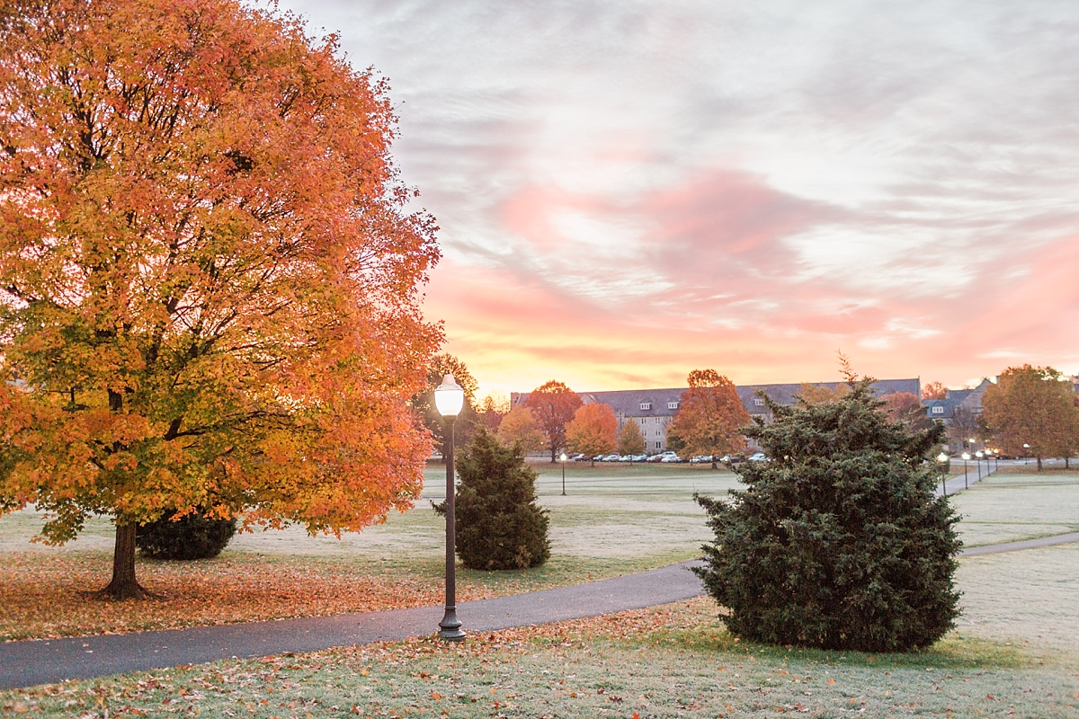
How did we advertise our leadership positions?
For both types of interviews, we held a Recruitment Event during the last week of the fall semester and invited students from our Pathways to Success classes to attend.
THE EVENT

Slide 6
2018 Additional Recruitment Sources
Coordination with all college departments
Posted on VT Daily News
Posted on Showoff (streaming TV screens)
Residence Life Advisors
Table cards in dining halls
Corps of Cadets
Residential Leadership Communities
Career and Professional Development
University Studies Advisor
Non P2S first year students
Continuing Students

Slide 7
TITLE | SECTION TITLE
The Group Interview Application Process - The Student
STEP 2
STEP 1
STEP 2
STEP 3
STEP 4
Joined Canvas Site
Decided which application to submit
Completed Application (Quiz) and uploaded headshot
Chose a time for interview preference
(AM or PM)
Notes:
Joined Canvas site (VT’s course management system)
Decided which application to submit
Just OA
Just PM
Or both
Complete Application and upload a headshot
So that we could start associating names with faces early on
Choose a time for interview preference (AM or PM)
Just because of numbers and availability, we had only 1 session in the AM

Slide 8
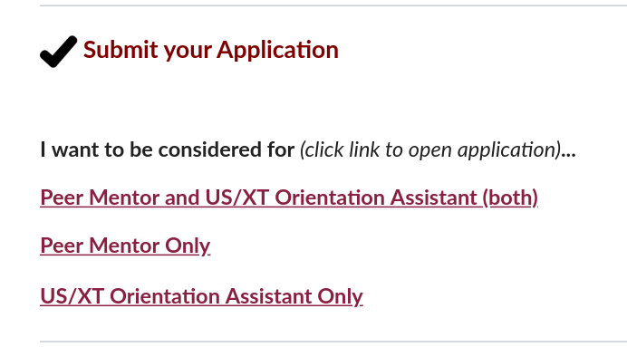
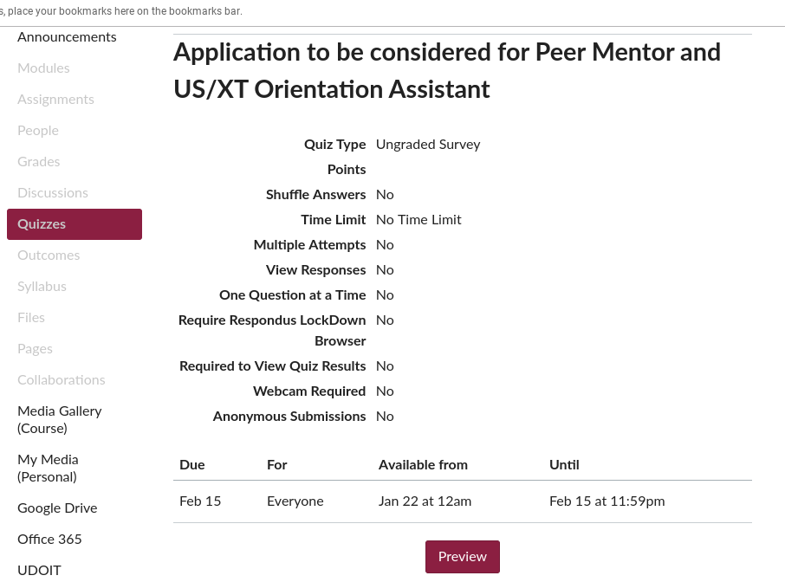
The application was available the first week of February
with a March 2nd deadline. All students who met application
requirements were invited to interview.
Notes:
For those of us who are visual learners, here are a couple screenshots of what the canvas site looks like
Anyone who met the basic application requirements received an interview

Slide 9
Structure of the Group Interview Event
CHECK-IN
OPENING SESSION
ICE BREAKER
ACTIVITIES
WRAP-UP
Notes:
CHECK IN
1. Students were divided into groups prior to the interview (8 groups of 6 students).
OPENING SESSION
1. Welcome
2. Introduction of evaluators
3. explanation of the day & what to expect.
ICE BREAKER
First Group Icebreaker: Happiness is….
ACTIVITIES
Groups then moved from one activity to another throughout the morning- total of 5 activities
Allowed 20 minutes for each activity with 10 minutes in between to rotate.
Some activities had 2 groups working together, while other activities 2 groups doing the same activity simultaneously but in different rooms.
Each evaluating group consisted of a P2S Instructor or Advisor* and one current student leader. (*Advisors were invited from across campus.)
Final activity brought all groups back together in one room.
WRAP UP
Thank you and when students can expect to hear from us regarding selection
Reminder of required training dates

Slide 10
Advantages of the Group Interview Process
SAVES TIME
EVALUATORS
MULTI-DIMENSIONAL
IT WAS FUN!
Notes:
Saves time!
Formal Interview: Committee members have to review resumes to determine candidates to interview
Formal interview: Could take up to 20 hours total time just for the interviews – based on just 40 candidates
Group Interview: No resume review required
Group Interview: Interview Event is 4 hours, plus 2 hours to deliberate and determine which candidates will get an offer
Group Interview: All students who apply are offered an interview
Group Interview: All decisions are made in one day!
APPLICATIONS INCREASED
Higher Yield – more students applied in 2018 and 2019 than did in each year of the formal process (2014-2017) ?????
EVALUATORS
Involves across campus partners – College Advisors, Residence Life, Career and Professional Development
Former student leaders act as evaluators - student to student perspective
MULTI-DIMENTIONAL
Most evaluators got to see every candidate
See candidates in various situations that would be necessary for the job
It was fun!
Event was fun for candidates and evaluators
Candidates had an opportunity to be themselves and make new friends
Relaxed atmosphere

Slide 11
Group Interview Activities
Domino Challenge
Survival Challenge
Puzzle Challenge
Student Panel
Written Responses

Slide 12
What are we looking for?
TEAMWORK: took initiative in providing solutions
PROBLEM SOLVING: open to other ways of reaching the goals of the exercise; took logical steps to reach the goal with the help of teammates
COMMUNICATION: communicated thoughts and opinions to group; considered and listened to other candidates thoughts and opinions
LEADERSHIP: comfortable in a leadership role; encouraged participation from everyone
Puzzle Challenge
Domino Challenge
Domino Challenge
Challenge between the groups to see which could knock down more dominos
Allows 2 groups to be in the same room
Each group builds their own tower of dominos

Slide 13
What are we looking for?
SOCIAL SKILLS: relaxed and very much at ease when speaking
CRITICAL THINKING: thoughtful, meaningful and exceptional answers, ability to relate majority of Answers back to the role
COMMUNICATION: exceptionally expressed themselves & communicated answers well; maintained eye contact; positive body language
LEADERSHIP: comfortable in a leadership role; encouraged participation from everyone
Puzzle Challenge
Student Panel
Student Panel
This activity was separated into two rooms
One group per room
Students discussed one prompt as a group
Notes:
This activity required the students to be the panel.
Started with the same opening question for each candidate –
Why did you apply
What other activities/obligations do you have planned for next fall
In one word, how would someone else describe you
Ask candidates “situational” questions, for example
What resources did you use in your first year of college? What would you tell a new students about using those resources?
Have you had an experience at VT that seemed frustrating or unenjoyable at the time, but turned out to be an important learning opportunity? How would you describe the experience to a new student?

Slide 14
Student interactions (during down time) were observed and evaluated
Written Responses
Domino Challenge
Personal Response
Students responded to questions in written form
What are we looking for?
SOCIAL SKILLS: relaxed and very much at ease interacting with other students in group and evaluators
COMMUNICATION: took initiative to reach out to students in group and evaluators; maintained eye contact; positive body language
LEADERSHIP: comfortable in a leadership role; encouraged participation from everyone
Challenge used questions from the formal application and interview process
Notes:
Students were asked to respond to questions that would traditionally be asked in a formal interview.
Why are you interested in this position?
What skills/leadership experience do you have that make you a qualified candidate?
What do you hope to gain from this leadership position?
Intentionally had “down time” in this activity. Students were evaluated on how they handled this time…
did they interact with other group members
did they interact with the evaluators
This was important for us to see as the Peer Mentors will have to be comfortable making conversation – even when the students don’t want to!

Slide 15
What are we looking for?
TEAMWORK: Provided constructive feedback to others AND consistently asked for feedback on their performance
PROBLEM SOLVING: open to other ways of reaching the goals of the exercise; took logical steps to reach the goal with the help of teammates
COMMUNICATION: communicated thoughts and opinions to group; considered and listened to other thoughts and opinions
LEADERSHIP: comfortable in a leadership role; encouraged participation from everyone
Puzzle Challenge
Student Panel
Survival Challenge
This activity was separated into two rooms
One group per room
Students worked together as a group

Slide 16
What are we looking for?
TEAMWORK: took initiative in providing solutions; asked for feedback; consistently encouraged input from others
PROBLEM SOLVING: open to other ways of reaching the goals of the exercise; took logical steps to reach the goal with the help of teammates
COMMUNICATION: communicated thoughts and opinions to group; considered and listened to other candidates thoughts and opinions
LEADERSHIP: comfortable in a leadership role; encouraged participation from everyone
Puzzle Challenge
Puzzle Challenge
This activity brought all groups back to one room
Each group was asked to complete the same activity
Required across-group teamwork and
interactions to complete
Notes:
FINAL ACTIVITY – ALL GROUPS IN ONE ROOM – GROUPS HAD TO WORK WITH OTHER GROUPS TO COMPLETE THE TASK

Slide 17
Deliberation & Selection Process
Initial ranking made same day - directly after event
Combined all scores for each candidate
Indicated which positions candidate applied for and rank ordered within
Opportunity for additional information to be shared based on personal experience with the candidate which could affect rank order
Reviewed written responses the following week and changed ranking if necessary
Notes:
EACH BULLET COMES IN ONE AT A TIME

Slide 18
From a Student Perspective
lGroup Interview
InformalInforl
5-6 others to play off of/interact with
Focused on interpersonal interactions and teamwork abilities
Space to showcase people skills and leadership skills
Based off actions
Resume not required
Traditional Interview
Formal
One/two on-one
More focused on individual and their ability to talk about themselves
Based off articulation
Resume required
Notes:
Background:
I was interviewed though a traditional interview in 2017 for the position of OA and I was invited to be an evaluator for the group interview for 2018
When I went in for a traditional interview..
My resume was lacking bc I was a sophomore without any tangible leadership positions at this point
Had no idea what the STAR method was
Had spend most of my life trying to silent my desire to talk about myself in order to be more engaged in the lives of others around me (not a bad quality necessarily but really hurts me in interviews)
I was tense, in my head, and insecure in my answers because I was trying so hard to be polished
I actually didn’t get the job initially. I came in as an alternate
Fast forward to the next year, I was told that they were doing a group interview for the new candidates
I loved this idea because the people they are looking to hire are ones who are
Personable
Take initiative
Work well with a team
And exhibit leadership abilities
This way candidates could show their skills rather than just talk about it
AND evaluators were able to see candidates at work
Anyone can tell you in a traditional interview that they have leadership skills, but here you were able to witness it firsthand which gave us more ideal candidates
Not to mention, if I DIDN’T get the job as an OA, I would not be standing here today
I am an Academic Coach for US
I am on a Steering Committee for a new Living Learning Community for US
I go there when I need a quiet place to study
I am here speaking on behalf of the Department.
My life would look very different right now if it were not for that initial job that I almost didn’t get because I couldn’t articulate my abilities in the traditional interview.

Slide 19
What We Learned for 2019:
FOR RECRUITMENT EVENT
The Space
Divided up instructors & peer mentors into topic areas and had students rotate around the room to get information
Allowed students to socialize with current Peer Mentors
Notes:
Divided up instructors & peer mentors into topic areas and had students rotate around the room to get information on the following:
Application/Selection
Training
VIA Living Learning Community
Explore Technology
Peer Mentor Role/Responsibilities
Peer Mentor Perspectives

Slide 20
What We Learned for 2019:
FOR INTERVIEW/SELECTION PROCESS
The Space
- Move up application deadline - January 22nd to
February 15th
⁻ Offer only one time block for interview event
Do not pre-assign groups - Randomly assigned at
check-in
Need “Activity Bank” for different activities year to year
Email candidates evaluation link during Wrap Up
Created “shared” excel spreadsheet for ease of deliberation
Revision of the Student Panel and Written Response activity
Revise our evaluation forms
Notes:
THE SPACE
-Do not pre-assign groups - Randomly assigned at check-in
There were no shows, so some groups had fewer members than others.
We felt this might have been a disadvantage for them.
-Revision of the Student Panel activity
Allow only ONE candidate to respond to each question
Eliminates “piggybacking” and duplicate responses
Revision of the Written Response activity
Moved some previous Student Panel questions to Written Response
Perhaps have a short group activity planned if time allows
Revise our evaluation forms

Slide 21
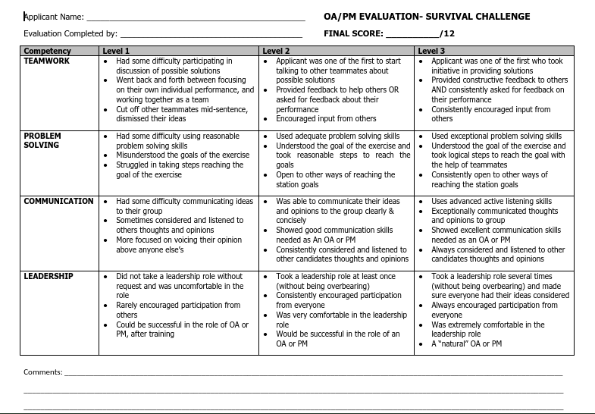
2018 Survival Challenge Evaluation Form
Notes:
LEARNED QUICKILY THAT THIS FORM WAS TOO MUCH TO BE ABLE TO DIGEST AND EVALUATE CANDIDATES AT THE SAME TIME
All forms revised to 3 competencies and 3 levels
Condensed descriptions - Only 2 bullet points for competency level

Slide 22
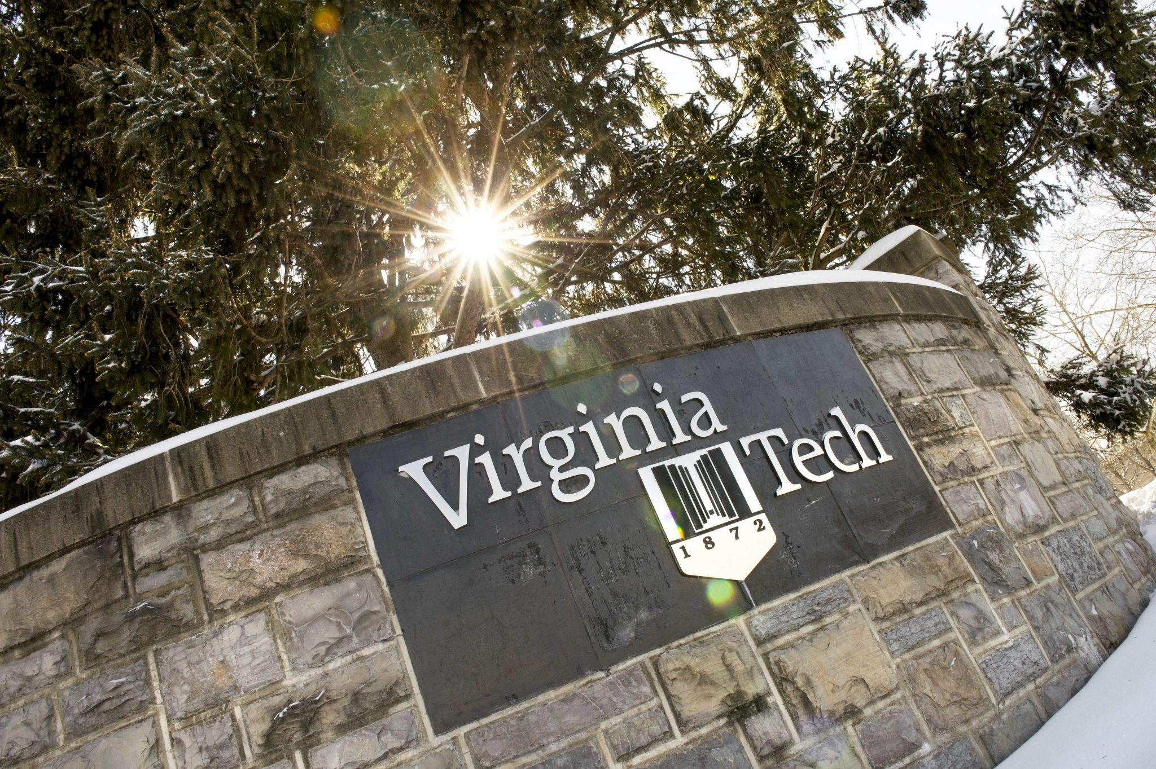
Thank You!
Questions??

Slide 23
Please remember to submit your evaluation on Guidebook! https://guidebook.com/g/fye19/
#FYE19

