Slide 1
Defining Academic and Student Affairs Collaboration in RLCs
MARGARET LEARY, TINA MULLER, SAMANTHA KRAMER,
JOHN SOPPER, MARY ELLEN WADE, RICHIE GEBAUER

Slide 2
Year One STORY COLLABORATION
introduction purpose of the study research question(s)
PATH TO COLLABORATION
lit review, models, adapted NSLLP survey delphi study
FUTURE STEPS findings, data, conclusion

Slide 3
ELON ● Multi-Institutional Research Study
Residential Learning Communities as a High-Impact Practice:
Three-summer research seminar
Facilitates multi-institutional research on types of Residential Learning Communities (RLCs)
Projects use mixed-methods approach to conduct qualitative and quantitative research
Our Research Study:
Established collaboration and integrative learning themes at all 6 participating universities
Using AAC&U Integrative Learning rubric
Focuses on developing a better understanding of how to successfully assess SA/AA collaboration within RLCs on individual campuses

Slide 4
PURPOSE ● Goals
Learn about the research question, Delphi study process and how we used it to create a definition of collaboration in RLCs.
Identify the importance of collaboration and assessing the levels of collaboration in RLCs to increase effectiveness and student success.
Develop strategies for key collaboration elements to utilize on their campuses.

Slide 5
INTRO ● Research Questions
What is the relationship between academic and student affairs collaboration and the practice of integrative learning in residential learning communities (RLCs)?
Specifically...
How is collaboration in RLCs between academic and student affairs defined?
Which elements of collaboration between academic and students affairs foster the practice of integrative learning?

Slide 6
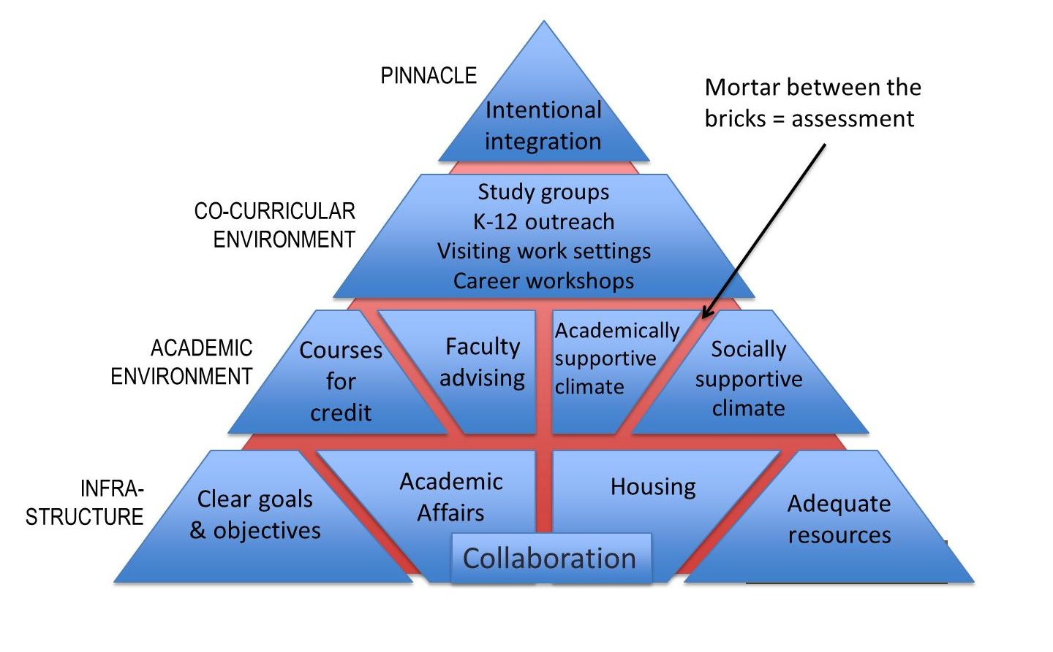
LITERATURE ● Influences
LLP Best Practices Model (Inkelas et al., 2018)
One Size Does Not Fit All (Manning et al., 2014)
RLC Literature
The BPM for LLCs. Reprinted from Living-Learning Communities That Work: A Research-Based Model for Design, Delivery, and Assessment (p. 18), by K. K. Inkelas, J. E. Jessup-Anger, M. Benjamin, & M. R. Wawrzynski, 2018, Sterling, VA: Stylus. Copyright 2018 by Stylus Publishing, LLC.

Slide 7
LITERATURE ● Benefits of Collaboration
Learning from multiple perspectives (Frost et al., 2010; Kezar, 2001)
Re-center focus on student learning (Kezar, 2001; Kuh, 1996; Love & Love, 1995; Nesheim et al., 2007)
Improves retention, academic performance, overall institutional environment (Arcelus, 2011; Ellett & Schmidt, 2011; Magolda, 2005)

Slide 8
LITERATURE ● Barriers to Collaboration
Complexity of campus climates and cultures (Brown et al., 2009; Schroeder, 1999)
Misunderstanding of roles (Golde & Pribbenow, 2000; Peltier, 2014; Philpott & Strange, 2003)
Value of research and student engagement (Pearson & Bowman, 2000)
Clear definition of collaboration (Golde & Pribbenow, 2000)

Slide 9
LITERATURE ● One Size Does Not Fit All
Out of Classroom Centered | Extracurricular Co-curricular
Administrative Centered | Functional Silos Student Services
Learning Centered | Competitive and Adversarial Seamless Learning
Student Centered | Ethic of Care Student Driven Student Agency
Academic Centered | Academic--Student Affairs Collaboration Academic Driven
Manning, K., Kinzie, J., & Schuh, J. (2013). One size does not fit all: traditional and innovative models of student affairs practice. New York: Routledge.

Slide 10
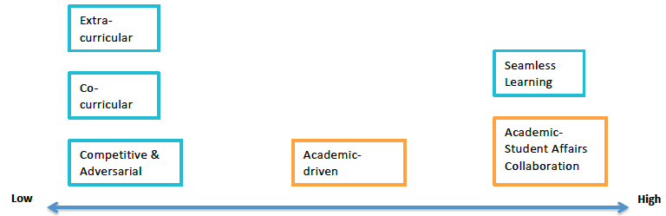
LITERATURE ● Collaboration Continuum
Level of Collaboration Between AA and SA
Manning, K., Kinzie, J., & Schuh, J. (2013). One size does not fit all: Traditional and innovative models of student affairs practice. New York: Routledge.

Slide 11
PATH ● NSLLP Adapted Survey
With the permission of Karen Inkelas, this was administered to LLP/RLC Directors on our 6 campuses to provide us with descriptive information surrounding the organizational/ leadership structure of individual LLPs/RLCs.
Reviewed data at Elon

Slide 12
METHODOLOGY ● Collaboration
How is collaboration in RLCs between academic and student affairs defined?
Lit Review
+
One Size Does
Not Fit All
+
NSLLP survey
Delphi Study - Defining collaboration in RLCs

Slide 13
METHODOLOGY ● Delphi Study
Collect input from experts via a structured process - feedback and synthesis (Ziglio, 1996)
Appropriate when expert judgement = evidence for answering a question (Linstone and Turoff, 1975)
Appropriate when limited knowledge exists or consensus is lacking (Kezar and Maxey, 2016)

Slide 14
METHODOLOGY ● Delphi Study
Round 1 | Open Ended Questions role with RLCs essential elements to be included in a common definition of collaboration between SA and AA in RLCs
Round 2 | Likert-Scale Questions: level of agreement with elements derived from Round 1
Round 3 | Draft Definition feedback on the draft, open response broad definition, four elements, overall feedback
Round 4 | Draft Definition repeated Round 3 with colleagues at Elon

Slide 15
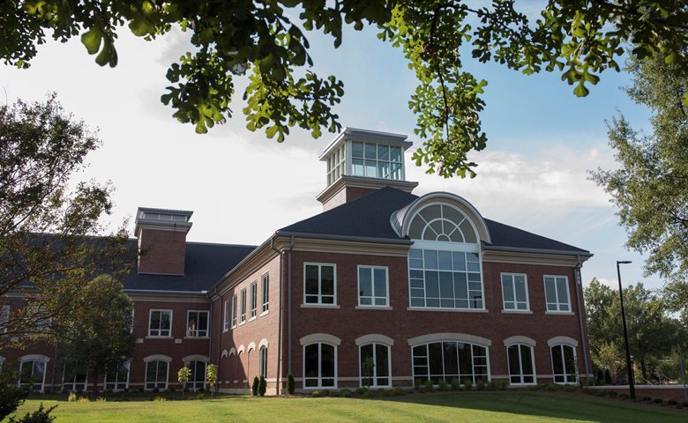
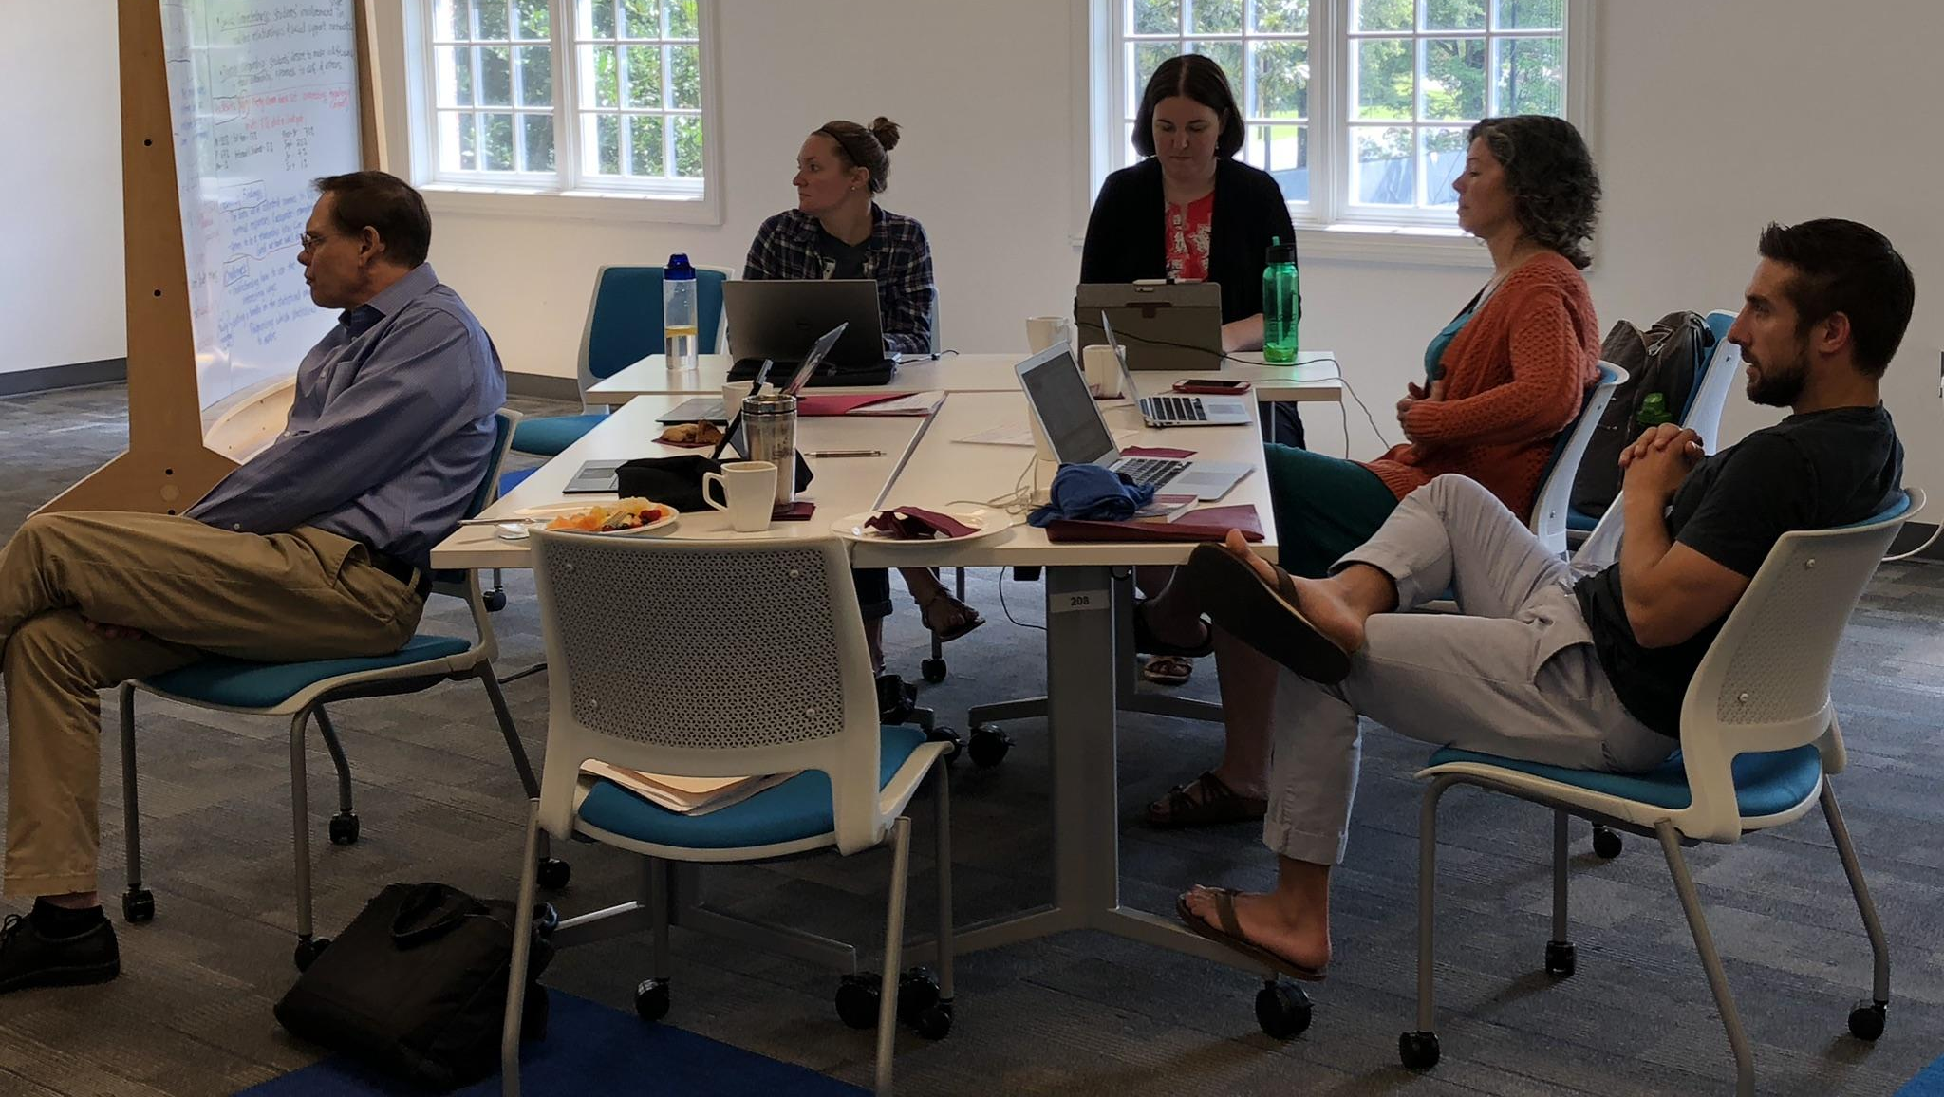
FINDINGS ● Collaboration Defined
The following definition emerged from the study:
Collaboration between academic and student affairs is the continuous process of cultivating an interdependent relationship where each stakeholder is mutually committed to working toward the shared purpose of holistic student learning.
More importantly, the researchers defined continuous process, interdependent relationship, and commitment to a shared purpose, which emerged as the key elements of collaboration within the context of RLCs.

Slide 16
NEXT STEPS ● Collaboration Tool
Translate these key elements from definition into a tool that faculty, staff, and student leaders can utilize to identify and evaluate collaborations within their institutional context.
What type of collaboration do you have on your campuses?

Slide 17
CONCLUSION ● Next Steps
Test survey-rubric instrument based on our Delphi Study and Elon participants
Final edits, based on feedback and finalize process to administer
Administer at all six campuses Winter/Spring
Develop a methodology to determine if there is a correlation between AA/SA Collaboration and Integrative Learning
RLC COLLABORATION defined and instrument created
SURVEY IMPLEMENTATION focus
Correlation b/w Academic Affairs & Student Affairs COLLABORATION & INTEGRATED LEARNING

Slide 18
References
Arcelus, V. J. (2011). If student affairs-academic affairs collaboration is such a good idea, why are there so few examples of these partnerships in American higher education? In P. M. Magolda & M. B. Baxter Magolda (Eds.), Contested issues in student affairs: Diverse perspectives and respectful dialogue (pp. 61-74). Sterling, VA: Stylus.
Browne, M. N., Headworth, S., & Saum, K. (2009). The rare, but promising, involvement of faculty in residence hall programming. College Student Journal, 43(1), 22-30.
Ellett, T. & Schmidt, A. (2011). Faculty perspectives on creating community in residence halls. The Journal of College and University Student Housing, 38(1), 26-39.
Frost, R. A., Strom, S. L., Downe, J., Schultz, D. D., & Holland, T. A. (2010). Enhancing student learning with academic and student affairs collaboration. The Community College Enterprise, 16(1), 37-51.
Golde, C. M. & Pribbenow, D. A. (2000). Understanding faculty involvement in residential learning communities. Journal of College Student Development, 40(1), 27-40.
Inkelas, K. K., Jessup-Anger, J. E., Benjamin, M., & Wawrzynski, M. R. (2018). Living-learning communities that work: A research-based model for design, delivery, and assessment. Sterling, VA: Stylus Publishing, LLC.
Kezar, A. (2001). Documenting the landscape: Results of a national study on academic and student affairs collaborations. New Directions for Higher Education, 116, 39-51.
Kezar, A., & Maxey, D. (2016). The Delphi technique: An untapped approach of participatory research. International Journal of Social Research Methodology, 19(2), 143-160.
Kuh, G. D. (1996). Guiding principles for creating seamless learning environments for undergraduates. Journal of College Student Development, 37(2), 135-148.

Slide 19
References
Linstone, H. A., & Turoff, M. (2002). The Delphi method: Techniques and applications. Reading, MA: Addison-Wesley Publishing Company, Advanced Book Program.
Love, P. G. & Love, A. G. (1995). Enhancing student learning: Intellectual, social, and emotional integration. ASHE-ERIC Higher Education Report, no. 4. Washington, DC: George Washington University, Graduate School of Education and Human Development.
Magolda, P. M. (2005). Proceed with caution: Uncommon wisdom about academic and student affairs partnerships. About Campus, 9(6), 16-21.
Manning, K., Kinzie, J., & Schuh, J. (2013). One size does not fit all: Traditional and innovative models of student affairs practice. New York, NY: Routledge.
Nesheim, B. E., Guentzel, M. J., Kellogg, A. H., McDonald, W. M., Wells, C. A., & Whitt, E. J. (2007). Outcomes for student affairs-academic affairs partnership programs. Journal of College Student Development, 48(4), 435-454.
Pearson, F. & Bowman, R. L. (2000). The faculty role: Implications for collaboration with student affairs. College Student Affairs Journal, 19(2), 29-40.
Peltier, M. S. (2014). The impact of faculty perception of student affairs personnel on collaborative initiatives: A case study (Doctoral dissertation). Retrieved from ProQuest Dissertations Publishing.
Philpott, J. L. & Strange, C. C. (2003). On the road to Cambridge: A case study of faculty and student affairs in collaboration. The Journal of Higher Education, 74(1), 77-95.
Schroeder, C. C. (1999). Partnerships: An imperative for enhancing student learning and institutional effectiveness. New Directions for Student Services, 87, 5-18.

Slide 20
References
Ziglio, E. (1996). The Delphi method and its contribution to decision-making. In Adler, M., & Ziglio, E. (Eds.), Gazing into the oracle: The Delphi method and its application to social policy and public health (pp. 3-33). Philadelphia, PA: Jessica Kingsley Publishers.

Slide 22
This project was supported by the 2017-2019 Research Seminar on Residential Learning Communities as a High-Impact Practice, a multi-institutional research initiative hosted by Elon University’s Center for Engaged Learning (www.CenterForEngagedLearning.org).
THANK YOU - Questions

