Slide 1
Structuring the Prep Year of College for Student Success
Jennifer R. Keup, Ph.D.
Director
National Resource Center for The First-Year Experience
and Students in Transition

Slide 2
Conference Objectives
Introduce the importance of the prep year for higher education and society
Look into the most significant experiences in operating prep years
Get acquainted with the ways and mechanisms of operating prep prep years as well as standards of quality performance
Set a basis for establishing a vison for a better operation of the prep year at Saudi universities
National center for the first year in higher education …[to] promote and improve students learning teaching, and transition from general into academic education

Slide 3
National FYE Center

Slide 4
However, let’s be sure to begin at the beginning…

Slide 5
Prep Year Features
Comprehensive
Intentional
Integrated
Flexible
Systemic
Organizationally horizontal
Student centered

Slide 6
A Working Definition
“The first-year experience is not a single program or initiative, but rather an intentional combination of academic and co-curricular efforts within and across postsecondary institutions.”
(Koch & Gardner, 2006)

Slide 7
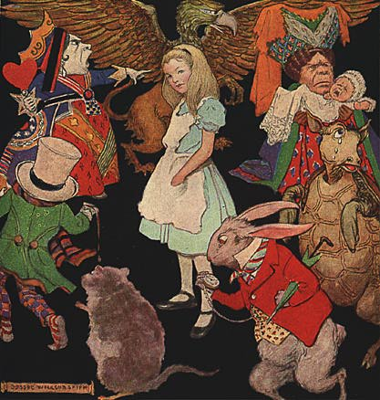
To What End?
“Excuse me,” said Alice, “how do I get out of here?”
“That depends a great deal on where you want to end up” said the cat.
“I don’t care where I end up,” said Alice, “I just want out!”
“Well,” said the cat, “if it doesn’t matter where you end up, it doesn’t matter which road you take.”
Carroll, 1865

Slide 8
FYE Outcomes
What do we hope students will get, earn, or experience as the result of their prep/first year of college?

Slide 9
Retention
Goal of “improved retention/graduation rates” | Percent
First-year seminars | 89
Early alert warning systems | 89
Learning communities | 83
Orientation | 82
Bridge programs | 75
Undergraduate research | 49
Service-learning | 31

Slide 10
Beyond Retention
“The almost singular focus on retention and graduation rates as…[first-year] student success is inadequate, [there must be] a revised definition grounded in student learning outcomes.” “Definitions of student success must include not only retention and graduation rates, but also a wide range of student learning and developmental outcomes.”
(Reason & Gansemer-Topf, 2013)

Slide 11
Beyond Retention
“Student persistence, or retention to the sophomore year, and academic achievement…are common measures [and] are of great importance as metrics for student success [but] learning outcomes desirable for all college students, such as written and oral communication, information literacy, problem solving, civic engagement, and intercultural and global understanding are also worthy of study.”
(Kinzie, 2013)

Slide 12
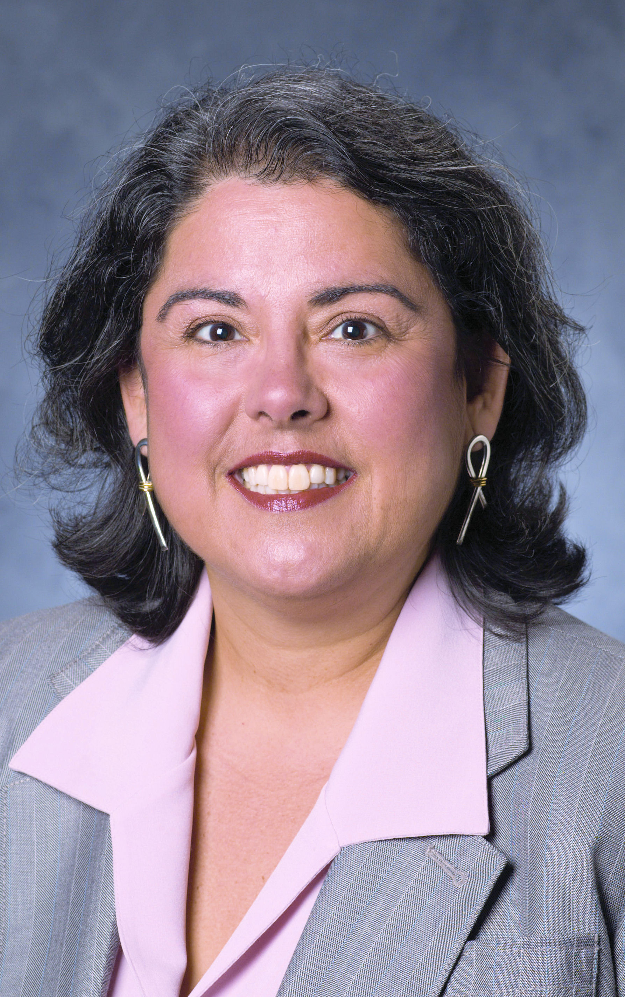
Beyond Retention
“While many [theories] have seen the role of first-year and transition programs as solely focused on retaining the student, these programs should have a greater influence on setting the tone for what it means to be an educated individual and the responsibilities that come with gaining a postsecondary education.”
(Torres & LePeau, 2013)

Slide 13
How would you know you had a “successful” and “effective” prep year if you had 100% retention?

Slide 14
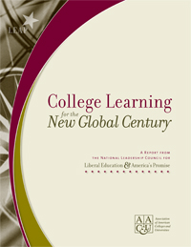
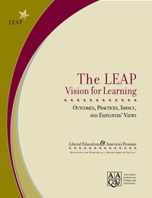
21st Century:
Learning Outcomes
Knowledge of human cultures and the physical and natural world
Intellectual and practical skills
Personal and social responsibility
Integrative learning

Slide 15
Metacompetencies for
Employability
Build & sustain working professional relationships
Analyze, evaluate, and interpret data from various sources
Engage in continuous learning
Oral communication and persuasion
Project planning and management

Slide 16
Metacompetencies for
Employability
Ability to create new knowledge
Understand the impact of company practices in a global setting
Build a successful team
Coach, mentor, & develop others
Initiative

Slide 17
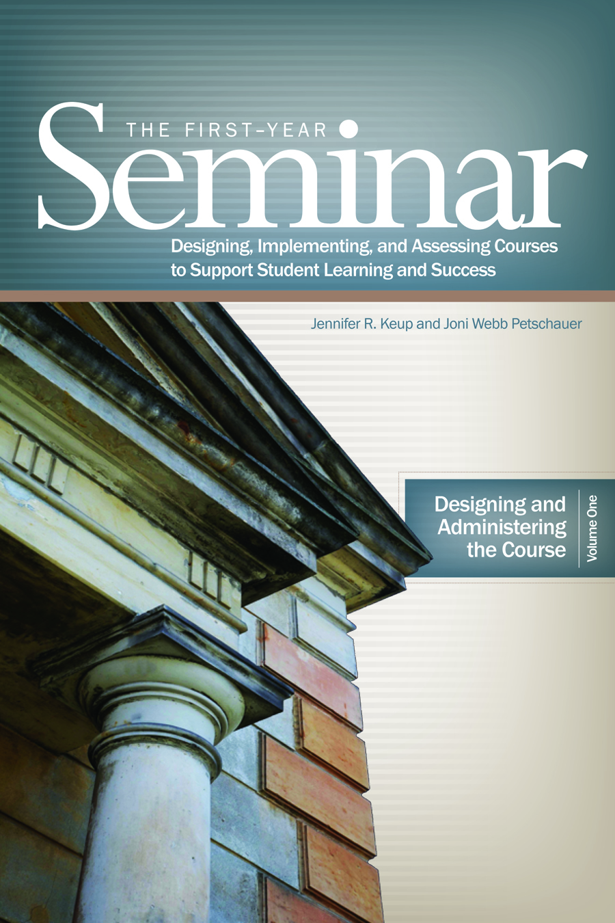
Domains for FYE/Prep Year Outcomes
Retention
Academic skills/experiences
Campus connection
Interpersonal skills
Personal development
Employability
Civic engagement/democratic citizenship

Slide 18
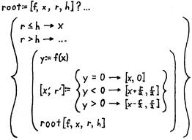
Formula for Success?

Slide 19
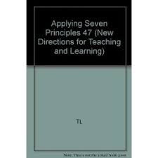
Standards & Criteria
Seven Principles for Good Practice in Undergraduate Education
Encourage contact between students & faculty
Develop reciprocity & collaboration between students
Respect diverse talents & learning styles
Promote active learning
Timely feedback for evaluation
Emphasize time on task
Communicate high expectations

Slide 20
Standards & Criteria
Conditions for Student Success
“Living” Mission and “Lived” Educational Philosophy
An Unshakable Focus on Student Learning
Environments Adapted for Educational
Enrichment
Clear Pathways to Student Success
Improvement-Oriented Ethos
Shared Responsibility for Educational
Quality and Student Success

Slide 21
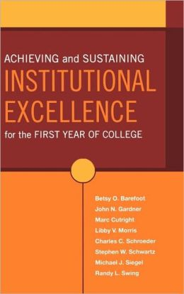
Criteria for FYE “Excellence”
“Evidence of an intentional, comprehensive approach to improving the first year that is appropriate to an institution’s type and mission.”
“Evidence of assessment of the various initiatives that constitute this approach.”
“Broad impact on significant numbers of first-year students, including, but not limited to special student subpopulations.”
“Strong administrative support for first-year initiatives, evidence of institutionalization, and durability over time.”
“Involvement of a wide range of faculty, student affairs professionals, academic administrators, and other constituent groups.”

Slide 22
Excellence is driven by…
An institutional commitment and responsibility for the first year
Leadership operating on multiple levels
Efforts designed for all or for a critical mass of students
Assessment for improvement
A clarity of institutional identity an mission
A respect for students
Direct involvement of an institution’s faculty members
Attention to pedagogy in first-year courses
Creative acquisition and judicious use of financial resources
A steady outward gaze; the willingness to learn from and share with others
An intentional first-year curriculum and supportive cocurriculum
An environment where divisional walls are down

Slide 23
What tools (“ways and mechanisms”) do we have to enact these standards of excellence in pursuit of Prep-Year outcomes?

Slide 24
High-Impact Practices…
…are curricular and cocurricular structures that tend to draw upon high-quality pedagogies and practices in pursuit of 21st century learning outcomes; they are “teaching and learning practices that have been widely tested and have been shown to be beneficial for college students..,[toward] increase rates of retention and student engagement.”
Kuh, 2008

Slide 25
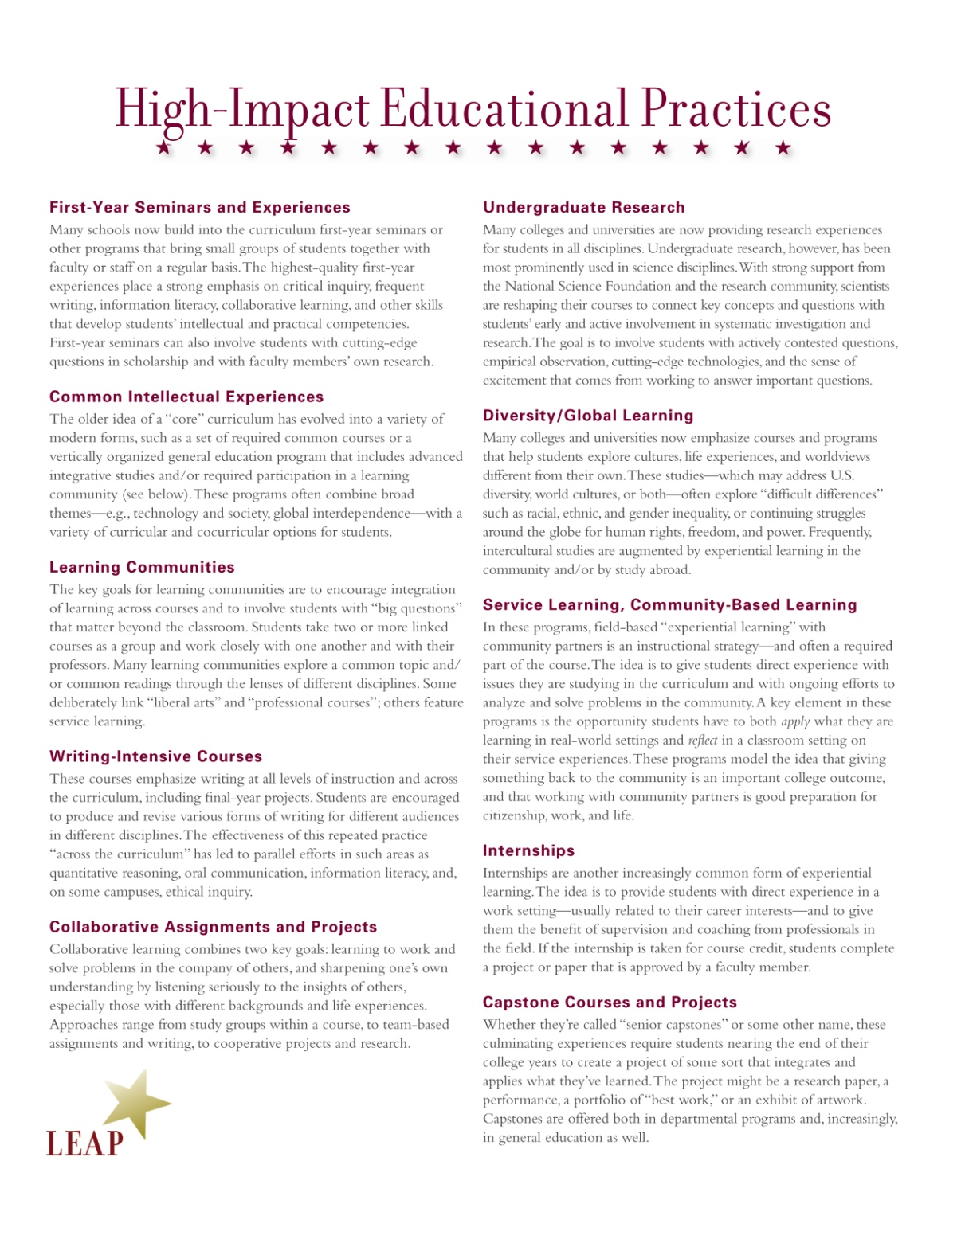
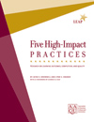
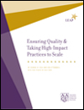
Notes:
This growth in a base of scholarship and best practice really positioned FYS well and gave them traction in the higher education landscape.
So much so that when AAC&U released their list of 10 high-impact practices as part of their LEAP project (Liberal Education and America’s Promise), LC were on it.
Really a sign that these programs have become institutionalized.

Slide 27
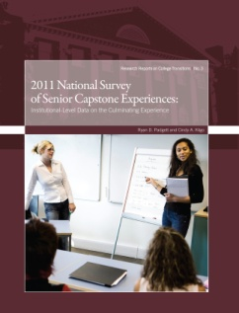

Slide 28
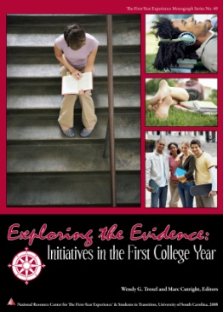
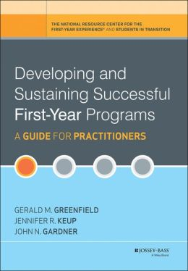
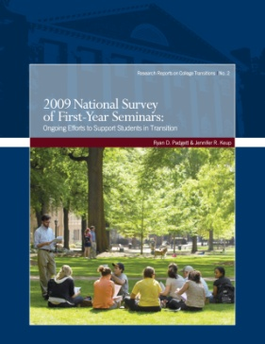
HIPs in Combination
High-Impact Practices in the FYS | %
Collaborative assignments & projects | 67.2
Diversity/Global learning | 58.8
Writing-intensive | 42.5
Common reading experience | 38.1
Learning community | 36.8
Service-learning | 31.8
Undergraduate research | 12.8

Slide 29
Percent of institutions

Slide 30
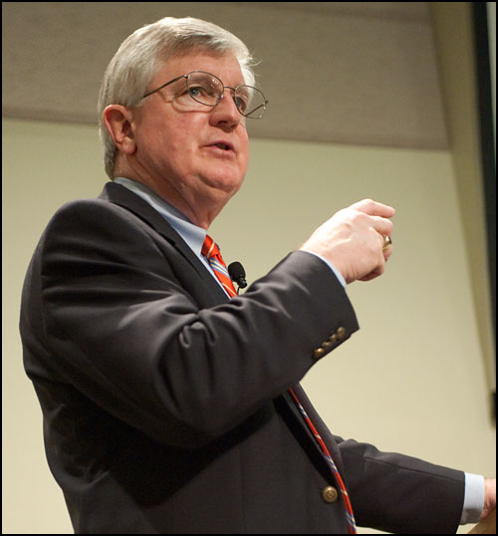
“So, today when I am asked, what one thing can we do to enhance student engagement and increase student success? I now have an answer: make it possible for every student to participate in at least two high-impact activities during his or her undergraduate program, one in the first year, and one taken later.”
(Kuh, 2008)

Slide 31
“While promising, they are not a panacea. Only when they are implemented well and continually evaluated…will we realize their considerable potential.”
Kuh in Brownell & Swaner, 2010

Slide 32
Limitations of HIPs
We overemphasis the impact of offering and participating in HIPs on learning outcomes and retention
How we structure HIPs matters more than just having them
High-impact “practices [tend to] be used in more functional rather than novel approaches.
It is also important to highlight their relevance and reflection outside of the classroom setting
Less than 60% of institutions have assessed their high-impact practices in the past 3 years

Slide 33
What Ensures Quality?
High-Impact Practices should…
Create an investment of time and energy
Include interaction with faculty and peers about substantive matters
Have real-world applications
Employ high expectations
Include frequent feedback
Provide exposure to diverse perspectives
Demand reflection and integrated learning
Include accountability

Slide 34
Parting Thoughts
“The construct of thriving as an expanded vision of student success provides a framework for conceptualizing new ways of helping students reap the full benefits of higher education. The very word thriving implies that success involves more than surviving a four-year academic obstacle course. Students who thrive are vitally engaged in the college endeavor—intellectually, socially, and emotionally. They experience what Tagg (2003) calls deep learning; they are investing effort within the classroom and managing their lives well beyond it.” (Shreiner, Louis, & Nelson, 2012)

