Slide 1
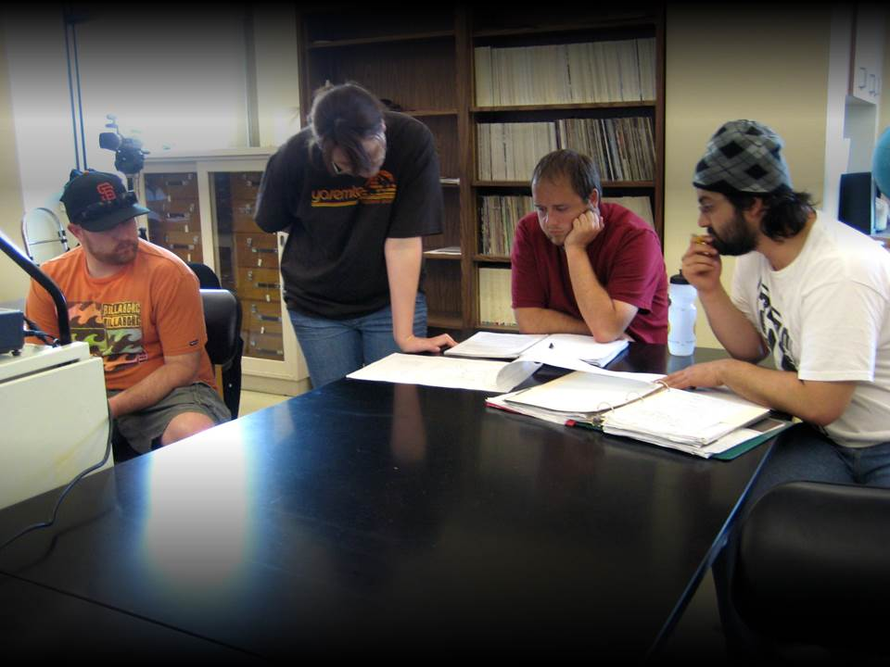
Intellectual Oomph in the First Year Experience
Nancy Page Fernandez Freshman Programs Cal State Fullerton | Jennifer Keup National Resource Center for First-Year Experience and Students in Transition
Sally Murphy Undergraduate Studies CSU East Bay | Ken O’Donnell California State University Office of the Chancellor
Notes:
Ken: Welcome and intros. The four of us will each take about eight minutes to give you our perspective, and then do a lightning round of reactions and take-aways before opening up at the end with at least fifteen minutes for questions.
Jennifer Keup will begin and end with the main points about what we’re all learning (both in and out of California), and the CSU-centric pieces elsewhere are intended as one illustration of how that new knowledge might be applied to specific contexts.
[toss to Jennifer]

Slide 2
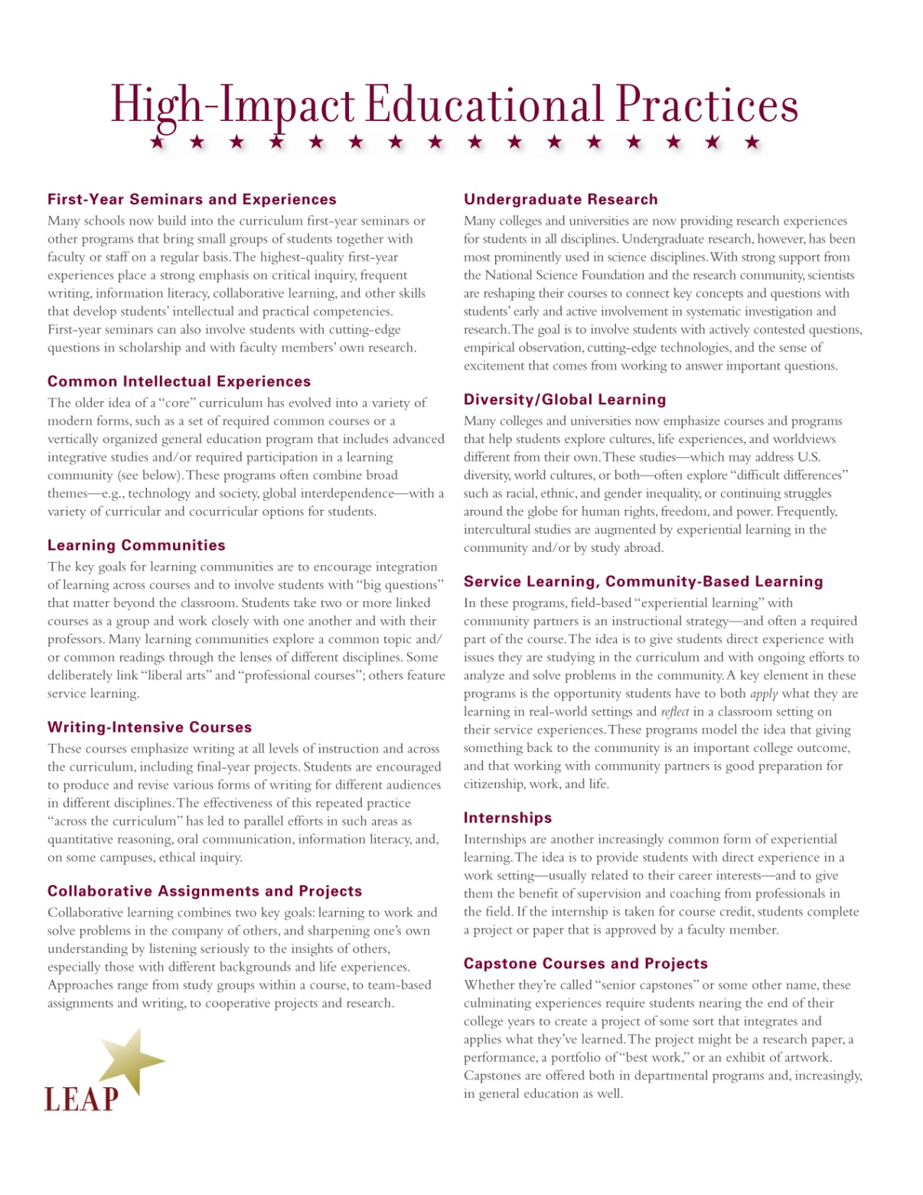






Notes:
This growth in a base of scholarship and best practice really positioned LC well and gave them traction in the higher education landscape.
So much so that when AAC&U released their list of 10 high-impact practices as part of their LEAP project (Liberal Education and America’s Promise), LC were on it.
Really a sign that these programs have become institutionalized.

Slide 3
“High-Impact Practices…”
…are curricular and cocurricular structures that tend to draw upon high-quality pedagogies and practices in pursuit of 21st century learning outcomes; they are “teaching and learning practices that have been widely tested and have been shown to be beneficial for college students..,[toward] increase rates of retention and student engagement.”
Kuh, 2008
Notes:
So let’s start with a working definition of high-impact practices.

Slide 4
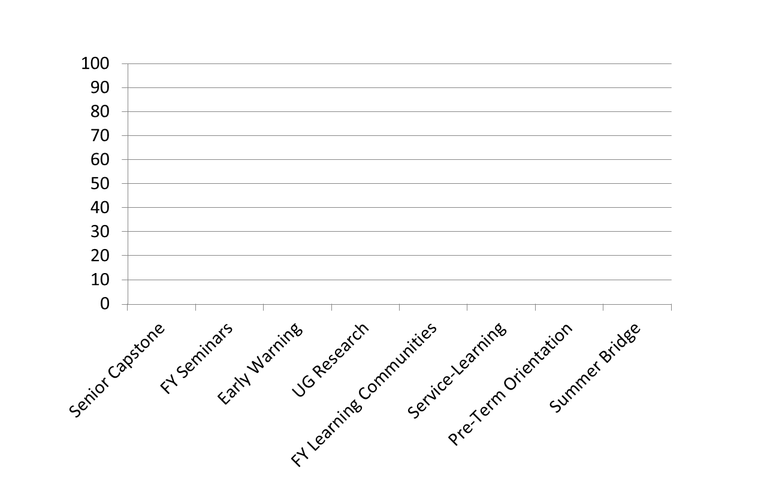
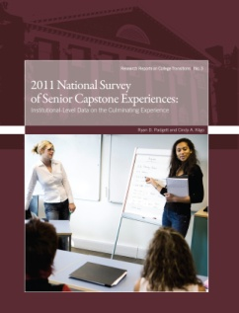


97%
93%
91%
90%
83%
80%
44%
41%

Slide 5

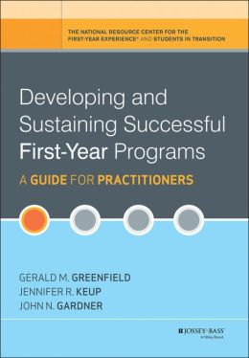


HIPs in Combination
High-Impact Practice in the FYS | %
Collaborative assignments & projects | 67.2
Diversity/Global learning | 58.8
Writing-intensive | 42.5
Common reading experience | 38.1
Learning community | 36.8
Service-learning | 31.8
Undergraduate research | 12.8
Notes:
Administered triennially since 1988
2009 Administration 10/30-12/18
Sent to 3,225 institutions in three waves
-Chief Academic Officer
-Chief Executive Officer
-Chief Student Affairs Officer
1,028 usable responses
890 with first-year seminars

Slide 6
However…
“While promising, they are not a panacea. Only when they are implemented well and continually evaluated…will we realize their considerable potential.”
Kuh in Brownell & Swaner, 2010
Notes:
So let’s start with a working definition of high-impact practices.

Slide 7
Quality
High-Impact Practices

Slide 8
Consideration of Quality
First-Year Seminars
  60% are “extended orientation”
  44% are offered for one credit
  Changing patterns of requiring the course
  More FYS in CCs and MSIs
Service Learning
  42% don’t require specific # of service hours
  Service is often of a short duration (<10 hours)
  Evidence of integration into the classroom, most notably in the form of a writing exercise (77%) or class discussion (77)%

Slide 9
Consideration of Quality
Learning Communities
  Range from structurally-related to thematically integrated
    Most frequently a co-enrollment model that includes only some courses (74%)
    Some integration of residential life into living-learning communities (31%)
Senior Capstone Experiences
  Course-based model is still the “coin of the realm”
  Internships and performance-based models are underutilized
  Tends to be discipline specific and not draw on interdisciplinarity

Slide 10
Consideration of Quality
HIPS and student support tends to be heavily “book-ended” in first year and senior year
Heavily connected to institutional type
Wide variation of use, type, and impact by major
Limited to curricular and academic domains
Very little innovation
  “Practices [tend to] be used in more functional rather than novel approaches. It seems that these course practices have great, albeit currently unrealized, potential for transformation into truly high-impact learning experiences for students [and] pillars in an integrated, intentional first-year experience.” (Padgett & Keup, 2011)

Slide 11
Bottom Line….
We overemphasis the impact of offering and participating in HIPs on learning outcomes and retention
It is what we are doing within the HIPs that is contributing to these outcomes
  Innovative and integrative pedagogies
  Vetted good practices

Slide 12
ASSESSMENT
High-Impact Practices

Slide 13
Are we evaluating HIPs? Not Enough!
59% of respondents to the National Survey of First-Year Seminars say that they have assessed their seminar in the past three years.
58% of institutions responding to the National Survey of Sophomore Year Initiatives say that they have ever evaluated their second-year initiatives.
56% of institutions responding to the National Survey of Capstone Experiences indicate that they have assessed their seminar in the past three years.
8-13% of respondents to these instruments say that they “don’t know” if these assessment efforts have taken place.
Notes:
The time to start assessment? At least a year before you implement an initiative (“Yesterday”)

Slide 14
Misalignment
“Too often program objectives represent articulation of broad learning objectives but the assessment strategy relies upon transactional measures that do not adequately capture progress and achievement of student learning and program goals.”
Keup & Kilgo, forthcoming

Slide 15

Assessment as Criteria for “Excellence”
“Evidence of an intentional, comprehensive approach to improving the first year that is appropriate to an institution’s type and mission.”
“Evidence of assessment of the various initiatives that constitute this approach.”
“Broad impact on significant numbers of first-year students, including, but not limited to special student subpopulations.”
“Strong administrative support for first-year initiatives, evidence of institutionalization, and durability over time.”
“Involvement of a wide range of faculty, student affairs professionals, academic administrators, and other constituent groups.”

Slide 16
adaptability
High-Impact Practices

Slide 17
Consider adaptability
“It stands to reason that [HIP] key conditions can be adapted and incorporated into any teaching and learning situation inside or outside the classroom to promote higher levels of student performance. There are doubtless other high-impact activities…in which large number of students participate.”
Kuh, 2010

Slide 18
Characteristics of HIPs
Creates an investment of time and energy
Includes interaction with faculty and peers about substantive matters
Real-world applications
High expectations
Includes frequent feedback
Exposure to diverse perspectives
Demands reflection and integrated learning
Accountability

Slide 19
Emerging & Potential HIPs?
Campus activities
Employment
Student media
Advising
Athletics
Physical fitness and wellness
Supplemental Instruction
Student clubs and groups
Portfolios and performances
Transactional experiences
  Course registration
  Parking
  Financial aid
Peer leadership
Student support structures

Slide 20
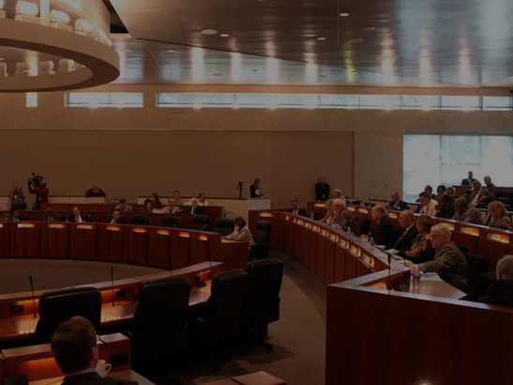
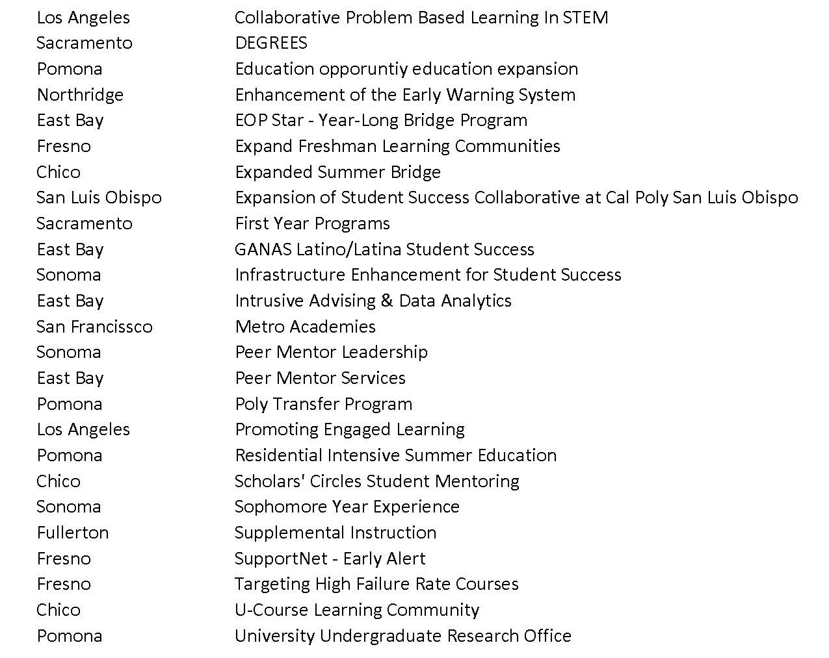
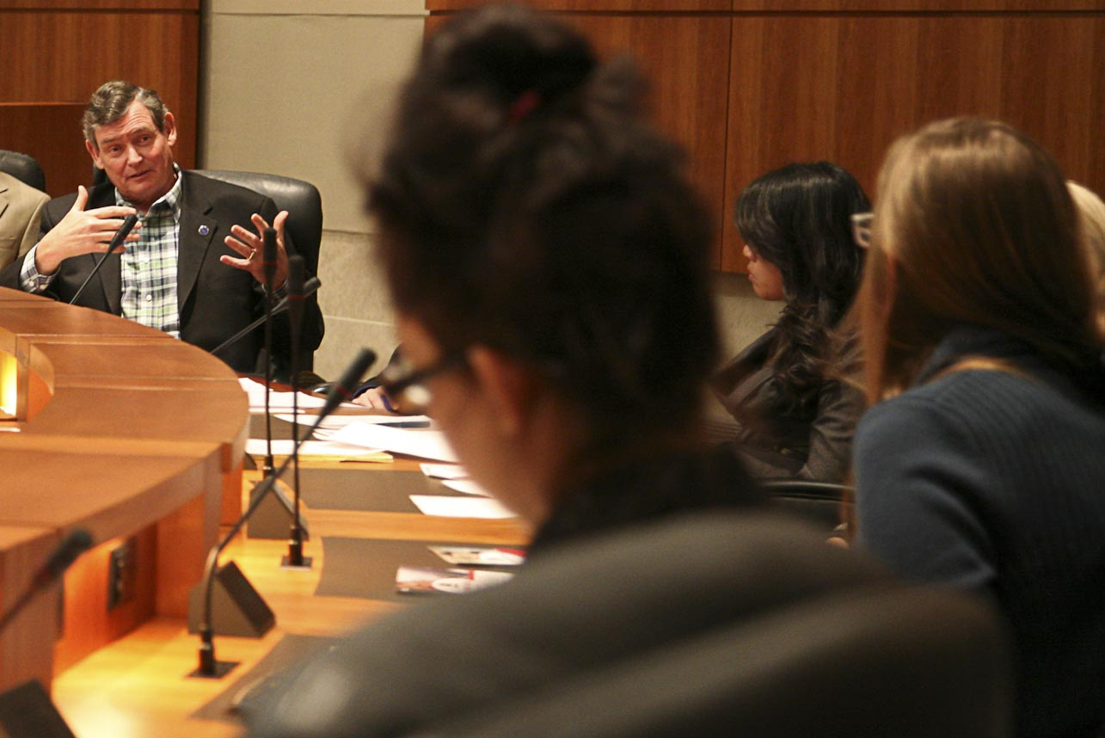
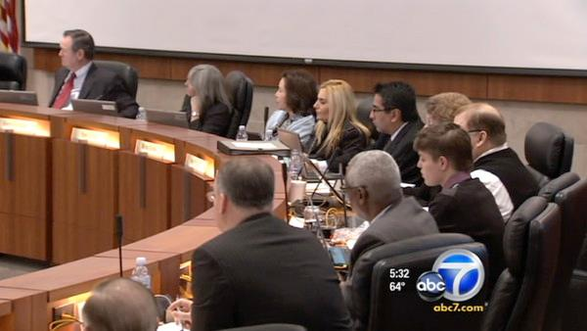
$7.2 million allocation for Academic and Student Success
Notes:
-- Board of Trustees.
Last year our new [click] Chancellor, Tim White, gave the work a [click] public boost when he announced an [click] innovative use of additional funding, not just for the usual growth in enrollment – i.e. access as it was earlier defined – but in support of real student learning and success.
Campuses responded to the invitation with over 35 proposals, some of the [click] funded ones here. This isn’t the whole list, but it’s enough for you to see some patterns.
First, there are a lot of high-impact practices here. Second, because the aim is to keep students enrolled, they happen a lot in the [click] first year of college, including those we funded from the two campuses represented here.
And finally, at least to me, this also looks like a list of all the things we cut during economic recessions. What we’d like to do on this turn of the business cycle is take the opportunity to do a better job of documenting why that’s a bad idea, and why it’s a false economy to cut the support programs that may really be the way the state will produce the graduates it needs.
So with that in mind, a couple of months ago we --

Slide 21

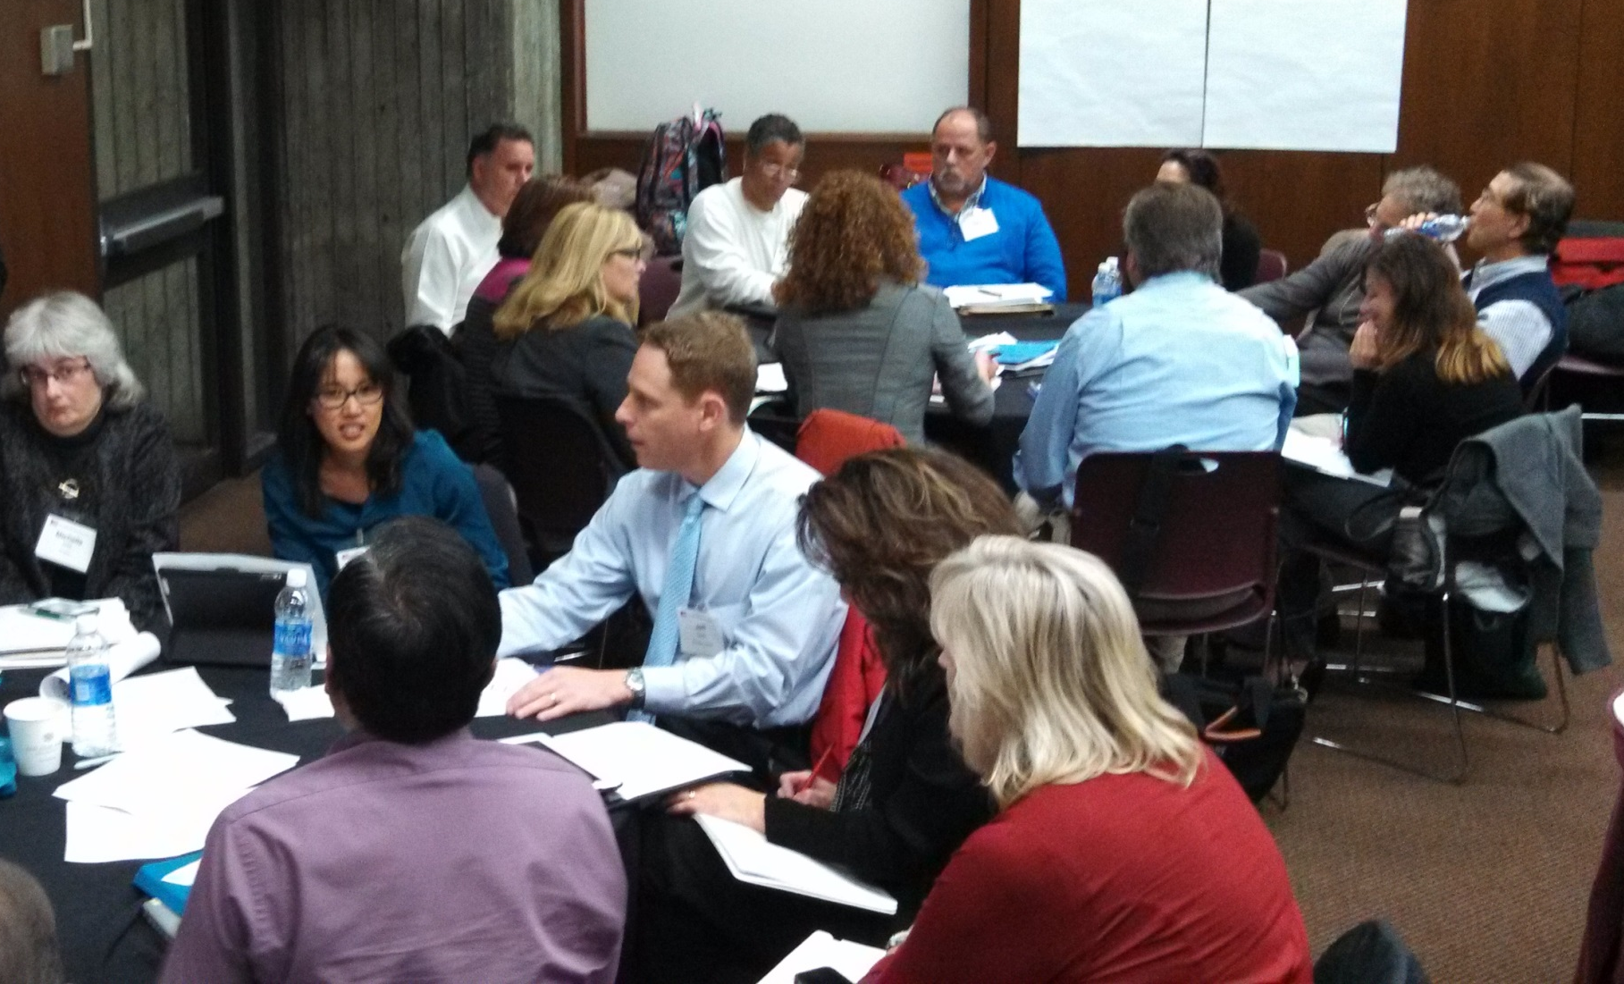
$7.2 million allocation for Academic and Student Success
Notes:
-- convened a meeting of the funding recipients and some national experts to talk about how we might build such a case – not just for educational effectiveness, but also for student success and, eventually, cost effectiveness. Jennifer, Sally and I were there, and although Nancy wasn’t she’s among the other experts from around the CSU whose help we’ll need to refine our research.
Our success at this moment – our ability to protect ourselves against the next downturn – is urgent. California’s budgets are notoriously unstable, and we can expect catastrophic downturns every 5-7 years.
Bracing ourselves for the next one will depend on how clearly we can say what we mean by “intellectual oomph,” drawing the connection between academic rigor and the student’s persistence and completion.
For that we’re relying on research from Jennifer and NRC, but also – just as importantly – on the ways our different campuses understand quality. For that we’ll turn to our reps from Fullerton and East Bay, beginning with Nancy Page Fernandez of Cal State Fullerton’s First Year Experience.

Slide 22

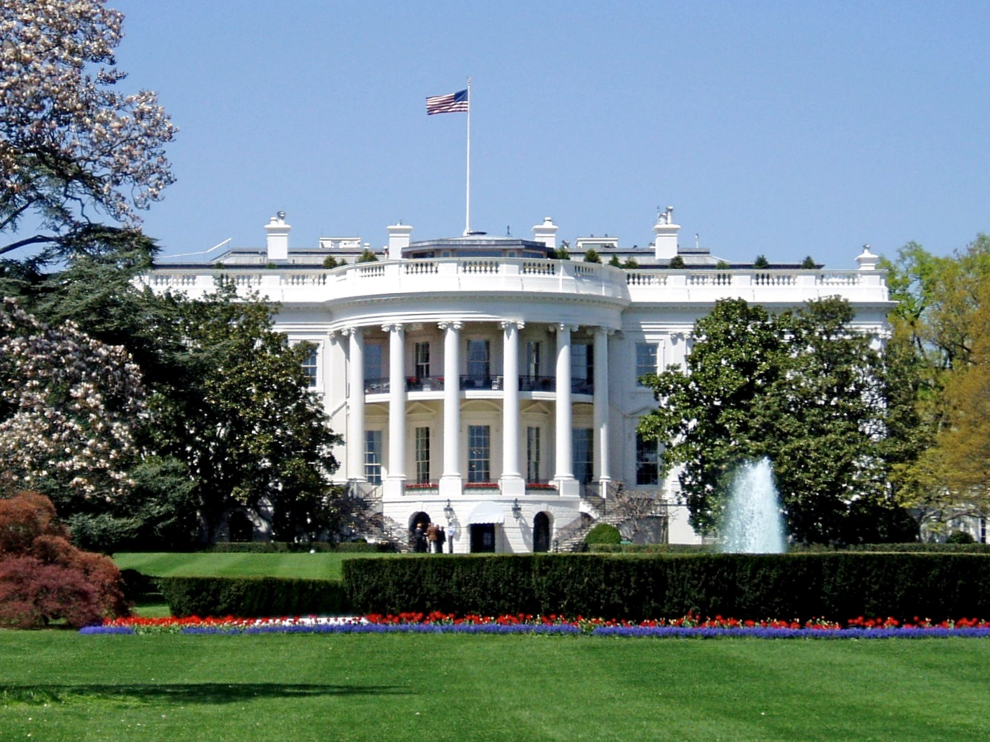

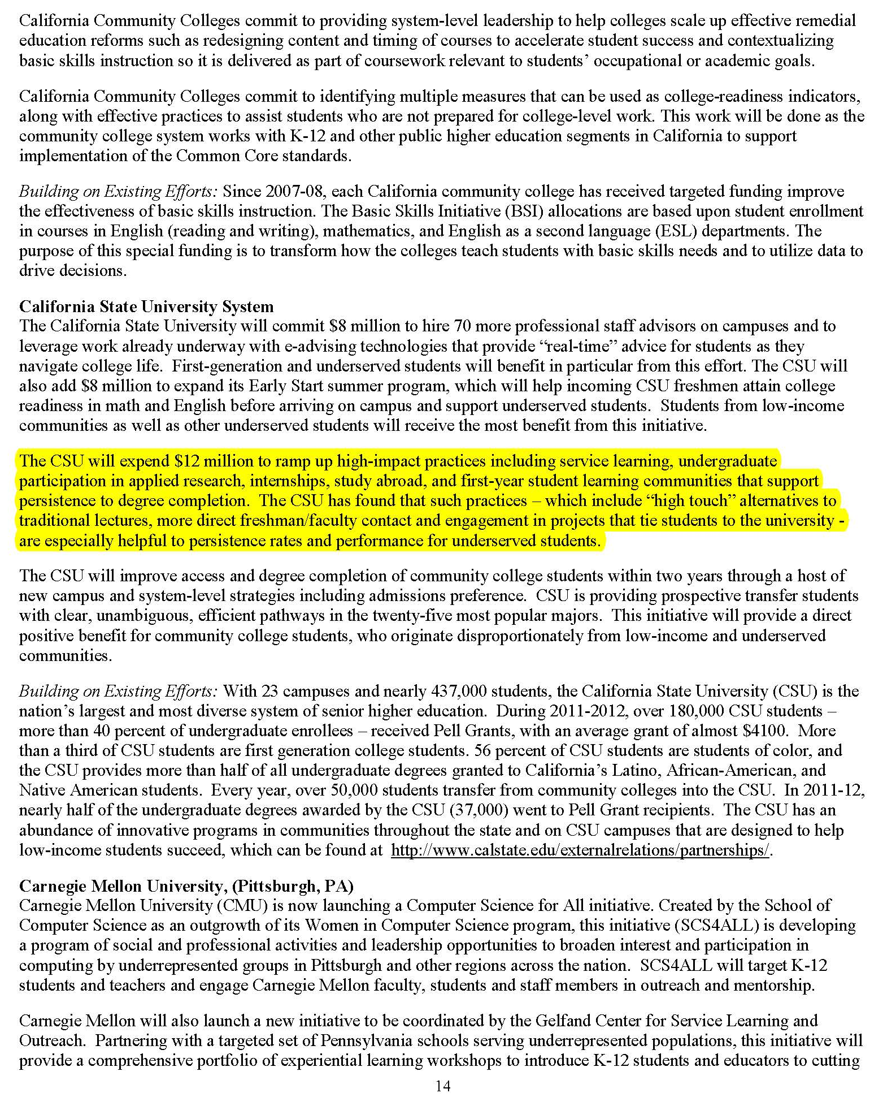
White House Higher Education Summit
January 16, 2014

Slide 23
A Field test of adaptability and sustainability
High-Impact Practices
Notes:
Describe East Bay’s freshman and students we serve; the change in typical students over my time—especially the decision to increase frosh enrollment numbers

Slide 24
The Enlightened Period
Fall 1998 – Fall 2006: Well supported freshman learning communities
  enrichment funds,
  faculty stipends,
  service learning,
  common reading,
  freshman seminars)
2004: developed Early Alert module for Bb

Slide 25
Beats, Physics, and the Mind
FALL | WINTER | SPRING
Philosophy (Aesthetics) or Music (Computer Comp) -4- | Music or Philosophy -4- | Physics (Acoustics) -4-
Composition -4- | Public Speaking -4- | Critical Thinking or Elective -4-
Frosh Seminar -1- | Frosh Seminar -1- | Frosh Seminar -1-
Major or Elective -4- | Major or Elective -4- | Information Literacy -2- Yoga -1-
13 units | 13 units | 12 units

Slide 26
The Good Years

Slide 27
The Decline
2005: lost service learning
2006: lost funding for faculty development and learning community enrichment
2009: lost funding for common reading
Started a peer mentor program under the radar

Slide 28
The Hard Years

Slide 29
The Good Times Return
2011: service learning returned in FLCs
2012: enrichment activities returned to FLCs
2014: faculty stipends for integrating curriculum returns this summer

Slide 30
The whole picture
Notes:
The thanks go to James Houpis, Provost
And
President Leroy Morishita, President

Slide 31
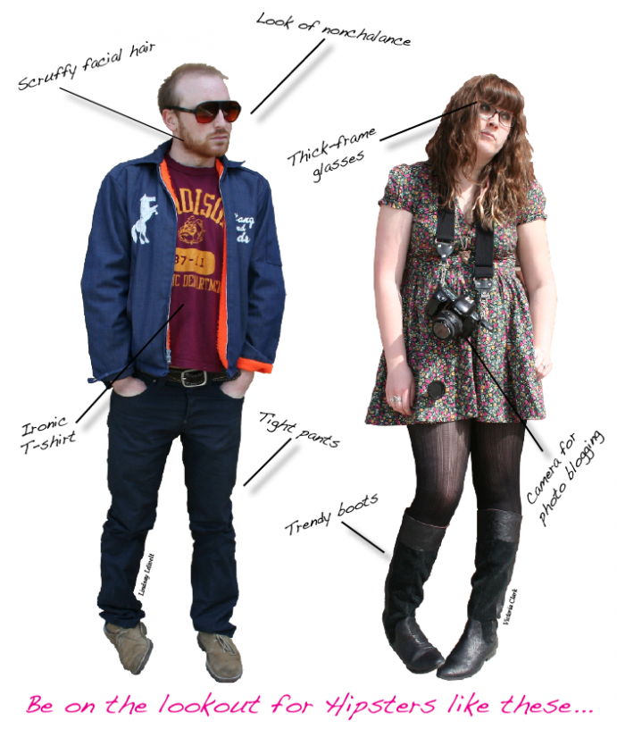
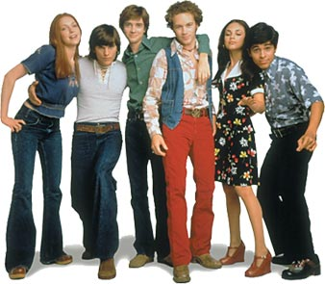
CSUF – HIP then and now
Freshman Programs 1997 to present
Supplemental Instruction
2007 to present
CSUF Strategic Plan 2013-2018
“Increase participation in High-Impact Practices (HIPs) and ensure that 75% of CSUF students participate in at least two HIPs by graduation.”
Notes:
At CSUF we are fortunate that we have good longitudinal data about Freshman Programs, our comprehensive FYE program, and our more recent Supplemental Instruction pilot. We are a very large campus, however, and these interventions so far have touched relatively small numbers of our students—about 10-12% of the freshman class each year, and for a the pilot Biology SI about 120 students per year. How can we build a strong case for increasing the scale and achieving sustainability of these successful initiatives?

Slide 32

Data Aggregated Over Time
Moon, S., et al. (2013). High Impact Educational Practices as Promoting Student Retention and Success.
Supplemental Instruction 2007-2010
Freshman Programs 2003-2010
N = 1211 completed the course
486 (40%) participated in SI
Disaggregated by URM and non-URM status
  40% of class URM students
  38% of SI participants are URM
  38% of URM students in SI
Controlled for HS GPA
N = 27,564 first-time frosh
3069 (11%) participants in FP
Disaggregated by URM and non-URM status
  44% of frosh are URM
  47% of FP participants are URM
Controlled for HS GPA and level of parental education
Notes:
Dr. Sunny Moon in our office of Institutional Research and Analytical Studies came up with the brilliant notion of aggregating the data over time to give us significant populations for robust statistical analysis. In the case of Supplemental Instruction, she combined four cohorts from fall 2007 through fall 2010, yielding a total population of about 1200. Looking at Freshman Programs from 2003 to 2010 created a population of over 27,000.

Slide 33
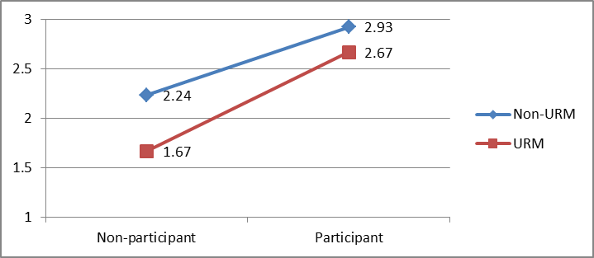
Supplemental Instruction
Significantly improved grades and success rates for both URM and non-URM students
85% of SI participants were likely to pass, vs. 57% of non-participants
After controlling for student previous GPA, positive outcomes of SI were still present and significant
URM students gained more benefits from SI participation than non-URM, narrowing the achievement gap
Moon, S., et al. (2013). High Impact Educational Practices as Promoting Student Retention and Success.
Notes:
The results from both are impressive, and earned Dr. Moon’s paper a research award at the 9th Annual Symposium of something. The average pass rate (C or higher) in the 7 years prior to the study was only 63%, meaning that 47% of students received less than a passing grade. You can see above that all SI participants benefited, achieved an overall 85% success rate—and whopping increase of 22%! GPA was also a significant predictor of success, however, controlling for GPA still demonstrated a positive effect of SI participation. The figure above shows the interaction effects (SI by URM), graphically demonstrating that SI participation contributed to closing the achievement gap between URM and non-URM students.

Slide 34
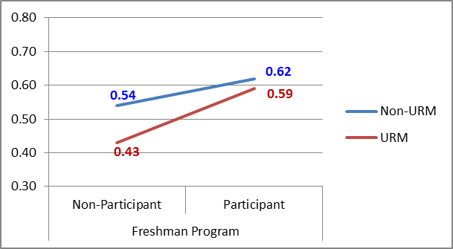
Freshman Programs
Descriptive statistics consistently show positive effects on:
1-year and 2-year retention
6-year graduation rate
GPA
The effects of FP participation became stronger as students progressed toward graduation
61 % of FP participants graduated in 6 years, compared to 50% of peers
After controlling for HS GPA, positive outcomes still present
All students benefited from FP participation. URM students benefited more than non-URM, narrowing the achievement gap
Moon, S., et al. (2013). High Impact Educational Practices as Promoting Student Retention and Success.
Notes:
With Freshman Programs we have 9 years of cohort data. Again, however, the benefits are consistent, with all students achieving gains and URM students gaining the most benefits. Dr. Moon’s study here is particularly interesting because some research suggests that the benefits of first-year experience wane (and even disappear) over the students’ college years. In this study the the gap between participants’ and non-participants’ academic success widened, resulting in an 11% difference in 6-year graduation rates.

Slide 35
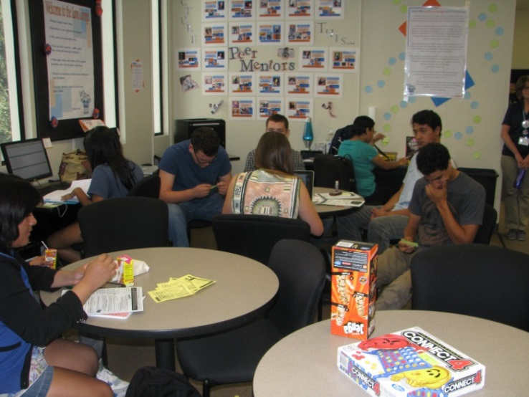
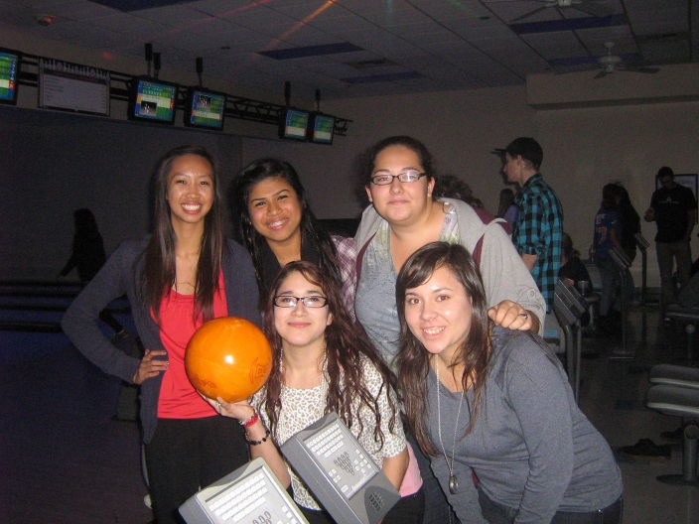
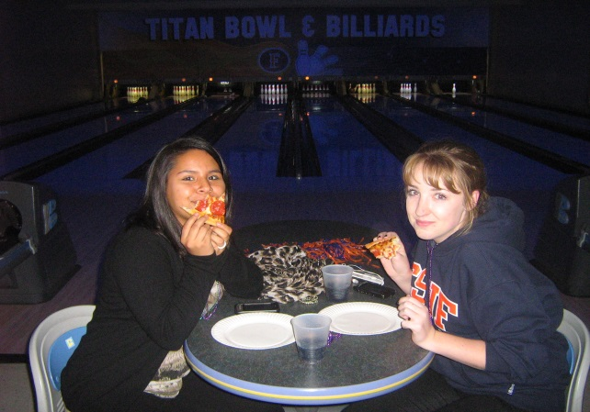

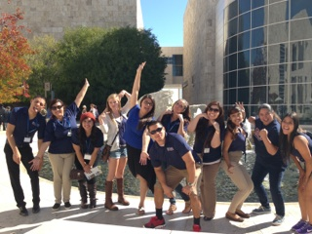
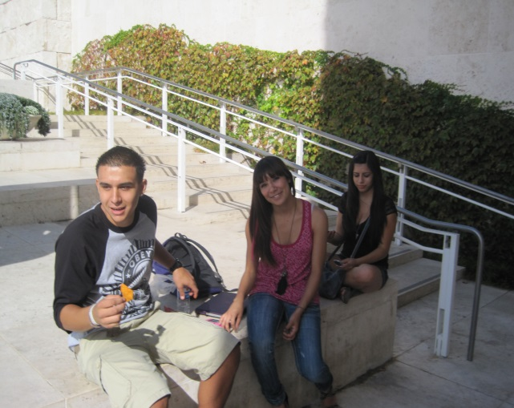
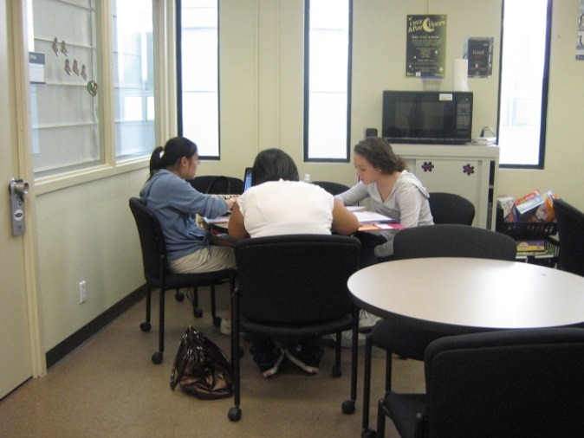
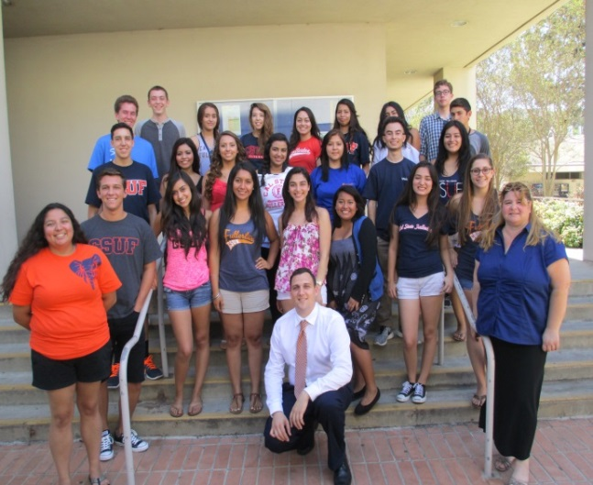
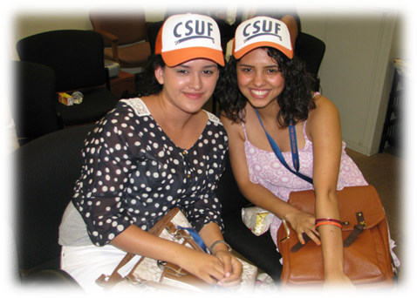
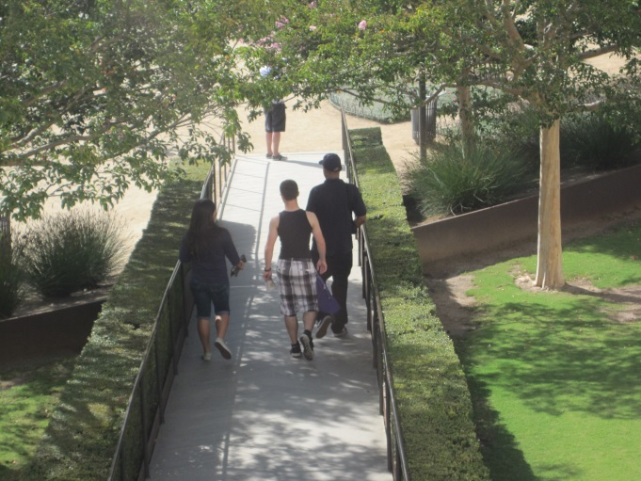
Notes:
Dr. Moon concludes, and I think many in this room would agree, that SI and FYE are showing students how to be actively engaged in learning, and they are doing that within a collaborative environment where students learn with and from each other. In these cooperative and social learning environments, students begin to develop the tools and habits of mind for college success. The NSSE, of course, is a national measure of engagement, so last year we decided to use a selection of NSSE questions in our annual FP assessment survey to see how our students’ responses compared to their peers at CSUF, our comparison institutions and the CSU.

Slide 36

Comparing to data from the
National Survey of Student Engagement
About how often have you done each of the following:
Asked questions or contributed to class discussion
Worked with classmates outside of class
Put together ideas from different courses
Used email to communicate with an instructor
Discussed ideas from readings or class with an instructor
Discussed ideas from readings or classes with others outside of class
Had serious conversations with students of a different race or ethnicity than your own
Notes:
We selected NSSE questions that aligned with our student learning outcomes. The online survey was administered to our 2012 cohort of 540 students, and we got 128 responses (24% response rate). We compared our 2012 cohort data to the 2011 NSSE Mean Comparisons data. For every question above, our FP participants mean was higher that CSUF frosh and CSUF seniors as well! The FP participants means were also at the top of the comparisons, closing any gaps between our university and the other institutions.

Slide 37

NSSE Enriching Educational Experiences
What have you done or plan to do before graduating?
Practicum, internship, field experience
Community service or volunteer work
Study abroad

Slide 38
Conclusion: Where’s the oomph?
Our institutions are constantly changing (and sometimes struggling) with budget reductions, leadership changes, new populations of students, etc.
Longitudinal research can show consistent and significant positive impact despite variations
What can we keep consistent and reliable:
  Alignment with institutional mission and local context
  Creating, developing and maintaining our programs on the basis of current research
  Faculty and staff development to share the research and how to effectively apply it
  Assess regularly and in a range of ways

Slide 39
Intellectual Oomph in the First Year Experience
Nancy Page Fernandez Freshman Programs Cal State Fullerton | Jennifer Keup National Resource Center for First-Year Experience and Students in Transition
Sally Murphy Undergraduate Studies CSU East Bay | Ken O’Donnell California State University Office of the Chancellor

