Slide 1
First-Year Seminars at 2-Year Colleges: Data Informed Design
Jennifer R. Keup & Donna Younger
2011 AACC Annual Convention
New Orleans, Louisiana
April 12, 2011

Slide 2
Objectives of this Session
Introduce the role of first-year seminars at community colleges over the past few decades;
Gain a greater understanding of what first-year seminars are, how they are organized, & the purpose they serve in the community college curriculum;
Generate discussion about how respective institutions compare to a national profile; and
Consider institutional innovations or refinements based on the national profile.

Slide 3
Community Colleges and the Challenge of Student Success
Key factors –
open enrollment
varied approaches to education
underprepared student population
academically and psychosocially
Notes:
“varied approaches” -- transient; alternating work and school; focused on transfer rather than completion, etc

Slide 4
A Broad Spectrum Treatment: The First Year Seminar
The seminar
provides support for transition
strengthens key academic skills
illustrates the nature and purpose of
higher education
supports development of educational
goals and studentship practices

Slide 5
FYS101: Introduction to first-year seminars IN THE COMMUNITY COLLEGES
How far back
in higher education history do we need to go to find evidence of the earliest first-year seminars?
Classical Greece
1790s
1880s
1930s
1970s
3

Slide 6
What Is a First-Year Seminar?
A course designed to “assist students in their academic and social development and in their transition to college. A seminar, by definition, is a small discussion-based course in which students and their instructors exchange ideas and information. In most cases, there is a strong emphasis on creating community in the classroom.” (Hunter & Linder, 2005, pp. 275-276).

Slide 7
Tendency Toward “Engaging Pedagogy”
A variety of teaching methods
Meaningful discussion and homework
Challenging assignments
Productive use of class time
Encouragement for students to speak in class and work together
(Swing, 2002)

Slide 8
Types of First-Year Seminars
Extended orientation seminars
Academic seminars with generally uniform content
Academic seminars on various topics
Professional or discipline-based seminars
Basic study skills seminars
Hybrid seminars
(Barefoot, 1994)
Notes:
Typology of seminars developed by Betsy Barefoot in her dissertation research, drawn from early administrations of the survey
Extended orientation—freshman orientation, college survival, college transition or success course—typically focuses on intro to campus resources, time management, academic and career planning, learning strategies, and personal development—most common type of seminar
Academic with generally uniform content—interdisciplinary or theme-oriented course, may be gen ed requirement, focuses on academic theme/discipline with significant emphasis on academic skills such as critical thinking or expository writing
Eckerd College—Western Heritage in a Global Context—”introduces students to the arts and sciences of human civilization. . . . by discussing great works and ideas from Western civilization and comparing them or putting them into context with great works from non-Western civilization” (Hunter & Linder, 2005, pp. 279-280)
Academic seminar on various topics—similar to common topics course but driven by faculty member’s disciplinary or research interests; each section likely to have different topic; often interdisciplinary
University of Michigan
Looking at Traditional China Through Its Most Famous Novel: The Story of the Stone
The Poetry of Everyday Life
Colonialism and Its Aftermath
Inventing Race
Basic Study Skills—for academically underprepared students, focus on basic academic skills such as grammar, notetaking, reading texts
Pre-Professional/Discipline—designed to prepare students for entry into specific major or profession—typically seen in engineering, health sciences, business, or education

Slide 9
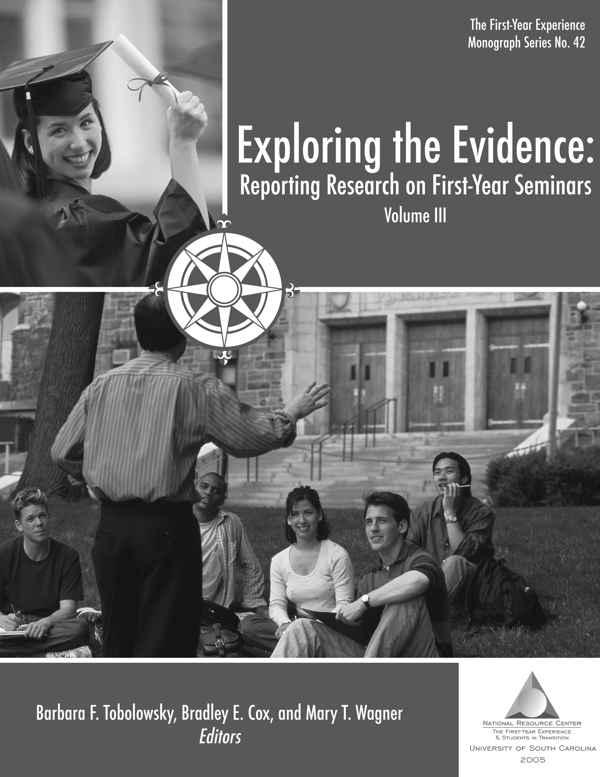
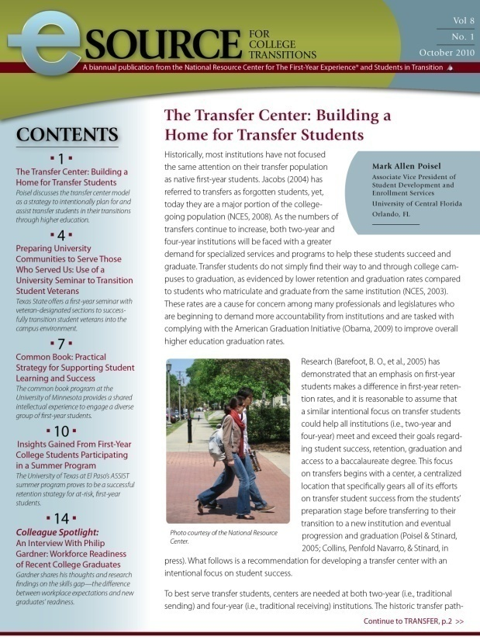
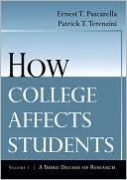
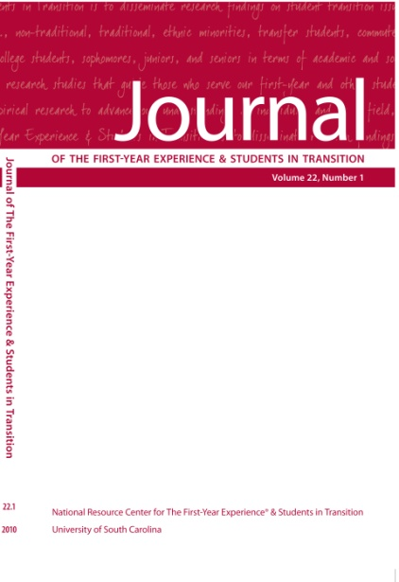
Evidence of Effectiveness? YES!

Slide 10
Evidence of Effectiveness
More positive and more frequent interactions with faculty
Greater perception of faculty support
Enhanced knowledge and use of campus resources
Greater involvement in student activities
Increase in time management skills
(Brownell & Swaner, 2010)

Slide 11
Evidence of Effectiveness
“In short, the weight of evidence
indicates that FYS participation has statistically significant and substantial positive effects on a student’s successful transition to college and the likelihood of persistence into the second year as well as on academic performance…and on a considerable array of other college experiences.” (Pascarella & Terenzini, 2005)

Slide 12
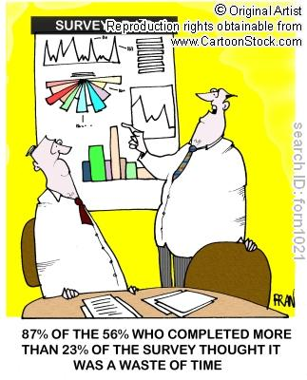
2009 National Survey of First-year seminars

Slide 13
2009 National Survey of First-Year Seminars
Methodology for 2009 administration
Administration: Oct. 30 – Dec. 18, 2010
Invitation sent to 3,225 institutions in 3 waves
Incentive program
1,028 responses (32% response rate)
87.3% of 2009 respondents (N=890) reported having a first-year seminar
Notes:
Up from 65% on 1994 survey
Some accounts indicate as high as 94%

Slide 14
2009 Survey Participants
Institution Type | Number | Percentage
Two-year | 298 | 29
Four-year | 731 | 71
Public | 529 | 52
Private, not-for-profit | 422 | 41
Private, for-profit | 68 | 7
*The remainder of the presentation will focus on data from two-year campuses in the sample (N=298)
Notes:
Slightly under-represents 2-year campuses (38.5% nationally)
29% of respondents saying that had FYS were 2-year colleges
Slightly over-represents public institutions (38.6% nationally)

Slide 15
All Types of First-Year Seminars Offered
Notes:
Q12
No right way of doing this seminar
Increase in number of institutions offering multiple types of seminars on campus
“Hybrid” category

Slide 16
Primary Types of First-Year Seminars Offered
Notes:
Q15

Slide 17
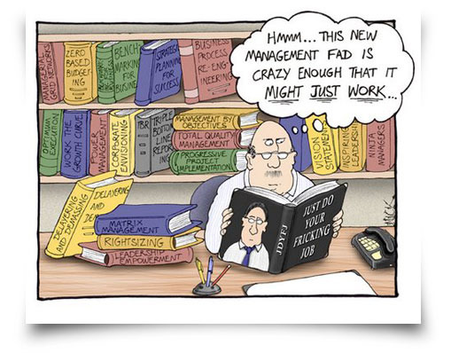
Course Administration

Slide 18
Administrative Home of First-Year Seminar
Unit | 2009
Academic department | 32.9%
Academic affairs | 30.1%
Student affairs | 17.4%
College or school | 5.0%
First-year program office | 3.7%
63.9% of courses have a seminar director
40.0% of course directors are full time
Notes:
Q61
Q62
Q63
2006
51%
14%
13%
11%
NA

Slide 19
Administration of Seminars
Average size of seminar program is around 20-25 sections
A majority of seminars have classes enrolling 20-29 students
20-24 students/section: 41.6%
25-29 students/section: 23.1%
Approximately 31.5% of institutions require all first-years to take the seminar
Notes:
Q16
Q17
Q19
Most common subpopulations required to take the seminar (Q19)
Academically under-prepared students
Provisionally-admitted students
Also:
Learning community participants
Student athletes
Honors students

Slide 20
Credit Hours
11% offered FYS for no credit
Notes:
Q49
32 + 8 = 40%

Slide 21
Grading and Credit
Most seminars (84.9%) are letter graded
72.2% of seminars are one term (quarter or semester) in length
Seminar credit applies toward graduation in most cases
As an elective: 59.8%
General education: 33.0%
To the major: 9.8%
Notes:
Q47
Q46
Q50

Slide 22
Who Teaches the Seminar?
Instructors | 2009
Adjunct faculty | 61.7
FT non-tenure track faculty | 46.0
Student affairs professionals | 45.1
Tenure-track faculty | 41.7
Other campus professionals | 23.8
*Peer instruction is not present in community colleges
Notes:
Q21

Slide 23
Who Teaches the Seminar?
36.1% of institutions have some team taught sections of the seminar
4.6% team teach all sections
19.6% of institutions have some sections of the seminar taught by the students’ academic advisors
Notes:
Q23
Q25

Slide 24
Instructor Training & Compensation
68.0% of respondents offer training for first-year seminar instructors
42.9% require training
70.5% of respondents indicate that instructor training is < 1 day long
Most frequent compensation is a stipend
The second most frequent responses were “None” and “Part of overload”
Notes:
Q43
Q44
Q45

Slide 25
Top Course Topics
Most Important Course Topics | 2009
Study skills | 59.6%
Campus resources | 56.2%
Academic advising/planning | 43.4%
Time management | 34.5%
Least common: Diversity, Financial literacy,
& Specific disciplinary topics
Notes:
Q67
2006
38.1%
40.8%
36.7%
40.6%
28.6%

Slide 26
Course Practices
Practice | 2009
Online component | 61.6%
Linked to other courses | 35.2%
Service-learning | 19.6%
Common reading component | 10.5%
Notes:
Q57
Q52
Q54
Q55
2006
49.1%
40.2%
35.3%
NA

Slide 27
A first-year seminar does not equal a first-year experience
Online Learning
Development Ed
Common Book
Orientation
Service Learning
FYS
Learning Community

Slide 28
Seminar Assessment
Has your first-year seminar been formally assessed or evaluated since Fall 2006?
41.3%
Yes
14.2% don’t know
44.5%
No
Notes:
Q70

Slide 29
Common Seminar Goals
Objective | 2009
Orient to campus resources | 66.4%
Develop academic skills | 57.0%
Develop a connection w/institution | 51.5%
Personal development | 37.0%
Create common FYE | 14.9%
Develop support network/friends | 14.9%
Improve sophomore return rates | 11.9%
Notes:
Q66

Slide 30
Outcomes Measured
Outcome | 2009
Grade point average | 59.2%
Persistence to second year | 57.7%
Satisfaction with faculty | 53.5%
Satisfaction with the institution | 47.9%
Use of campus services | 42.3%
Academic abilities | 40.8%
Persistence to graduation | 36.6%
Participation in campus activities | 35.2%
Connections with peers | 31.0%
Notes:
Q81
How do these match up with course goals and topics

Slide 31
Assessment Strategies
Assessment | 2009
Student course evaluation | 91.1%
Institutional data | 78.9%
Survey instrument | 72.2%
Interviews w/instructors | 44.4%
Focus groups w/instructors | 42.2%
Focus groups w/students | 36.7%
Interviews w/students | 28.9%
Notes:
Q76
Q77
Q71
Locally developed 83.1%
CCSSE 96.0%

Slide 32
The FY Seminar at Your Institution
If you have a seminar, how is it supporting the goals of students and of the institution?
If you don’t have a seminar, how might it be designed to support the culture, curriculum, and population of your college?

Slide 33
Questions?

Slide 34
For More Information
Jennifer R. Keup, Director
E-mail: keupj@mailbox.sc.edu
Phone: (803) 777-2570
Donna Younger, Dean of Academic Services
E-mail: dyounger@oakton.edu
Phone: (847) 635-1656

