Slide 1
Leave options for parents

Slide 2
Disclaimer
The information in this presentation is subject to change as we continue to receive interpretation and guidance from the Department of Administration as well as the Department of Labor related to the Families First Coronavirus Response Act (FFCRA).

Slide 3
Families First Coronavirus Response Act (FFCra) Overview
Assists employees who are impacted by COVID-19 and affords all employee groups, including temporary and students, two types of leave.
Leave can be utilized from April 1, 2020 - December 31, 2020.
Leave Types
Emergency Paid Sick Leave Act (EPSL)
Emergency Family and Medical Leave Expansion Act (EFMLA)

Slide 4
Requesting EPSL
Via PeopleSoft HCM eForm, Initiated by the Employee

Slide 5
epsl Overview
Provides up to 80 hours/10 workdays of paid sick leave for employees
May be used intermittently
Eligibility hours for part-time employees depends on aggregate hours as determined by Controller’s Office.
Six qualifying reasons related to COVID-19 (criteria shown on upcoming slides)
Qualifying reasons 1-3 cover normal rate of pay up to $511 per day
Qualifying reasons 4-6 cover 2/3 normal rate of pay up to $200 per day
Can use accrued sick, annual, or compensatory time to supplement remaining 1/3
Employees are eligible from day one of employment, no minimum employment period requirement.
All employee groups are eligible, including those who do not earn leave:
Student
Temporary
RGP
Time-limited

Slide 6
epsl Overview
Employees/Positions Not Eligible:
External Dual employees (eligibility determined by home agency)
Internal Dual appointments for FTE’s (their FTE is eligible)
Affiliates
Employees who work on an as-needed basis and are not scheduled to work do not qualify

Slide 7
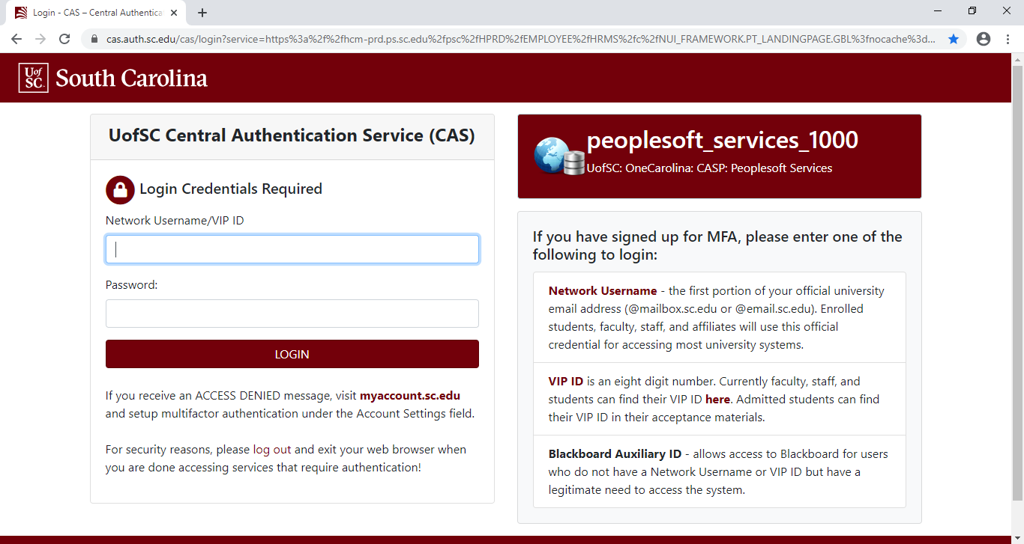
Getting started
Log into HR/Payroll System by clicking here.

Slide 8
Employee self service
Click on the appropriate tile:
COVID- 19 Emerg Paid Sick Leave
Up to 80 hours/10 workdays of paid leave
Both eForms are required if the employee is requesting both types of leave.

Slide 9
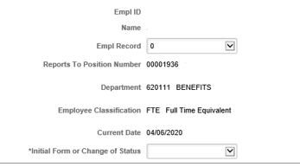
EPSL
Instructions
Employee Information
Select the EMPL Record # for the job for which you are requesting this leave.
For Temporary employees (including students), the applicable EMPL record should have been included in the letter from their department communicating reduced or zero hours.
Verify that the Department and supervisor that appear are the correct values for this job.
Select if this is the Initial Form or Change of Status.

Slide 10
EPSL
Criteria for Eligibility
Carefully review the reasons for Eligibility #1 through #6 (shown on next slide for clarity) and the associated information regarding how the pay will be treated with each one and select from the drop down.
Note: For Eligibility #1, we are not currently subject to a Federal, State, or local quarantine or isolation orders related to COVID-19.

Slide 11
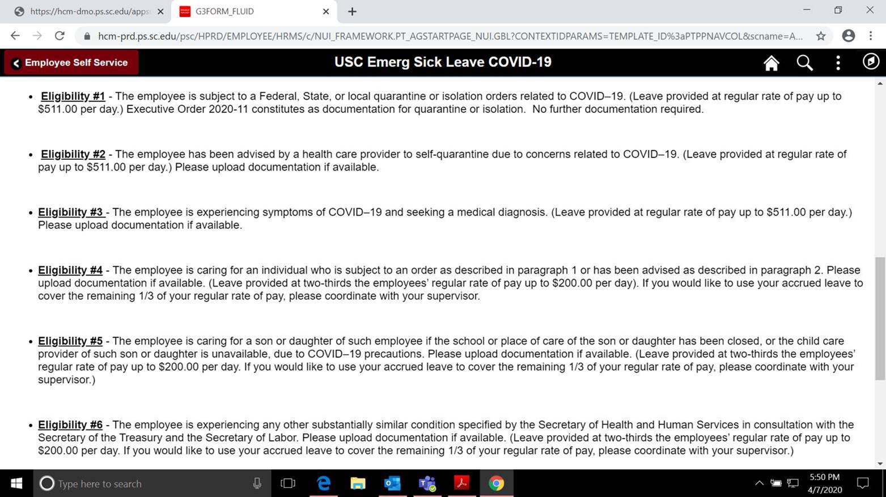
EPSL criteria

Slide 12
EPSL
File Attachments
Upload required/supporting documentation, examples include:
Copy of the Federal, State or local quarantine or isolation order related to COVID-19 applicable to the employee
Written documentation by a health care provider advising the employee to self-quarantine due to concerns related to COVID-19.
Picture of the school’s website closing notification
Telehealth email sent from the doctor.
May upload multiple documents by clicking on “Add”
Click the green Submit button.

Slide 13
EMAIL NOTIFICATION
From: PeopleSoft@peoplesoft.com <PeopleSoft@peoplesoft.com>
Sent: Monday, April 6, 2020 11:00 AM
To: THOMPSON, CONNIE <CONNIET@mailbox.sc.edu>
Subject: Coronavirus Emergency Leave eForm - Approved for C54250671
A Coronavirus Emergency Leave eForm – 156066 was approved on 2020-04-06-10.59.48.000000.
However, this is not the final step to ensure payment is processed for this approved leave. This approved leave must be entered into ITAMS and must not exceed the total eligible hours of 40. Managerial approval of the time entered in the timesheet is also required before the data will be processed into the HR/Payroll system and the payment will be issued. Please ensure that this process is completed in a timely manner so that payment for this approved leave is not delayed.
Empl ID: C54250671
Name: Travis Wendel
Total Eligible Hours: 40
eForm Comments:
To view this form, click the link: https://hcm-dev.ps.sc.edu/psp/HDEV/EMPLOYEE/HRMS/c/G3FRAME.G3SEARCH_FL.GBL?Page=G3SEARCH_FL&Action=U&G3FORM_FAMILY=EMPLOYEE&G3FORM_ID=156066&G3FORM_TASK=VWS
Employee will receive an auto-generated notification email of approval or denial.

Slide 14
Requesting EFmla Leave
Via PeopleSoft HCM eForm, Initiated by the Employee

Slide 15
EFMLA Overview
Expands the Federal Family and Medical Leave Act.
EFMLA and FMLA combine for the 12-week annual eligibility. If an employee has already exhausted their 12 weeks this year, they are not eligible for EFMLA.
Provides leave for employees who are unable to work, including work-from-home, as a result of having to care for a minor child due to a COVID-19 related closure of a school or childcare center.
EFMLA leave pays 2/3 salary up to $200 per day ($10,000 aggregate) after the 10th workday. First two weeks (10 days) are unpaid.
EPSL may be used to offset the first two weeks of unpaid leave
Can use accrued sick, annual, or compensatory time to supplement remaining 1/3
Must have been employed for 30 days from the effective date of the request. Does not have to be in current position (i.e. time worked as a temp counts if the employee just became an FTE on 4/5/2020).

Slide 16
Employee self service
Click the COVID-19 EFMLA tile:
Up to 12 weeks of leave (this counts towards the regular FMLA 12-week annual allotment)
First 10 days are unpaid but can be used in conjunction with 10 days of EPSL.
Both eForms are required if the employee is requesting both types of leave.

Slide 17
EFMLA
Carefully read the instructions at the start of the eForm.
Enter the requested start date for the leave.

Slide 18
EFMLA
Answer Yes or No to whether you wish to request EFMLA.
If you select Yes, then you must indicate whether you wish to request the use of other accrued leave to supplement your pay.

Slide 19
efmla
Upload documentation (required if you select Yes to using EFMLA in the previous step):
Picture of the school’s website closing notification
Email from school or childcare center notifying of closing
May upload multiple documents by clicking on “Add”
Click the green Submit button.

Slide 20
Email Notification
Employee will receive an auto-generated notification email of approval or denial.

Slide 21
IMPORTANT NOTE:
Receipt of Approval is not the end of the process! The leave MUST be entered into ITAMs using the applicable timecodes (shown on upcoming slides) and approved by supervisor as usual.

Slide 22
Leave Entry
Employee
Enter the leave by week into ITAMS
Supervisors
Approve the time
Assist in monitoring amount of leave eligible
ITAMS will not stop at 80 hours
If employees in FTE, RGP, TL position run out of leave
LWOP status

Slide 23
Other Leave/Time Options

Slide 24
Other Leave/time Options
Annual Leave
Sick Leave
Compensatory Time
Holiday Compensatory Time

Slide 25
Itams codes and Leave entry
COVID-19 Timecodes

Slide 26
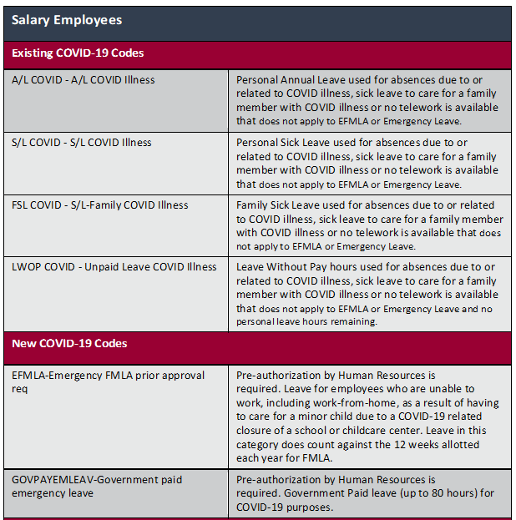
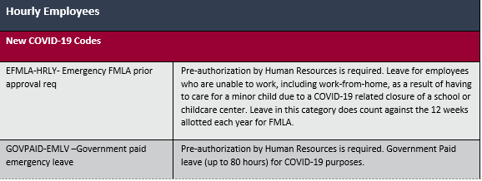

Slide 27
Thanks!
Division of Human Resources and Payroll

