Slide 1
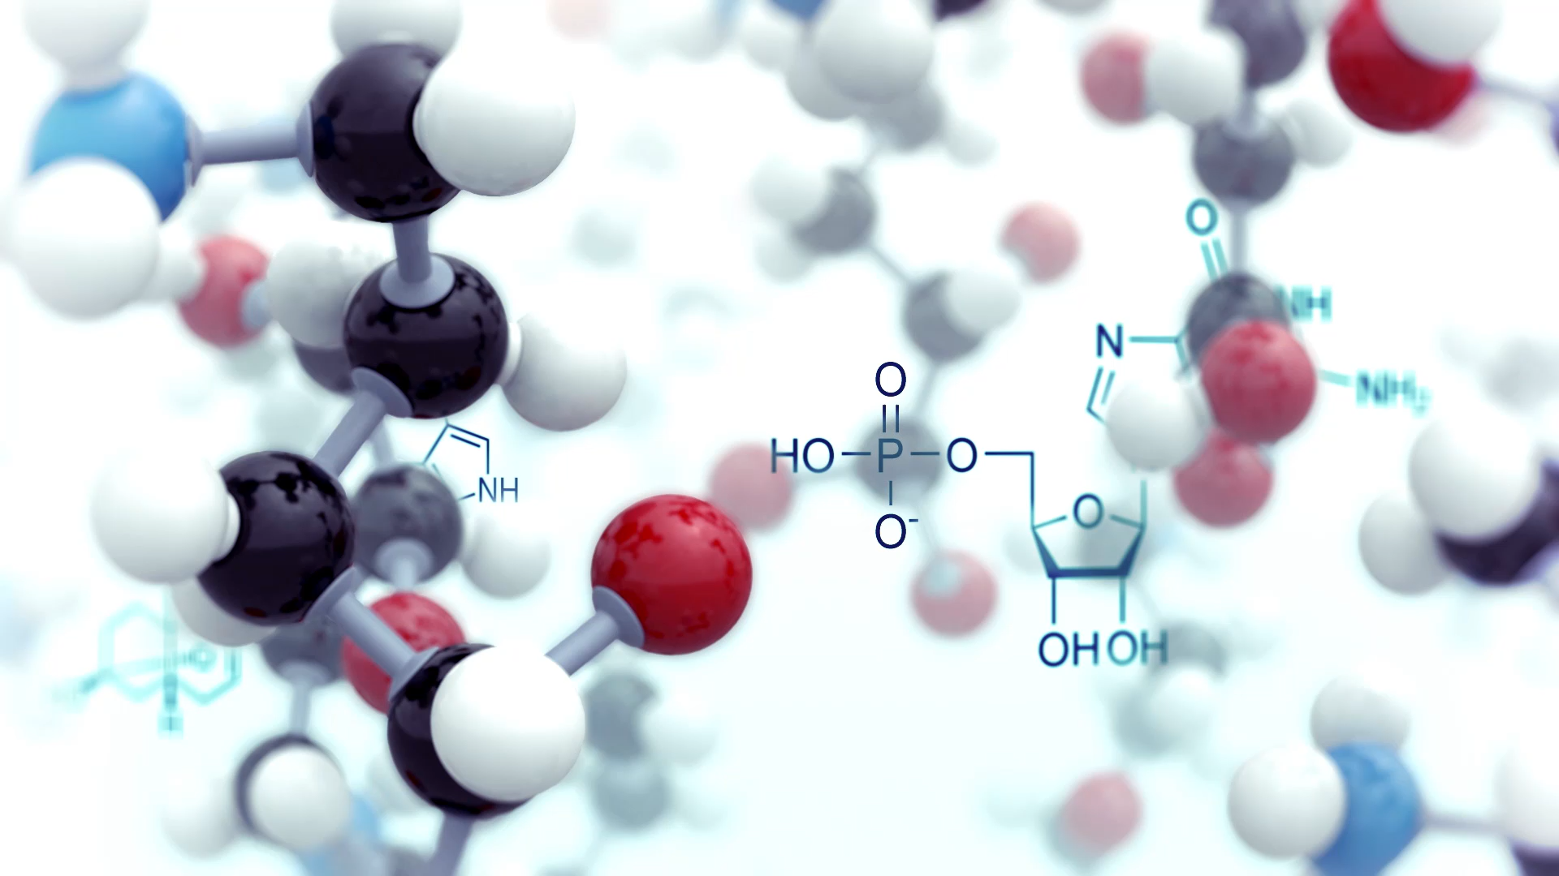
Managing Peroxide Forming Chemicals
USC Policy for Identification, Storage, Handling, and Disposal

Slide 2
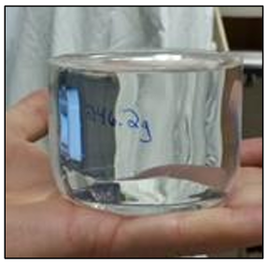
U of Minnesota
Methyl methacrylate explosion on storage.
Quote from a researcher in the UMN Chemistry Department: “A few years back, a bottle of methyl methacrylate exploded overnight on one of our storage shelves in Smith Hall. The only evidence that the bottle even existed was the 'puck' of polymer (photo on the left) and a small section of the bottle that included the cap and neck about 95% of the glass simply disappeared. It must have been quite the blast!”

Slide 3
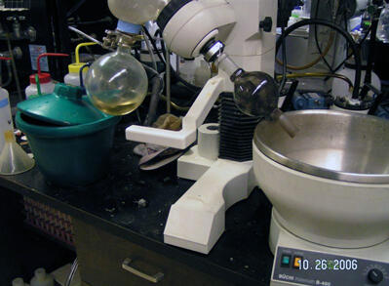
UC Berkely
Explosion during evaporation.
Undergrad student
Removing organic solvents from azobenzene precipitate (rotavap)
Round bottom flask exploded while adjusting it, sending glass fragments
Cuts that needed stitches
THF (uninhibited) & diethyl ether used
THF tested to have >100 ppm peroxide

Slide 4
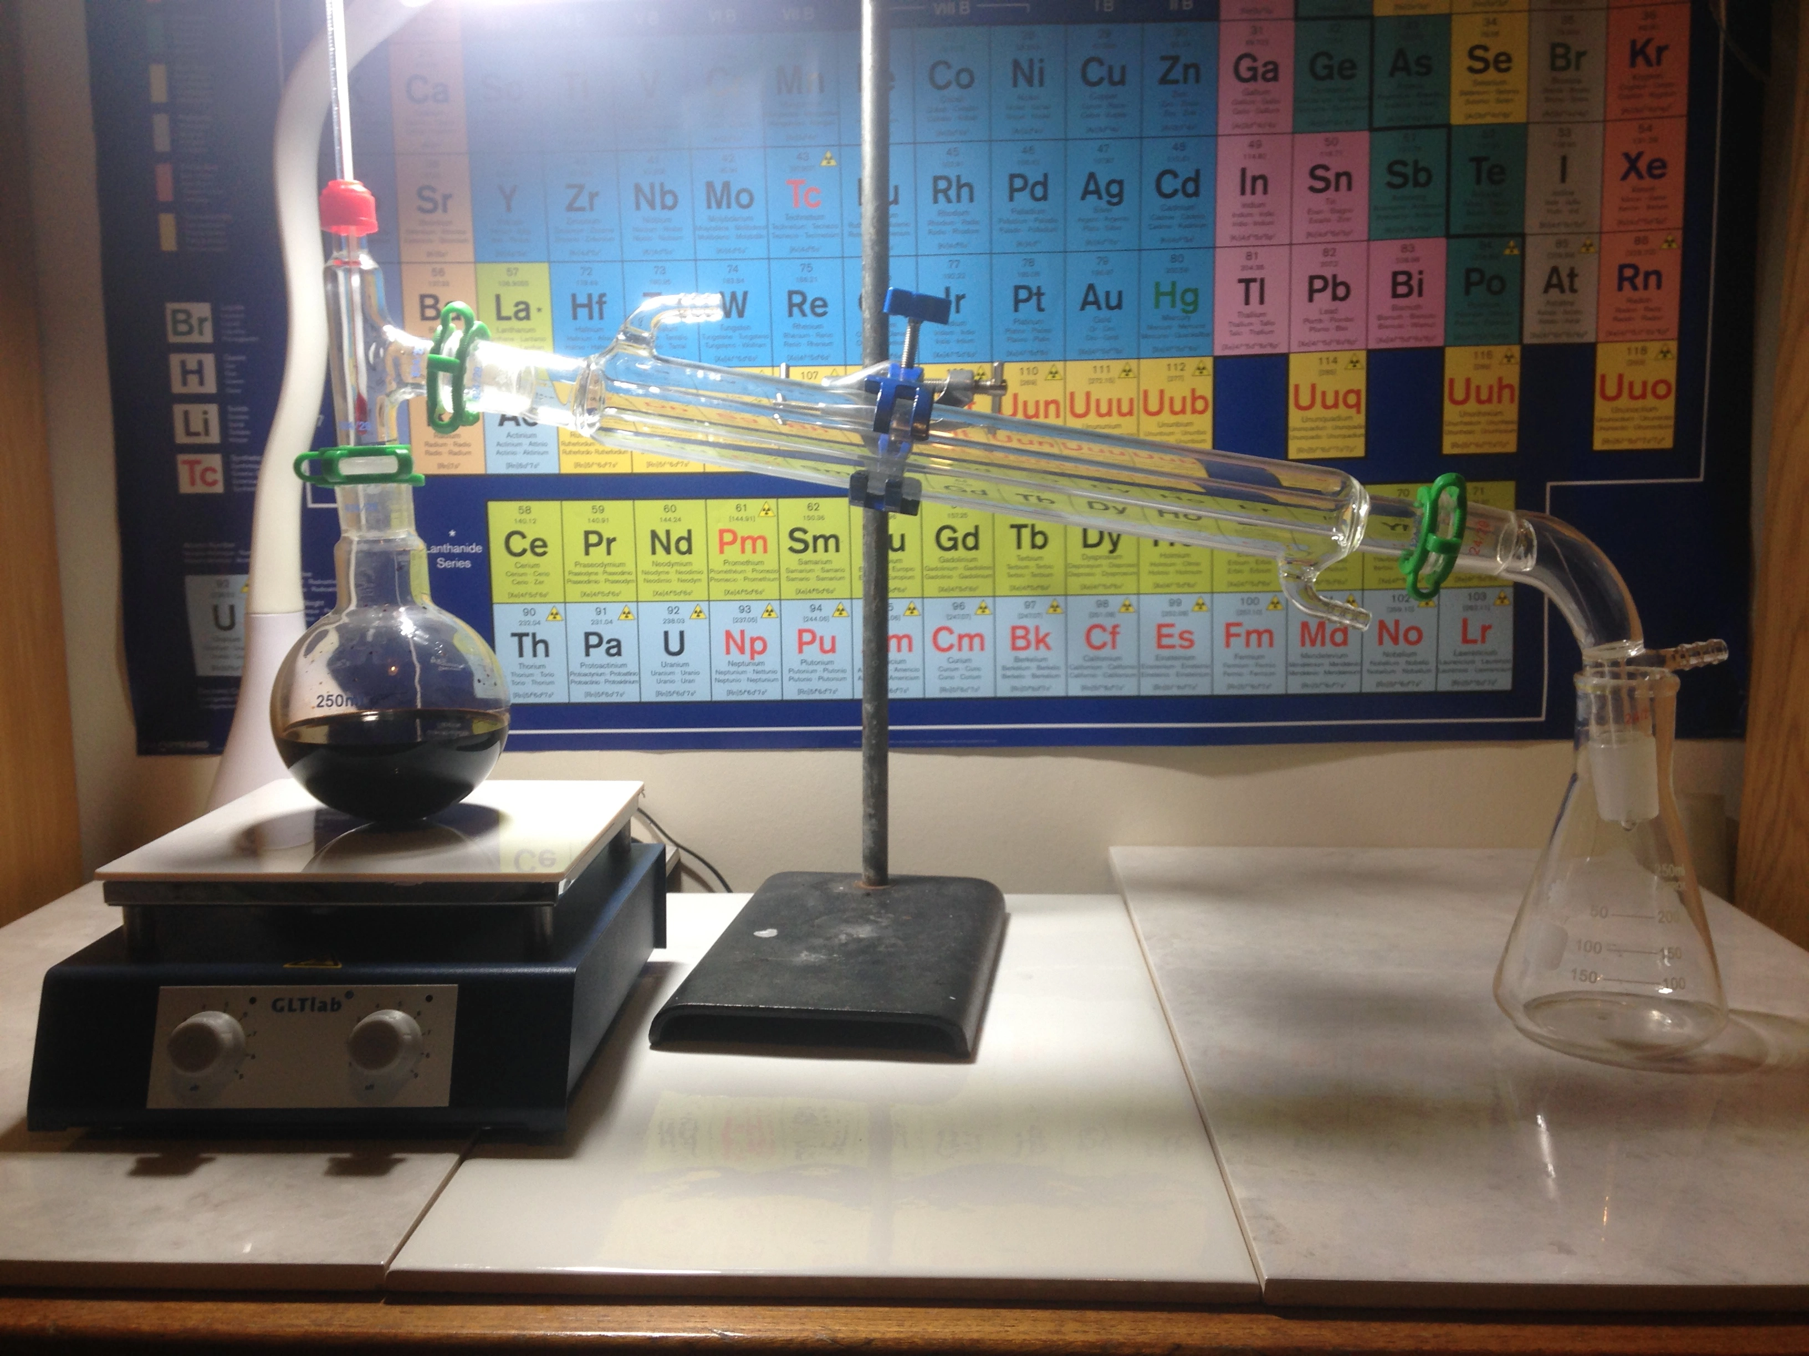
N. N. Semenov Inst. of Chemical Physics (Moscow)
Explosion during distillation.
Explosion at the end of 2-propanol distillation.
Conducted an experiment to determine what happened.
Found that diisopropyl ether formed during the refluxing of 2-propanol with magnesium.

Slide 5
U of Minnesota
Explosion while handling hazardous waste.
EH&S Technician
Chemical clean out
Poured solvent into bulking drum
“Empty” glass container detonated after being placed in a tip cart
Cart ripped in half, blew doors open, shook windows, damaged adjacent rooms
Residual peroxide crystals detonated with friction
Technician survived without major injuries

Slide 6
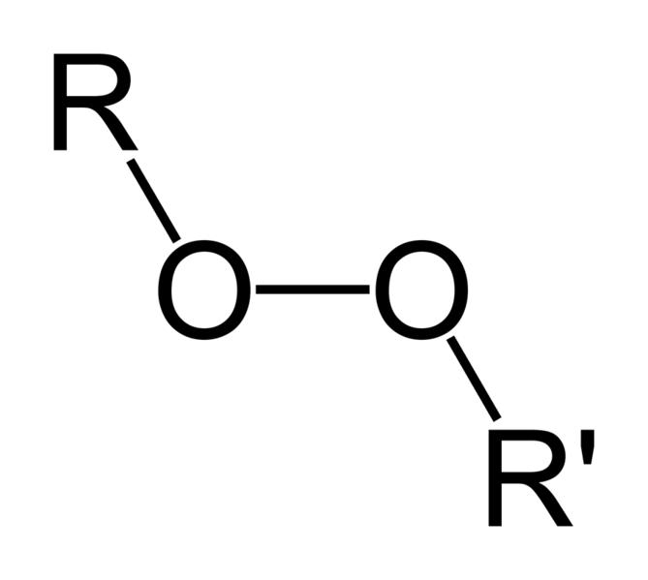
Peroxide Formation
Peroxides are compounds containing an oxygen-oxygen single bond (O-O).
Three pathways:
Autooxidation via Free Radicals – common
Reaction with Hydrogen Peroxide
Metal Peroxides
Signs:
Cloudiness
Discoloration
Crystals
Second liquid phase
Increased viscosity
Gel formation
Autooxidation
Initiation – trigger (heat, light, trace contaminants) kicks H off a compound (R-H), forming a free radical (R•).
Propagation – Carbon-centered radical reacts with O2 to form a peroxy radical (ROO•). Peroxy radical abstracts an H atom from another R-H molecule and regenerating a carbon radical. Cycle continuous making it a chain reaction.
Process slows down when 2 peroxy radicals combine to make non-radical compounds.
R-H → R• + H•
R• + O₂ → ROO•
ROO• + R-H → ROOH + R•

Slide 7

Peroxide Decomposition
Peroxides are inherently unstable due to the weak O-O bond (bond energy ~150 kJ/mol, much lower than C-C or O-H bonds). They can decompose through several mechanisms, often releasing energy violently:
Mechanisms of Decomposition
Thermal – heating breaks the O-O bond homolytically (splitting into two radicals).
Catalytic – transition metals (Fe2+, Cu+) cleaves. the O-O bond heterolytically forming new radicals.
Photolysis – UV light can cleave the O-O bond.
Explosive decomposition – some peroxides decompose rapidly when shocked or heated, releasing O2 and heat. The weak O-O bond and strained molecular structures make them prone to runaway chain reactions.

Slide 8
Compounds Prone to Peroxide Formation
Compounds with weak C-H bonds, unsaturations, or have functional groups that stabilize radical intermediates during autooxidation are prone to form peroxides.
1. Ethers
2. Alkenes with Allylic Hydrogens
Commonly used in laboratories:
Diethyl ether forms ethyl hydroperoxide.
THF have cyclic structure that makes it reactive and readily forms hydroperoxide.
Isopropyl ether has a tertiary C-H bond and forms peroxides faster than diethyl ether.
Conditions: Exposure to air, light or heat accelerates the process. Peroxides in ethers concentrate when ether evaporates, posing explosion risks.
Hydrogens on carbons next to a double bond are weakly bonded due to resonance stabilization of the resulting radical. Oxygen attacks these sites, forming allylic hydroperoxides.
Cyclohexene: Forms cyclohexenyl hydroperoxide.
Styrene: Can generate peroxides, especially during storage.
Terpenes (e.g., limonene): Found in essential oils, these unsaturated hydrocarbons autoxidize readily.
Conditions: Unsaturated systems exposed to air over time are prime candidates.

Slide 9
Compounds Prone to Peroxide Formation
3. Aldehydes
4. Compounds with Benzylic Hydrogens
The C-H bond in the -CHO group is reactive, and autoxidation can produce peracids (RCOOOH) rather than hydroperoxides. The carbonyl group facilitates radical formation.
Examples:
  Acetaldehyde: Forms peracetic acid (CH₃COOOH).
  Benzaldehyde: Slowly oxidizes to perbenzoic acid.
Conditions: Trace metals or light can catalyze this process.
Hydrogens on carbons next to an aromatic ring (benzylic positions) are reactive due to resonance stabilization of the radical intermediate.
Examples:
Cumene (isopropylbenzene): Forms cumene hydroperoxide, intentionally produced in industrial processes (e.g., phenol synthesis).
Ethylbenzene: Can autoxidize to a hydroperoxide.
Conditions: Air exposure and heat increase susceptibility.

Slide 10
Compounds Prone to Peroxide Formation
5. Alkynes with Propargylic Hydrogens
6. Certain Alcohols and Ketones (Less Common)
Similar to allylic hydrogens, hydrogens on carbons adjacent to a triple bond are prone to abstraction, leading to peroxide formation.
Examples:
Phenylacetylene: Can form peroxides under oxidative conditions.
While less reactive than ethers or alkenes, some alcohols and ketones can form peroxides under specific conditions, especially with hydrogen peroxide or catalysts.
Examples:
Acetone: Reacts with H₂O₂ to form cyclic peroxides like TATP (triacetone triperoxide), though this isn’t autoxidation—it’s a synthetic route.
Secondary alcohols: Can form hydroperoxides in rare cases with prolonged air exposure.

Slide 11
Table 1. PFC Classes and Hazards
Class | Description | Examples | Key Hazard
A | Severe peroxide hazard | Isopropyl ether, divinyl acetylene | Spontaneous peroxide formation
B | Peroxides form on concentration | Diethyl ether, THF | Explosive when concentrated
C | Peroxide-initiated polymerization | Styrene, butadiene | Polymerization risk
D | May form peroxides conditionally | Acetone, ethyl acetate | Lower risk, specific triggers

Slide 12

Why create a PFC
Some laboratories are managing their PFC’s better than others.
Undated and expired PFCs found during inspections
Unknown peroxide status (unsafe to open).
Need for remote opening by experts.
Additional expense.
Need to standardize management of PFCs to
Prevent accidents.
Avoid generating high-hazard wastes.
Avoid high cost of waste disposal.

Slide 13

Elements of the PFC Policy
Responsibilities
Procurement and Inventory Management
Storage Guidelines
Handling and Use Procedures
Testing for Peroxides
Disposal Procedures
Training Requirements
Emergency Procedures
Compliance and Audits

Slide 14
1. Responsibilities
Principal Investigators – understand all provisions of the PFC policy and assume ultimate responsibility for proper management of PFCs in their laboratory as outlined in the policy and ensure lab personnel are trained on procedures necessary to properly manage PFCs; may delegate specific tasks to a qualified research group member (PFC Manager).
PFC Manager – understand all provisions of the PFC policy. Complete training necessary to recognize peroxide formation, oversee procurement, ensure proper storage conditions, test for peroxides, and perform stabilization (if needed), maintain labeling and inventory records, request timely waste pickups, and provide hands-on training to other group members.
Lab Personnel –follow all procedures and guidelines described in this policy, report incidents, and comply with all other chemical and laboratory safety standards and guidelines.
Environmental Health and Safety (EH&S) – Develop and maintain the PFC policy, provide hazardous waste training, conduct lab safety inspections, and pick up properly managed hazardous waste for disposal by an authorized vendor.
Department Chairs – understand the provisions of this policy and enforce compliance in a timely manner; provide EH&S with a fund code to pay for any additional expenses in disposing of high-hazard PFC.

Slide 15
2. Procurement and Inventory Management
Maintain a chemical inventory in Campus Optics. Add containers and key dates for all PFCs. (System will generate a unique container # and identify the PFC class)
Purchase only quantities needed for immediate use (within 3 months for class A, 12 months for class B & C, and 24 months for Class D) to minimize storage time.
Always purchase the inhibited form unless the procedure calls for a pure substance.
Identify the PFC class of the chemical received and affix the corresponding color-coded PFC label on each container (round for small containers, rectangular for 1L or bigger containers). PRINT THESE LABELS IN COLOR.
Write on the PFC label:
Container #,
Received date,
Opened date,
(Manufacturer’s) Expiration date (if any)
Disposal date based on the PFC class and intended use of the chemical.
Whether chemical is inhibited or not.
Write all information on the PFC storage log for small containers.

Slide 16
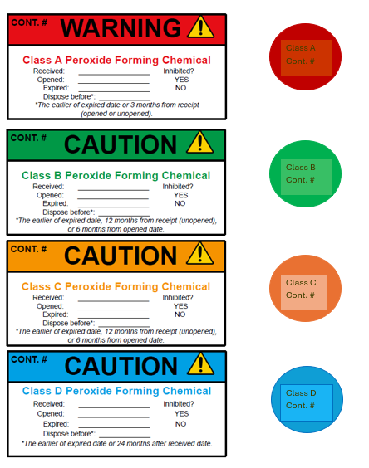
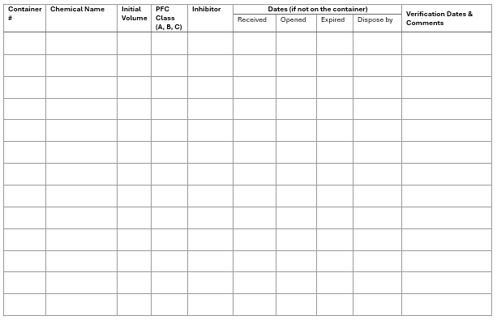
PFC Container Labels and Storage Log
PFC Labels
PFC Storage Log

Slide 17
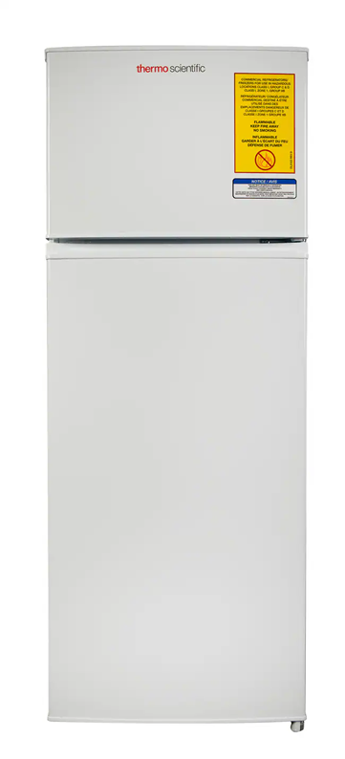
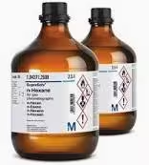
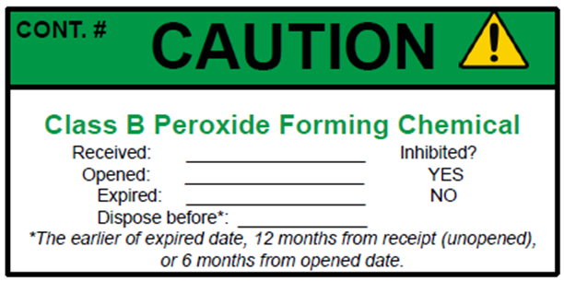
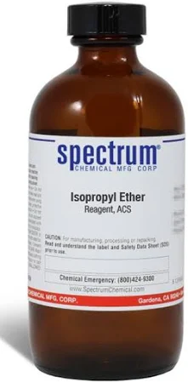

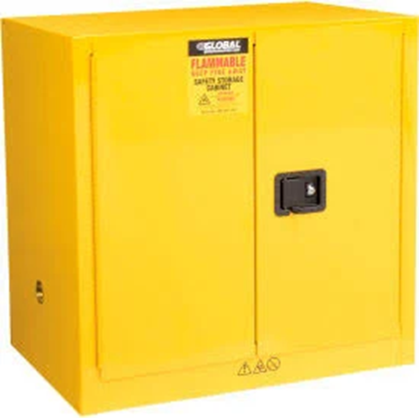

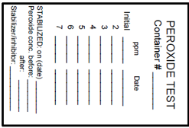
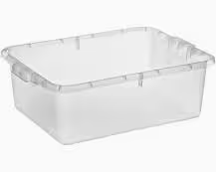
3. Storage area – cool, dark place, away from incompatibles.
PFC Label
Do not obstruct chemical ID and hazard information when placing the label.
Peroxide Test log
PFC Storage log
PFC Storage log
Peroxide Test log
Peroxide Test log
CAUTION
Peroxide-forming Chemicals
Cabinet for flammable solvents
Secondary containment or designated shelf in the cabinet/refrigerator
Explosion-proof refrigerator

Slide 18
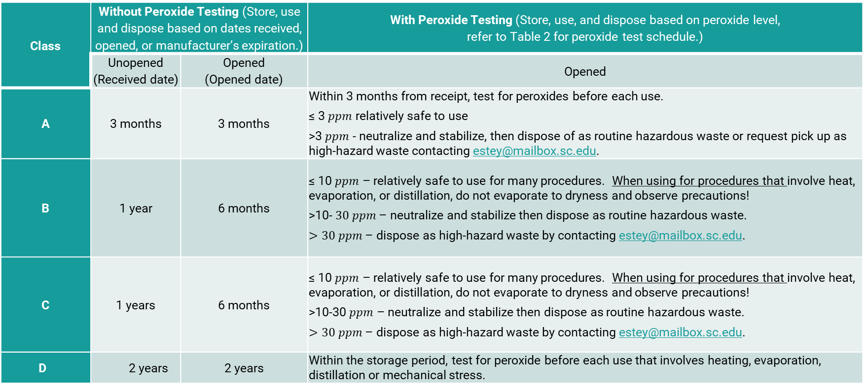
Table 1. Storage duration, disposal and chemical use schedule.
Class | Without Peroxide Testing (Store, use and dispose based on dates received, opened, or manufacturer’s expiration.) |  | With Peroxide Testing (Store, use, and dispose based on peroxide level, refer to Table 2 for peroxide test schedule.)
 | Unopened (Received date) | Opened (Opened date) | Opened
A | 3 months | 3 months | Within 3 months from receipt, test for peroxides before each use. ≤ 3 $ppm$ relatively safe to use >3 $ppm$ - neutralize and stabilize, then dispose of as routine hazardous waste or request pick up as high-hazard waste contacting estey@mailbox.sc.edu.
B | 1 year | 6 months | ≤ 10 $ppm$ – relatively safe to use for many procedures. When using for procedures that involve heat, evaporation, or distillation, do not evaporate to dryness and observe precautions! >10- $30 ppm$ – neutralize and stabilize then dispose as routine hazardous waste. $>30 ppm$ – dispose as high-hazard waste by contacting estey@mailbox.sc.edu.
C | 1 years | 6 months | ≤ 10 $ppm$ – relatively safe to use for many procedures. When using for procedures that involve heat, evaporation, or distillation, do not evaporate to dryness and observe precautions! >10-30 $ppm$ – neutralize and stabilize then dispose as routine hazardous waste. $>30 ppm$ – dispose as high-hazard waste by contacting estey@mailbox.sc.edu.
D | 2 years | 2 years | Within the storage period, test for peroxide before each use that involves heating, evaporation, distillation or mechanical stress.
Exceptions: Dispose by manufacturer’s expiration if sooner; immediately dispose if there are signs of peroxide formation (crystals, discoloration, increased viscosity, gel formation, pressure buildup).

Slide 19
4. Handling and Use Procedures
Wear chemical-resistant gloves, lab coat, safety goggles, and, if necessary, face shields and hearing protection when handling, especially for older containers.
Use in a fume hood to minimize inhalation exposure, reducing health risks from potential vapors.
Obtain aliquots from the original container in the amount that you will use immediately to avoid storage in improper containers (unsealed like beakers, volumetric flasks or containers with glass stoppers or metal lids).
Any excess chemical should be disposed of as hazardous waste according to established disposal schedule. Do not pour unused excess back into the original bottle. This will introduce trace impurities that may increase the rate of peroxide formation.
Ensure that the lids are closed tightly before returning to storage cabinets.
Practice good chemical hygiene to avoid cross-contaminating PFCs. Use glass and plastic equipment for handling (metal impurities can increase peroxide formation).
Check for signs of peroxide formation before opening containers. Do not open containers past their expiration date without prior testing to avoid handling potentially explosive materials.
Always test for peroxide before using PFCs in distillation/evaporation/heating procedures. These procedures remove the inhibitors. Plan on stabilizing the end product and do not store for long periods.

Slide 20
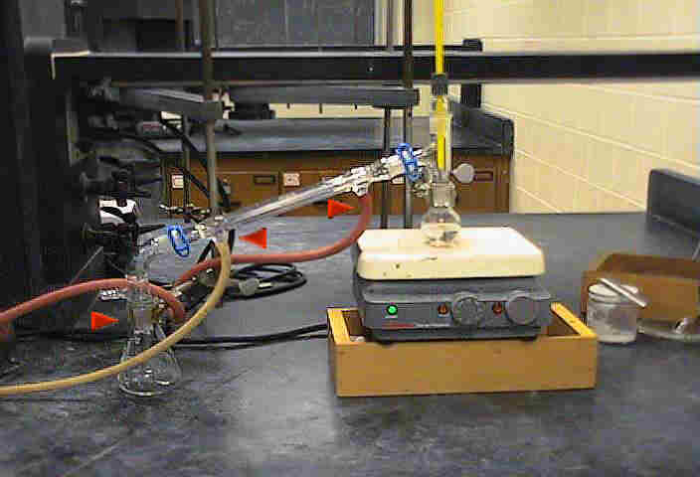
4. Precautions for distillation/evaporation
Distillation/evaporation increases the likelihood of more peroxide formation and subsequent detonation. Follow these precautions:
Test for peroxides before distilling; do not distill if the test shows > 10 ppm peroxides.
Distill under an inert atmosphere.
Set up distillation apparatus with Teflon sleeves between glassware joints to reduce friction as peroxides may accumulate in glassware joint during distillation.
Never distill to dryness. Stop distillations of a PFC when 20% of starting volume remains or add a nonvolatile oil such as mineral oil, which ensures going to dryness is not possible and help dilute any peroxides formed in the distillation pot.
Be cautious agitating or shaking the distillation pot.
Do not refrigerate/freeze the remaining solvent.
Distillation removes inhibitors so it is important to add an inhibitor post-distillation or sparge and store the distillate with inert gas.

Slide 21
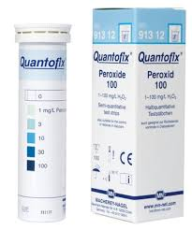
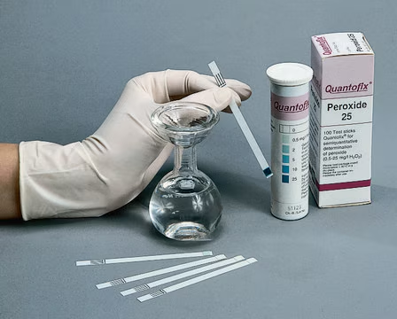
5. Testing for Peroxides
Testing for peroxide is required
Before using PFC in high-hazard procedures.
If intending to keep PFC beyond established storage time (Table 2).
Test for peroxide according to the PFC class and the testing schedule for each class.
Use Quantofix 100 or EM Quant peroxide test strips (0-100 ppm range). Read the manufacturer’s instructions and practice the procedure to improve proficiency.
Ensure that the test strips are within their expiration date to guarantee accuracy. Strips typically have a shelf life of 3 years if stored in a cool, dry place, away from sunlight and moisture.
Open the container and remove only the strips needed at one time, then close the container immediately. Do not touch the test field as oils or contaminants can affect the reaction. Ensure the solution is at room temperature, as temperature can influence color development and accuracy.
Use distilled water as Zero control and 3 ppm hydrogen peroxide as a positive control to verify the performance of the test strips. Always prepare the 3ppm hydrogen peroxide fresh on the day of the test.
Record test results on the peroxide test log or a peroxide test label that can be attached to large containers. Upload a photo of the test results for each container tested in Campus Optics (Container page, Add New Document on top right of the screen).

Slide 22
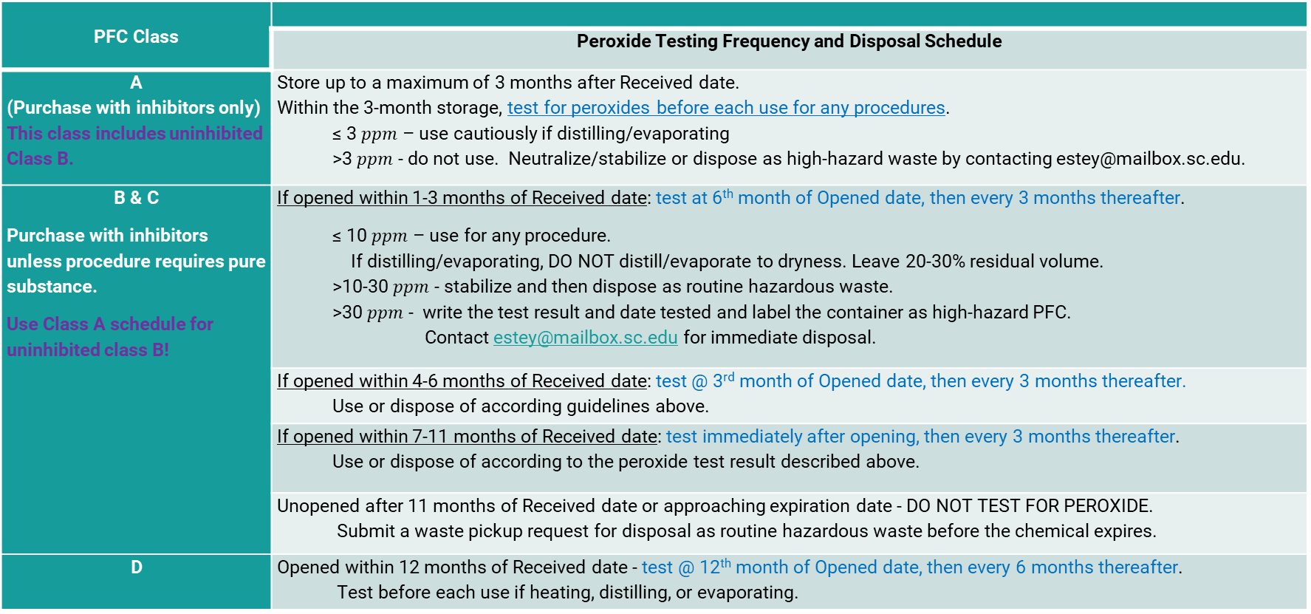
Table 2. Peroxide testing schedule
PFC Class
 | Peroxide Testing Frequency and Disposal Schedule
A (Purchase with inhibitors only) This class includes uninhibited Class B. | Store up to a maximum of 3 months after Received date. Within the 3-month storage, test for peroxides before each use for any procedures. ≤ 3 $ppm$ – use cautiously if distilling/evaporating >3 $ppm$ - do not use. Neutralize/stabilize or dispose as high-hazard waste by contacting estey@mailbox.sc.edu.
B & C Purchase with inhibitors unless procedure requires pure substance. Use Class A schedule for uninhibited class B! | If opened within 1-3 months of Received date: test at 6th month of Opened date, then every 3 months thereafter. ≤ 10 $ppm$ – use for any procedure. If distilling/evaporating, DO NOT distill/evaporate to dryness. Leave 20-30% residual volume. >10-30 $ppm$ - stabilize and then dispose as routine hazardous waste. >30 $ppm$ - write the test result and date tested and label the container as high-hazard PFC. Contact estey@mailbox.sc.edu for immediate disposal.
 | If opened within 4-6 months of Received date: test @ 3rd month of Opened date, then every 3 months thereafter. Use or dispose of according guidelines above.
 | If opened within 7-11 months of Received date: test immediately after opening, then every 3 months thereafter. Use or dispose of according to the peroxide test result described above.
 | Unopened after 11 months of Received date or approaching expiration date - DO NOT TEST FOR PEROXIDE. Submit a waste pickup request for disposal as routine hazardous waste before the chemical expires.
D | Opened within 12 months of Received date - test @ 12th month of Opened date, then every 6 months thereafter. Test before each use if heating, distilling, or evaporating.

Slide 23
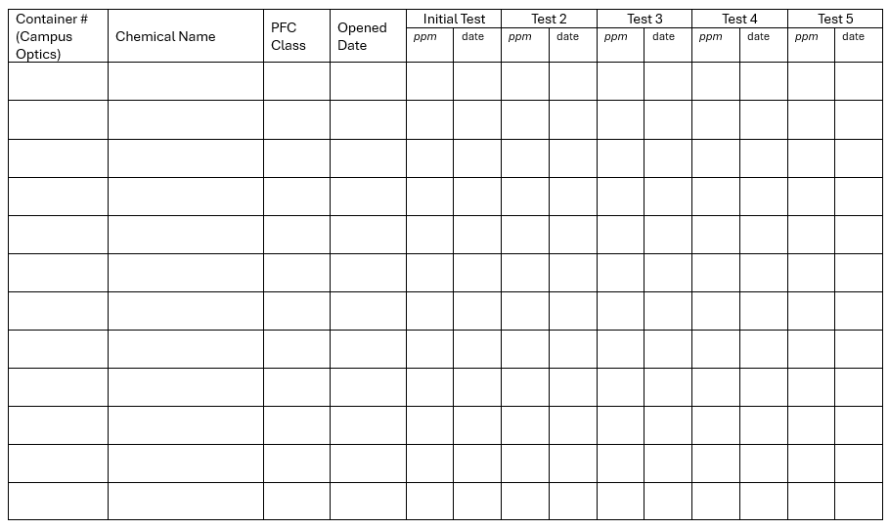
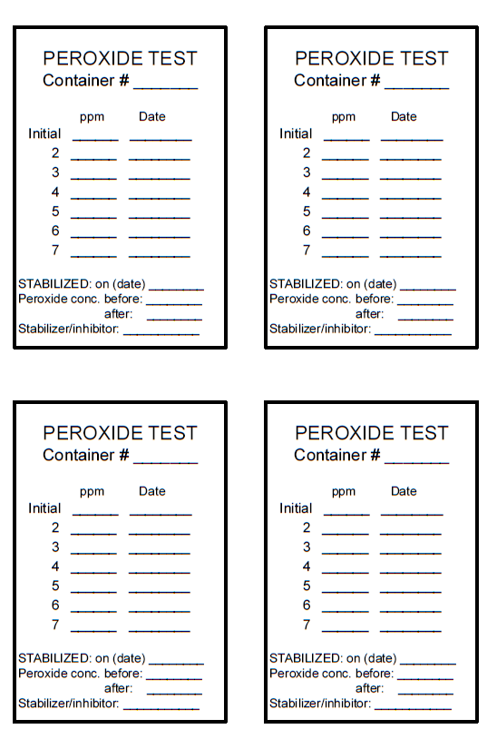
Peroxide test label for large containers and log for smaller containers.

Slide 24
6. Disposal Procedures*
Routine Hazardous waste
High-hazard waste
Unexpired and dated containers with no signs of peroxide formation
Neutralized and stabilized PFCs.
(React with reducing agents to a peroxide concentration <1 ppm, then add inhibitors).
  Undated containers
  Expired PFCs (containers kept beyond established storage duration without prior peroxide testing, refer to Table 2)
  PFCs showing signs of peroxide formation
  PFCs with >30 ppm peroxide
*Hazardous waste is regulated and governed by US Federal Law. It is unlawful to pour hazardous waste down the drain.

Slide 25
Method for Stabilizing PFCs
Select reducing agents.
Ferrous Sulfate (FeSO₄): Effective for ethers like diethyl ether or THF. Prepare a 10% aqueous solution,
Sodium Bisulfite (NaHSO₃): Suitable for aldehydes, ketones, and vinyl ether. Use a 5-10% solution. Avoid reducing agents that react with the parent compound.
Slowly add reducing agent while stirring gently with a glass rod.
Monitor for heat/gas evolution- stop and wait if excessive reaction occur.
Let the mixture sit for 1-2 hours to ensure peroxide reduction.
Retest with peroxide strips.
Repeat treatment until peroxide strip does not turn blue.
Add inhibitor.
Ethers, THF – 100-25 mg BHT
Alkenes & vinyl compounds – 25-100 mg hydroquinone
Secondary alcohols – 100-300 mg BHT

Slide 26
7. Training Requirements
This policy covers the identification, storage, handling, testing, disposal, and emergency procedures to equip personnel on the proper management of peroxide-forming chemicals. All personnel handling PFCs must complete:
EH&S Chemical and Lab Safety training.
Hazardous Waste training.
PFC training (lecture and hands-on).
Review/understand this policy and sign the PFC Policy Acknowledgement form.
Review and understand the written SOP for the use of PFCs for specific procedures.

Slide 27
8. Emergency Procedures
Fire/Explosion: Evacuate the area, activate the fire alarm, and call 911 for assistance. Call the USC Police at (803) 777-4215 for additional support.
Exposure: Rinse the affected area with water for 15 minutes and seek medical attention immediately. USC Employees, with their Supervisor, must call CompEndium Services at 877-709-2667 to report the exposure and obtain a medical treatment plan.
Spills: Clean up small spills using your spill kit and following recommended spill procedures. For larger spills (>200 ml), evacuate the area, post signage to prevent entry, and notify EH&S. Do not clean up large spills unless trained and equipped to do so to prevent exposure and further hazards.
Reporting: Report all incidents to EH&S within 48 hours for investigation and preventive measures. Our laboratory incident report form can be downloaded here.

Slide 28
9. Compliance and Audits
Quarterly verification by Lab (Campus Optics also sends a reminder).
Original label and PFC labels are intact and completed.
If containers have been opened, the “Opened date” is recorded.
PFC storage log is up-to-date and includes every PFC in the storage cabinets.
Peroxide testing has been conducted, if required, and recorded on the container or the Peroxide Test log.
Container and liquid have no signs of peroxide formation or polymerization.
Unannounced audits by EH&S Haz Waste.
Disposal cost for high-hazard PFCs will be charged back to the Department.

Slide 29

QUESTIONS?

