Slide 1
Service Delivery and Support Program Update – February 28, 2018

Slide 2
Service Delivery & Support (SDS) Program
We are changing the way DoIT does business
Our goal is consistent, reliable, repeatable service delivery

Slide 3
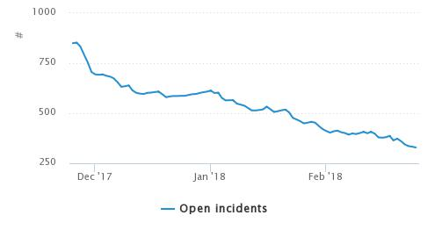
What have we done?
Improved Incident processes
Measuring response times
Open incidents has decreased by 55% since revising process

Slide 4
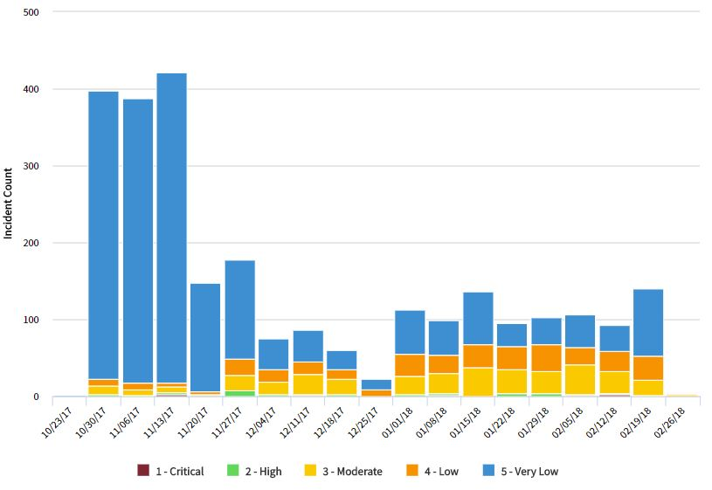
Since revising the Incident process, submitted Incidents have dropped ~80%

Slide 5
What have we done?
Service Delivery and Support Website
Encourages transparency and intended to keep you informed of our progress
View information about our ServiceNow updates
Submit feedback to let us know how we can improve
http://bit.ly/DoIT-SDS

Slide 6
What have we done?
New URL for our Self-Service Portal
sc.edu/ITHelp
Easy-to-remember website to order services, browse our Knowledge Base, or report an issue with an existing service
The existing website address, https://scprod.service-now.com/sp will continue to work normally

Slide 7
What have we done?
Customer Surveys
Customers who report an Incident will now receive a customer satisfaction survey
Let us know how your experience was
Feedback to be utilized for service improvements by our Incident Manager
Future surveys will also extend to other areas of DoIT, including contacts with the Service Desk

Slide 8
What have we done?
ServiceNow Enhancements
Telephony Order guide has been consolidated into one item, now Telephone Services
Previously, there were multiple items for requesting Telephone services
This change is designed to increase efficiency in requesting services and make our Service Catalog easier to use

Slide 9
What have we done?
ServiceNow Enhancements
It is now possible to view both the “Requested For” and “Affected User” under the Affected User column when using the My Work view for both Incidents and Requests.
Photography Services is no longer available in our Service Catalog. Photography Services has been transitioned from Division of IT to the Office of Communications and Public Affairs.

Slide 10
What have we done?
Continual Service Improvements (CSI)
Digital Certificate Renewals
Defined Cloud Services
Began establishing Service Definitions
Improving Process and Procedure Templates
Updates to DoIT Process and Procedure Knowledge Base

Slide 11
What’s Coming Next?
Reporting Time in ServiceNow
Planning for Pinnacle Integration
Ongoing Continual Service Improvement efforts
Timeline: Mid-April 2018 for Phase I

Slide 12
Questions?
Let us know!

