Slide 1
Service Delivery and Support Program Update – MARCH 28, 2018

Slide 2
What have we done this month?
Improving Incident processes
After-Hours support, 24x7x365 support for Priority 1 & 2 Incidents
Continually decreasing the amount of Open Incidents in ServiceNow

Slide 3
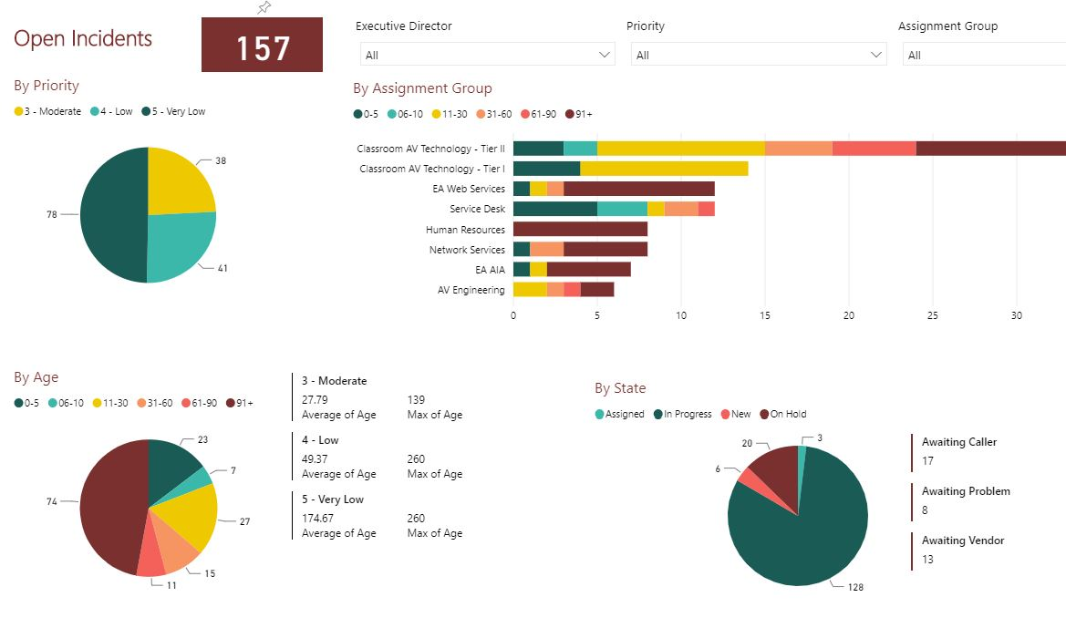

Slide 4
What have we done this month?
Improving Incident processes
It’s time to clean up old Incident data!
Please review any Incidents in your or your group’s queue if they should still be active, or converted into a Request
Service Requests are next!

Slide 5
Exec SM
Janeen Blanton
Strategic Services Director
SMO Director
Customer Service Sr Director
Interim PMO Director
Laurel Eddins
Ella Wider
Michael Cathcart
Al Crothers
The Strategic Services Team will handle the design, modification and retirement of services. They will also lead strategic initiatives such as the rollout of ITSM and CSI.
The Service Management Office will handle the transition and operations of services. This includes change management, knowledge management, problem management, and service level management.
Because we need a laser focus on customer service and support, we have formed a dedicated customer service group which includes all of our customer facing teams: Service Desk, Desktop Support and the Carolina Tech Zone.
Our Project Management Office will continue to lead both internal and external IT projects.

Slide 6
What have we done this month?
Service Definitions
Aptris On-site from March 5-9
Together, we have captured over 110 Service Definitions!
These will be used to build out ServiceNow and our Service Catalog

Slide 7
What have we done this month?
ServiceNow updates
Customers can now enter their own descriptions for requested items
Self-Service Portal enhancements: Shopping Cart and Knowledge Base
Updated processes and procedures added to the Knowledge Base

Slide 8
What have we done this month?
Time Worked
Available in ServiceNow, currently not mandatory
We are scheduling training for entering and using Time in ServiceNow
Defined procedure for entering time available in our Knowledge Base

Slide 9
The goal of reporting time in ServiceNow is to track the time we spend on Operational Work (Incident and Request) compared to Strategic Work (Projects and Enhancements)
Time Worked will be available throughout the platform (Incident, Tasks, etc.)
Remember, This is not ITAMS

Slide 10
Questions?

Slide 11
What have we done this month?
Employee Surveys
We wanted to gather your feedback on the Service Delivery and Support program
Surveys sent to both managers and to all-staff
15% Response Rate
Your feedback and support is vital to our organization’s success!

Slide 12
What have we done this month?
Continual Service Improvements (CSI)
Updated Service Lifecycle flowcharts
Defining Service Definitions
Improving Process and Procedure Templates
Updates to DoIT Process and Procedure Knowledge Base

Slide 13
What’s Coming Next?
Importing Business Services into ServiceNow
Training for Time Entry
Ongoing Continual Service Improvement efforts
Defining and updating Service Lifecycle workflows
Service Lifecycle documentation to reflect ITIL best practices
Mid-April 2018 for Phase I

Slide 14
What’s Coming Next?
Pinnacle Integration
Requirement gathering near complete
Final requirement meetings will be planned
Design is planned for next phase
We are requesting resources for a successful integration. Those resources are not guaranteed.

Slide 15
Questions?

Slide 16
Don’t Forget!
Service Delivery and Support Website
Keeps you informed of our progress
Submit feedback to let us know how we can improve
http://bit.ly/DoIT-SDS

