Slide 1
Service Delivery and Support Program Update – Jan. 31, 2018

Slide 2
Service Delivery & Support (SDS) Program
This is NOT just a ticketing system
This is NOT just a software implementation
We are changing the way DoIT does business
IT Service Management powered by ServiceNow

Slide 3
What is IT Service Management (ITSM)?
Customer focused approach to managing and delivering IT services
Aligns IT with business objectives
Establishes efficient processes based on best-practices
Provides foundation for improved estimation of service delivery
Accessibility of information and knowledge sharing across the organization
Makes best use of resources and capabilities which enhances customer service and satisfaction

Slide 4
What are the benefits of ITSM?
Through…
We gain…
Governance
Standardization
Process
Customer Focus
Reliability
Consistency
Efficiency
Transparency
Our end goal is consistent, reliable, repeatable service delivery

Slide 5
How does this affect me?
You may see more emails from the ServiceNow system requiring your input:
More information needed to resolve Incidents and fulfill Service Requests
Validating services are working as requested
Sign-off on change requests before promotion (for system changes requiring Change Management)

Slide 6
How does the program fit into the bigger picture?
The Division of Information Technology has established a focus on five strategic priorities
The Service Delivery and Support program has a direct impact on two of these priorities
Improving administrative efficiencies
Establishing a best-in-class service delivery model

Slide 7
Strategic Priority 3: Improve administrative efficiencies
We will work to streamline administrative systems and processes to minimize overhead and duplicated work.
OBJECTIVES:
Improve business processes
Integrate university systems
Improve business intelligence and analytics capabilities
Eliminate redundant technologies

Slide 8
Strategic Priority 4: Establish a best-in-class service delivery model
The services offered by the Division of Information Technology should be easily accessible, competitively priced, and repeatable.
OBJECTIVES:
Implement a robust Service Management program
Recruit, retain, and develop top talent
Develop sustainable billing/funding model
Identify and eliminate duplicate IT service offerings
Establish a solid governance model

Slide 9
How will we get there?
Utilizing the “crawl-walk-run” approach
Multi-phased roll-out of IT service delivery and support
Establishing an incremental adoption approach to be communicated on a regular basis

Slide 10
What have we done?
ServiceNow enhancements
The Service Portal has been improved based on customer feedback
You will now see "Report an Issue" instead of "Get Help" that will be used to notify us of an outage, report something is broken, or ask a question
Confirmation page for submitting a request or issue through ServiceNow

Slide 11
What have we done? Service Delivery and Support enhancements
Improved Incident processes
Measuring response times
Open incidents has decreased by 55% since revising process

Slide 12
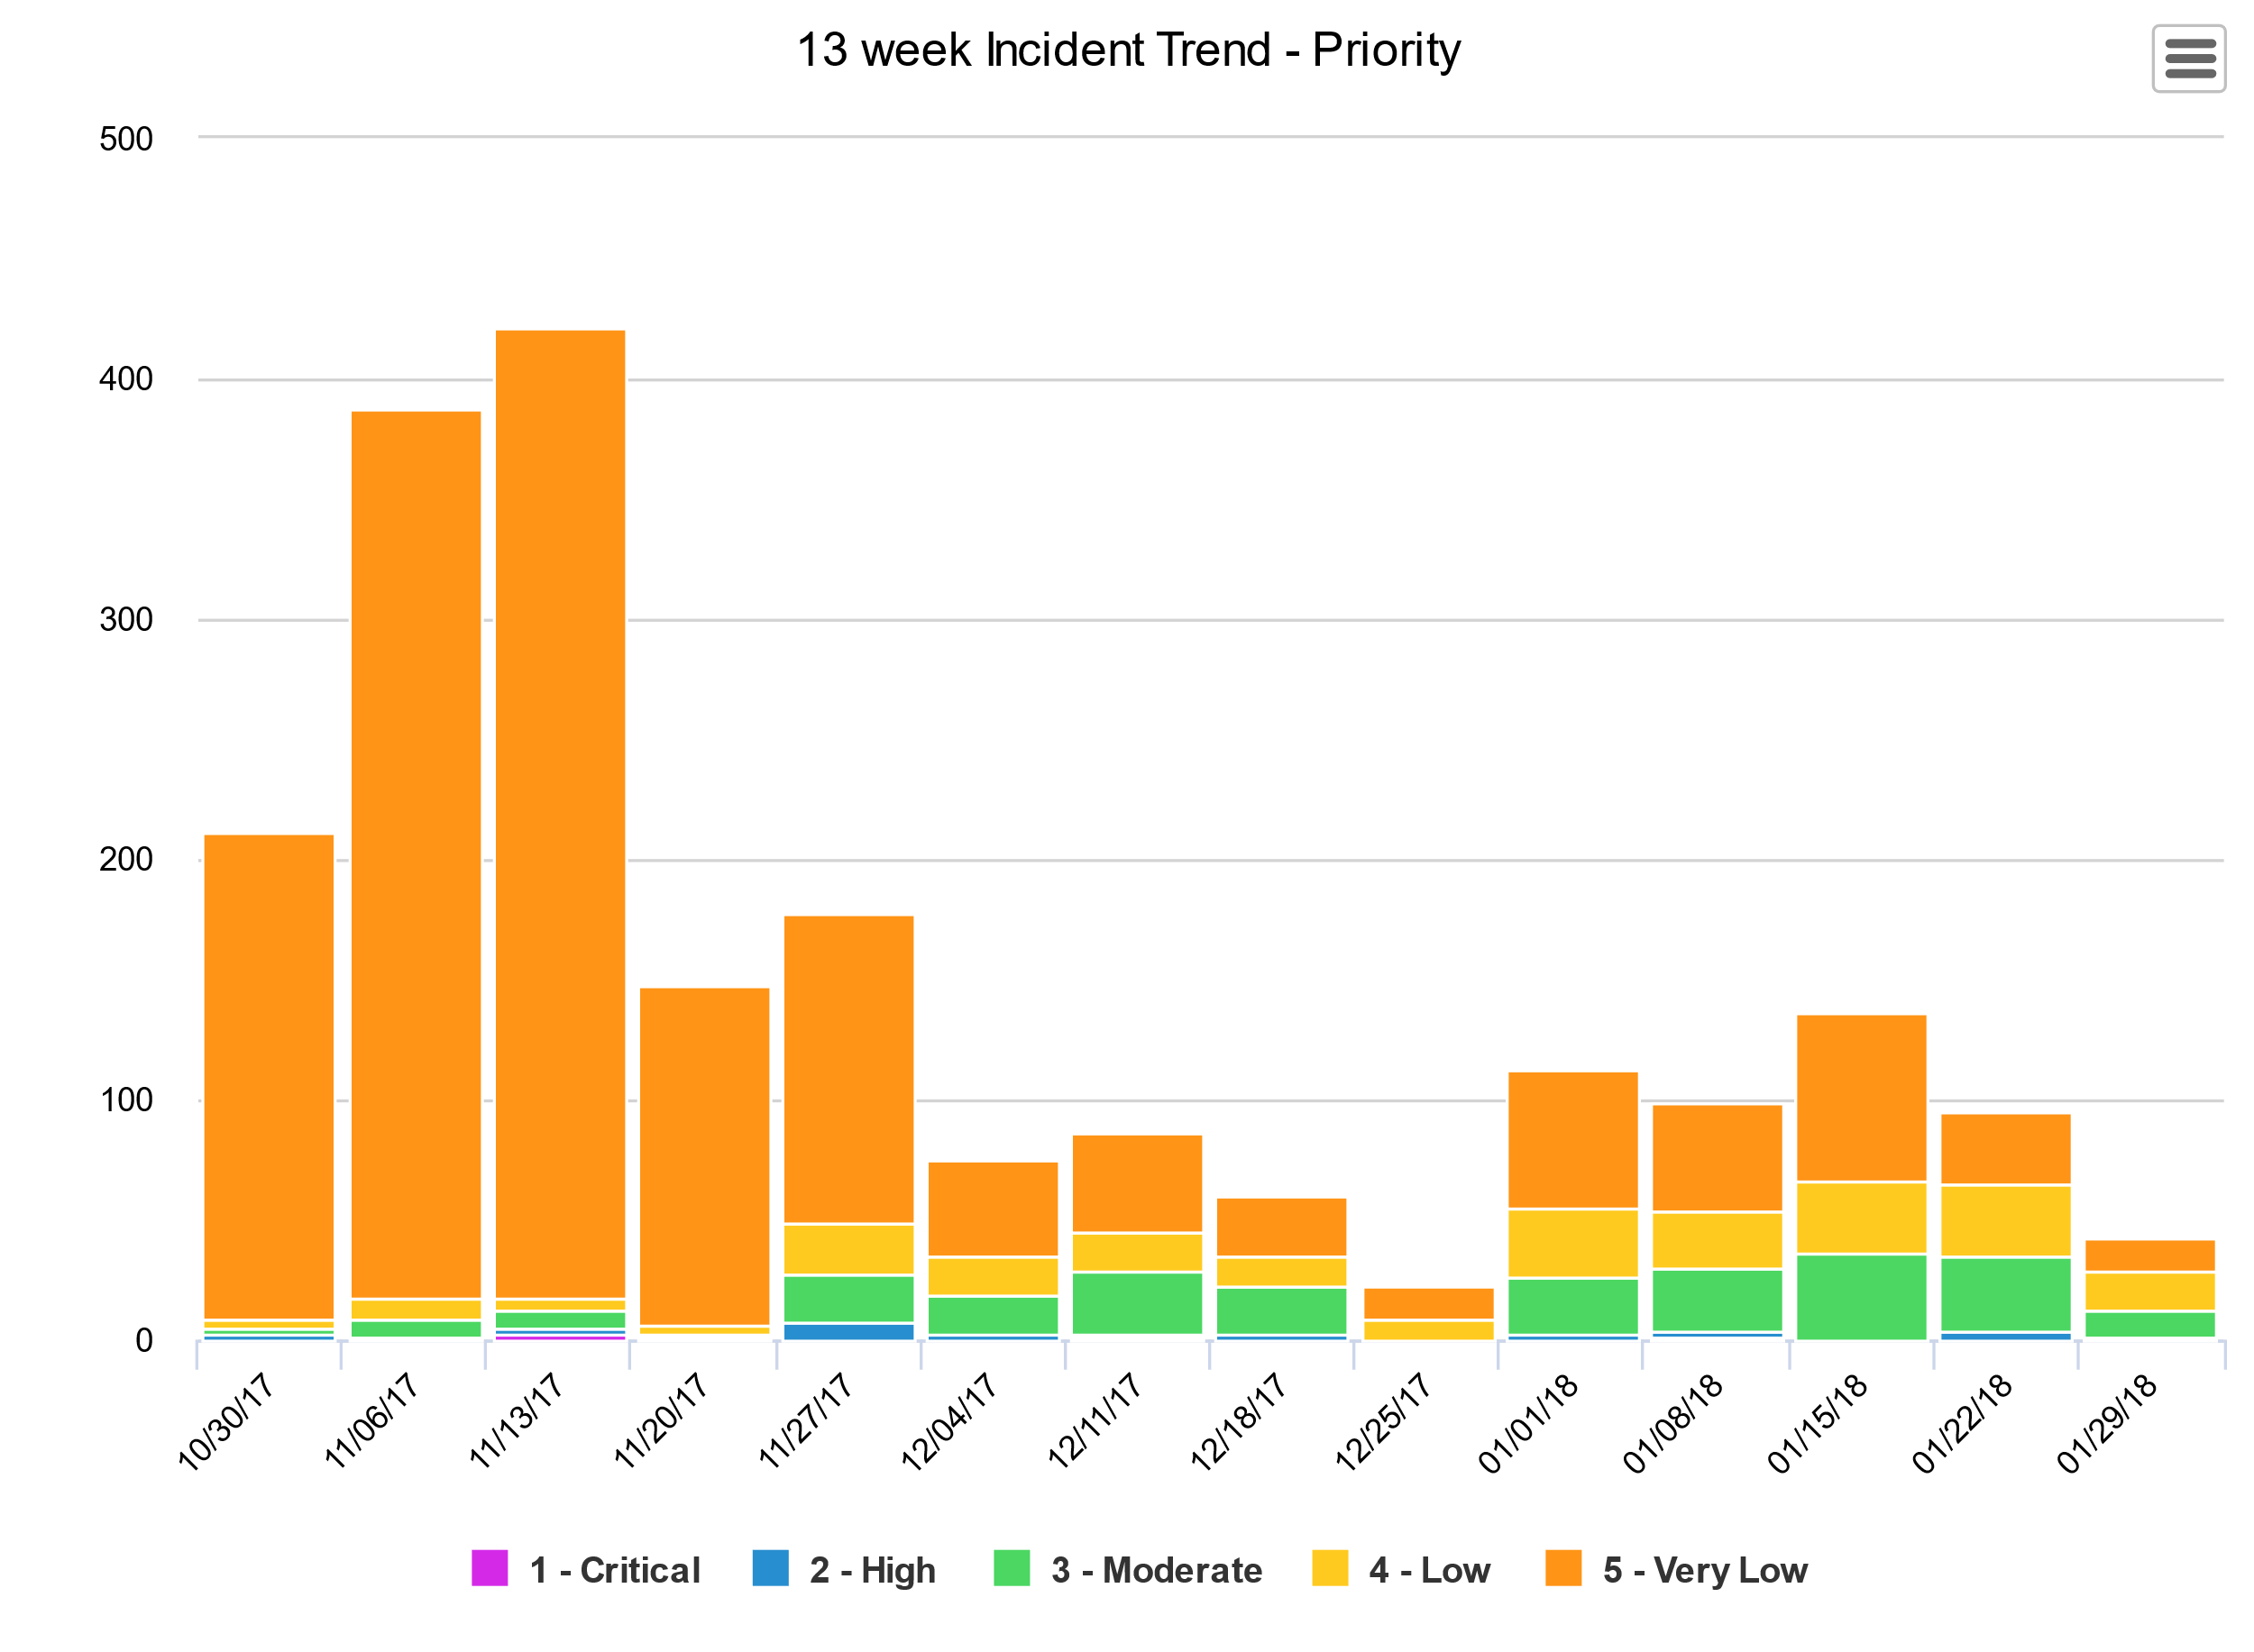
Since revising the Incident process, submitted Incidents have dropped 82%

Slide 13
What have we done?
Service Delivery and Support enhancements
Change Management processes
Blackout Dates - 2018 Change Blackout windows defined, available on the Self-Service Portal
Communications plans for Significant and Major Changes
Testing plans and User Sign-Off
Added Division of IT Process & Procedure Knowledge Base

Slide 14
What’s Coming Next?
Reporting Time in ServiceNow
Pinnacle Integration
Project & Enhancement
Improving Service definitions and Service Catalog
Ongoing Continual Service Improvement (CSI) and Communication efforts

Slide 15
What’s Coming Next?
Reporting Time in ServiceNow
The goal of reporting time in ServiceNow is to track the time we spend on Operational Work (Incident and Request) compared to Strategic Work (Projects and Enhancements)
Time Worked will be reported on the individual TASK level
SDS Program team will meet with area groups to determine appropriate time entry needs
This is not ITAMS

Slide 16
Pinnacle Integration
What’s Coming Next?
Integrating Pinnacle with ServiceNow for billing, asset management will be moved up in our roadmap
Integration will span over the course of multiple phases
Strategic resources needed for integration currently in planning stages
This is a new change and plans are still being made

Slide 17
What’s the Timeline?
Phase I – Mid-April 2018 (originally March 1)
Time Worked
Project & Enhancement
Ongoing CSI & Communication efforts
Pinnacle Requirements Gathering
Phase II – TBD
Still being planned
Pinnacle Integration with ServiceNow (continuing into Phase III)
Ongoing CSI & Communication efforts

Slide 18
Questions?
Let us know!

