Slide 1




Title of Project
[Your name here]
[Graduation with Leadership Distinction in PATHWAY]
Description
Conclusion
Beyond the Classroom (BTC) Experience
What were the most significant things you did, what was the role/commitment level, who else did you interact with (peers, colleagues, mentors), details on what this experience involved.
Analysis
What did you learn? Deeper understanding of yourself, others, your studies, or your future career aspirations, how did your understanding of a concept change your experience?
Describe the context of your BTC Experience here. Your role/title, where your BTC engagement took place (name and purpose of organization if appropriate). How long you spent. Why you got involved, etc.
How does this experience and learning impact your own decisions for the future? What guiding principles are you going to take with you in whatever you decide to do? Here is what I want to do for my future and why?
References/Acknowledgements
If necessary, provide a list of references that are relevant to your project.
This is also a good section to acknowledge anyone who was influential to your project.

Slide 2

Title of Project
[Your name here]
[Graduation with Leadership Distinction in PATHWAY]
Beyond the Classroom
Title of My Beyond the Classroom Describe the context of your BTC Experience here. Your role/title, where your BTC engagement took place (name and purpose of organization if appropriate). How long you spent. Why you got involved, etc.
Photo
Description
What were the most significant things you did, what was the role/commitment level, who else did you interact with (peers, colleagues, mentors), details on what this experience involved.
Photo
Analysis
What did you learn? Deeper understanding of yourself, others, your studies, or your future career aspirations, how did your understanding of a concept change your experience?
Photo
Conclusion
How does this experience and learning impact your own decisions for the future? What guiding principles are you going to take with you in whatever you decide to do? What do you want to do for your future and why?
This is also a good section to acknowledge anyone who was influential to your project.
Photo
Find out more information about me and my experiences at USC: www.eportfolios.com/andrewrsmith
arsmith@sc.edu

Slide 3

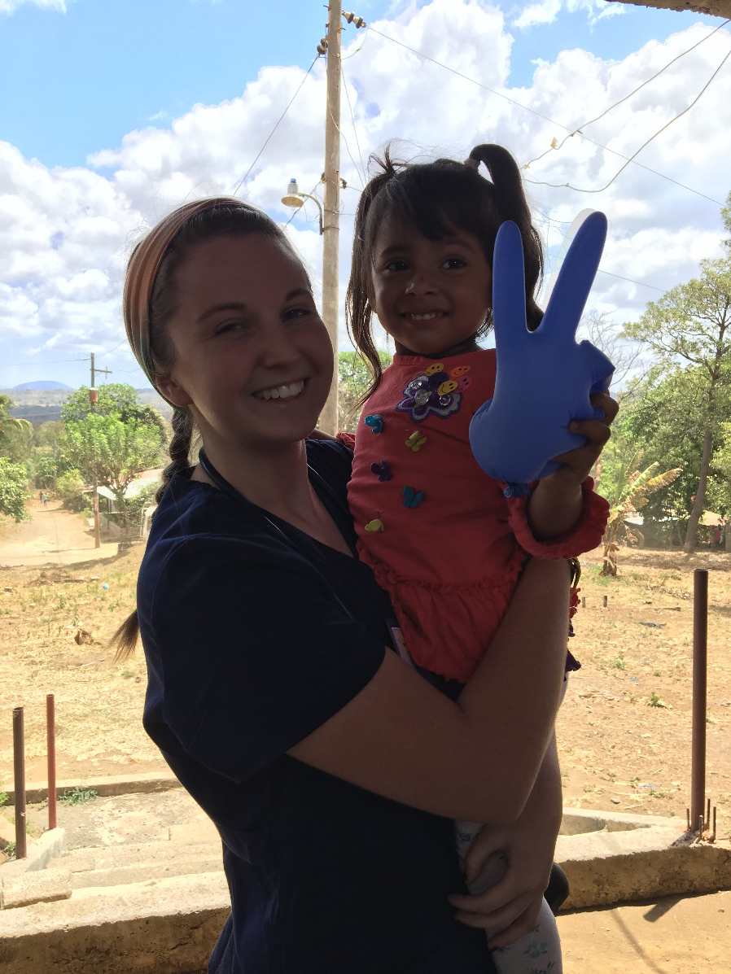
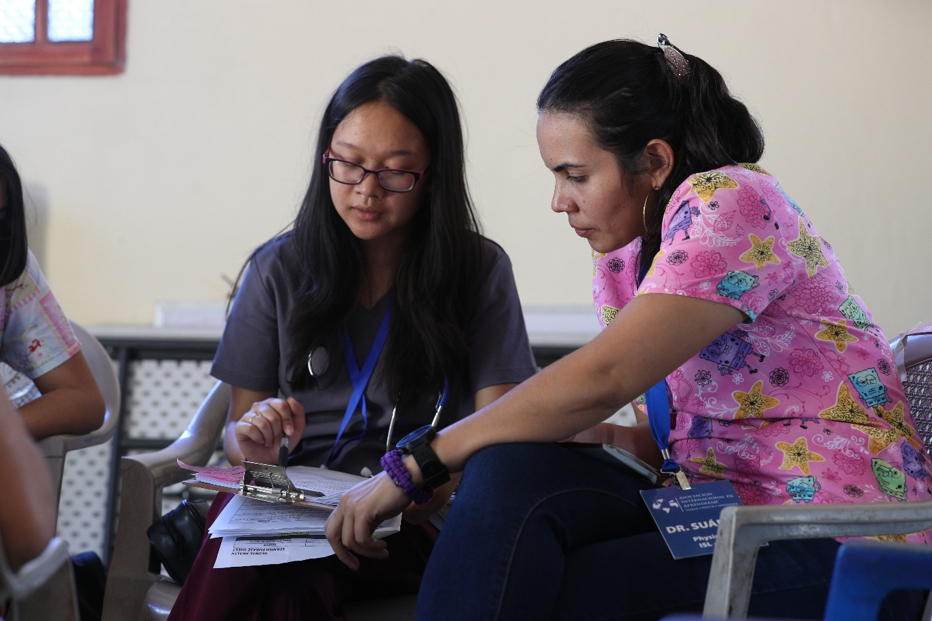

Title to Your Presentation
[Your name here]
Graduation with Leadership Distinction in [Pathway]
Beyond the Classroom
Describe the context of your BTC Experience here. Your role/title, where your BTC engagement took place (name and purpose of organization if appropriate). How long you spent. Why you got involved, etc.
Description
What were the most significant things you did, what was the role/commitment level, who else did you interact with (peers, colleagues, mentors), details on what this experience involved.
Analysis
What did you learn? Deeper understanding of yourself, others, your studies, or your future career aspirations, how did your understanding of a concept change your experience?
Conclusion
How does this experience and learning impact your own decisions for the future? What guiding principles are you going to take with you in whatever you decide to do? Here is what I want to do for my future and why?
View my ePortfolio here!

Slide 4
Title of Project
[Your name here]
[Graduation with Leadership Distinction in PATHWAY]
Beyond the Classroom
Describe the context of your BTC Experience here. Your role/title, where your BTC engagement took place (name and purpose of organization if appropriate). How long you spent. Why you got involved, etc.
Description
What were the most significant things you did, what was the role/commitment level, who else did you interact with (peers, colleagues, mentors), details on what this experience involved.
Analysis
What did you learn? Deeper understanding of yourself, others, your studies, or your future career aspirations, how did your understanding of a concept change your experience?
Conclusion
How does this experience and learning impact your own decisions for the future? What guiding principles are you going to take with you in whatever you decide to do? Here is what I want to do for my future and why?
View my ePortfolio here!

Slide 5
Title of Project
[Your name here]
[Graduation with Leadership Distinction in PATHWAY]
Include a QR code that leads to your ePortfolio, or project.
Main finding goes here, translated into plain English.
Emphasize the important words.
Analysis
What did you learn? Deeper understanding of yourself, others, your studies, or your future career aspirations, how did your understanding of a concept change your experience?
Beyond the Classroom
Title of My Beyond the Classroom Describe the context of your BTC Experience here. Your role/title, where your BTC engagement took place (name and purpose of organization if appropriate). How long you spent. Why you got involved, etc.
Conclusion
How does this experience and learning impact your own decisions for the future? What guiding principles are you going to take with you in whatever you decide to do? Here is what I want to do for my future and why?
Acknowledgements
This is also a good section to acknowledge anyone who was influential to your project.
Description
What were the most significant things you did, what was the role/commitment level, who else did you interact with (peers, colleagues, mentors), details on what this experience involved.

Slide 6


Title to Your Graduation with Leadership Distinction Presentation
[Your name here]
GLD in [Pathway]
Beyond the Classroom
Title of My Beyond the Classroom
Describe the context of your BTC Experience here. Your role/title, where your BTC engagement took place (name and purpose of organization if appropriate). How long you spent. Why you got involved, etc.
Analysis
What did you learn? Deeper understanding of yourself, others, your studies, or your future career aspirations, how did your understanding of a concept change your experience?
Main finding goes here, translated into plain English.
Emphasize the important words.
Main finding goes here, translated into plain English.
Emphasize the important words.
Conclusion
How does this experience and learning impact your own decisions for the future? What guiding principles are you going to take with you in whatever you decide to do? Here is what I want to do for my future and why?
Acknowledgements
This is also a good section to acknowledge anyone who was influential to your project.
Description
What were the most significant things you did, what was the role/commitment level, who else did you interact with (peers, colleagues, mentors), details on what this experience involved.
Insert small logos or graphics for emphasis.
Generate QR codes here:
https://www.qrcode-monkey.com/

Slide 7


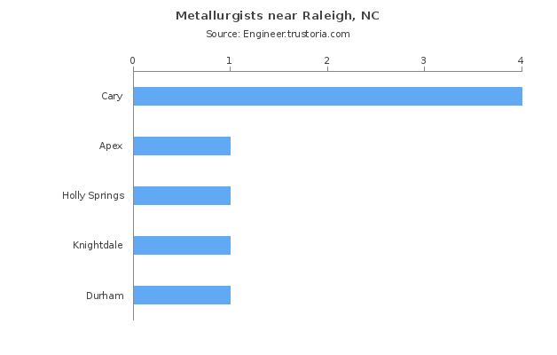
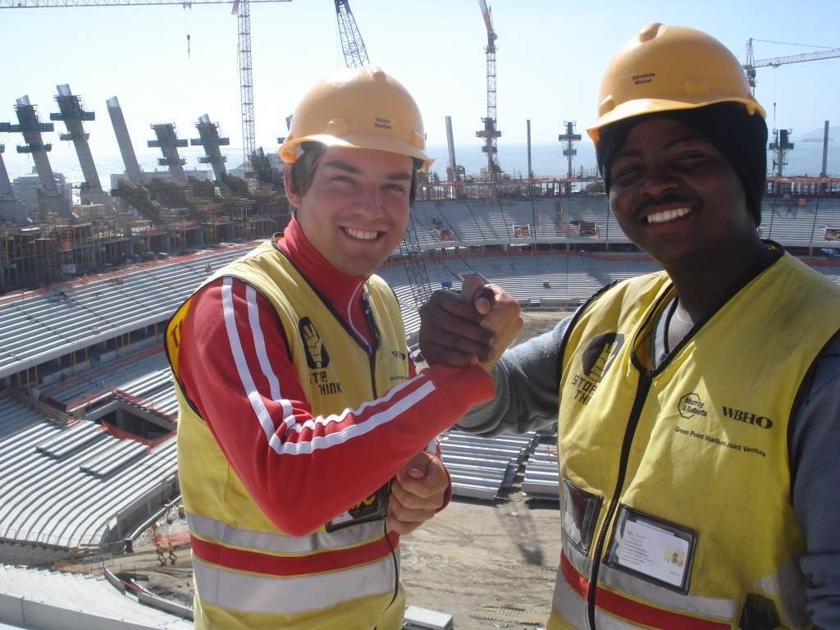
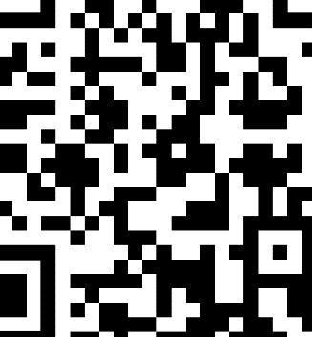
Title of Project
[Your name here] | [Graduation with Leadership Distinction in PATHWAY]
_____________________________________________________
Beyond the Classroom
Describe the context of your BTC Experience here. Your role/title, when and where your BTC engagement took place (name and purpose of organization if appropriate). How long you spent. Why you got involved, etc.
Analysis
What did you learn? Deeper understanding of yourself, others, your studies, or your future career aspirations, how did your understanding of a concept change your experience?
Description
What were the most significant things you did, what was the role/commitment level, who else did you interact with (peers, colleagues, mentors), details on what this experience involved.
Conclusion
How does this experience and learning impact your own decisions for the future? What guiding principles are you going to take with you in whatever you decide to do? What do you want to do for your future and why?
References & Acknowledgements
If necessary, provide a list of references that are relevant to your project.
This is also a good section to acknowledge anyone who was influential to your project.
View my ePortfolio here!

Slide 8
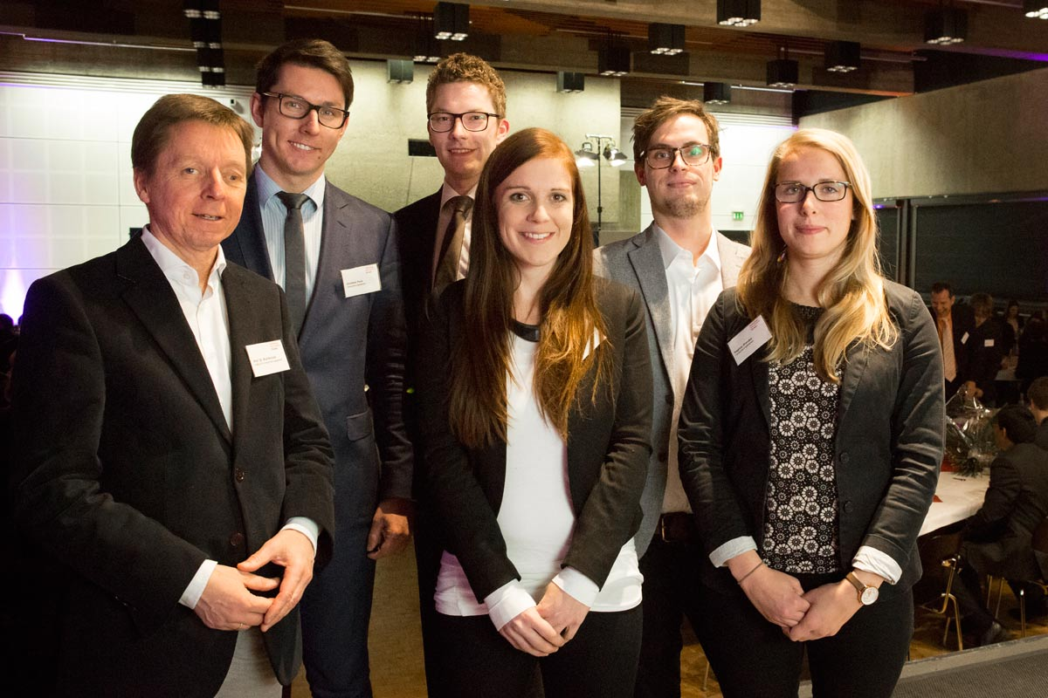
Title goes here; make it small if you need to free up space.
[Your name here] | [GLD in PATHWAY]
Customizing Your Poster Size
Create a vertical poster by customizing your slide size.
To set a custom size:
Select ‘Design’ in the ribbon.
Choose ‘Slide Size’ in the Customize section.
Select “Custom Slide Size…”
The width of your poster should be no larger than 42”. The height should be no larger than 48”
NOTE: Larger posters cost more. The minimum 24” height and 36” length will be your best value.
Beyond the Classroom
Title of My Beyond the Classroom Describe the context of your BTC Experience here. Your role/title, where your BTC engagement took place (name and purpose of organization if appropriate). How long you spent. Why you got involved, etc.
Description
What were the most significant things you did, what was the role/commitment level, who else did you interact with (peers, colleagues, mentors), details on what this experience involved.
Analysis
What did you learn? Deeper understanding of yourself, others, your studies, or your future career aspirations, how did your understanding of a concept change your experience?
Main finding goes here, translated into plain English. Emphasize the important words.
Maximum height is 48”
Conclusion
How does this experience and learning impact your own decisions for the future? What guiding principles are you going to take with you in whatever you decide to do? Here is what I want to do for my future and why?
This is also a good section to acknowledge anyone who was influential to your project.
Find out more information about me and my experiences at USC
Poster is still 36” wide, but now taller for more space.

