Slide 1
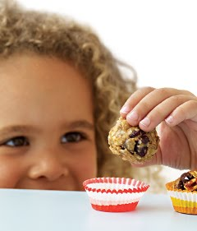
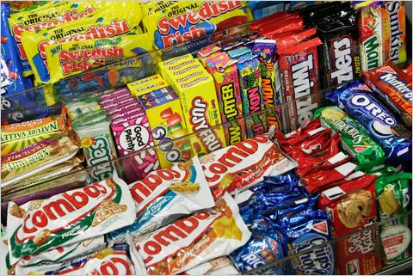
Integrating card-sort and qualitative interview methods to understand parents’ child-snack schemas
Christine E. Blake
Jennifer O. Fisher
Nicolas Younginer
Alex Orloski
Rachel Blaine
Heather Hamtil
Yasmeen Bruxton
Kirsten K. Davison
Funded by: NIH NICHD R21 HD074554

Slide 2
Background
Childhood obesity has increase over past decades
Corresponds to an increase in frequency and quantity of snacks
Especially high Solid Fats and Added Sugars (SoFAS)
Unhealthy snacking a potential contributor to excessive energy intake in children
Especially among low SES children
Parents’ snack schemas and practices likely play a strong role in child snacking behaviors

Slide 3
Schema theory
Mental representations of concepts that are constructed and shaped through experience
Consist of knowledge, attitudes, beliefs
Vary in complexity
Can have abstract and concrete elements
Are influenced by culture and upbringing
Are dynamic in nature
Schank and Abelson, 1977; Baldwin, 1992; Nishida, 1999; Holmberg and MacKenzie, 2002
Notes:
So… remember schema theory in general is …

Slide 4
Parenting around snacking
Unhealthy or negative effects on snacking
Overt control¹
Instrumental and emotional feeding²
Psychological control³
Healthy or positive effects on snacking
Encouragement²
Covert control¹
Behavioral control³
¹ Ogden, Reynolds, Smith, Appetite, 2006; ²Rodenburg et al., Public Health Nutr, 2013; ³Rodenburg et al., Appetite 2012

Slide 5
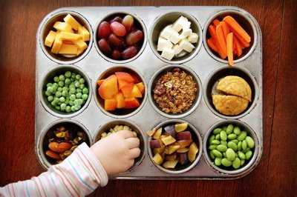
Study Purpose
This study used of a novel mixed-methods approach drawing on cognitive schema theory to gain a conceptual understanding of child snacking from parents’ perspectives.

Slide 6
Methods: Data collection
Sixty low-income parents of children aged 3-5
17 White
23 Black
20 Hispanic
Qualitative in-depth interviews integrated with card-sorting tasks (~60 minutes)
Audio-recorded and transcribed verbatim
Spanish interviews translated and verified
Card sort data managed using Excel spreadsheets

Slide 7
Interview Process
Define snack:
“When I say the word snack what do you think of?”
1st Card sort to identify what foods are snacks vs not
Determine snack purpose:
2nd Card sort to identify snacks goals
Questions to assess what, how much, why and when
Determine snack context:
3rd Card sort to identify snacks for different contexts
Questions to assess people, places, and situations
4th Card sort to determine frequency of child’s snack food consumption

Slide 8
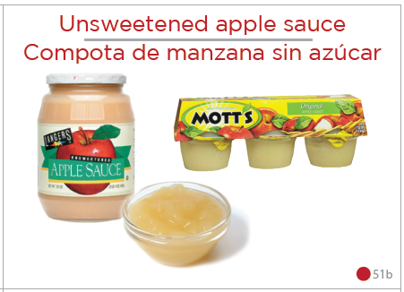
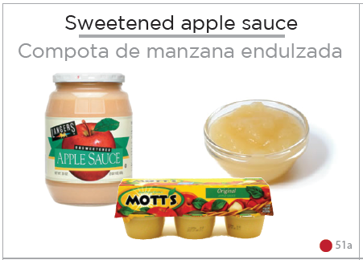
Cards
Derived from dietary intake data of a multiethnic sample of ~250 Children
Depicted 65 typical preschooler snacks
29 double sided with high versus low SoFAS versions of the same foods
Varied in SoFAS (Solid Fats Added Sugars) content
Included foods and beverages
Included text in English and Spanish

Slide 9
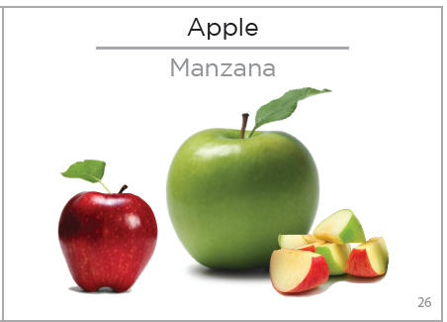
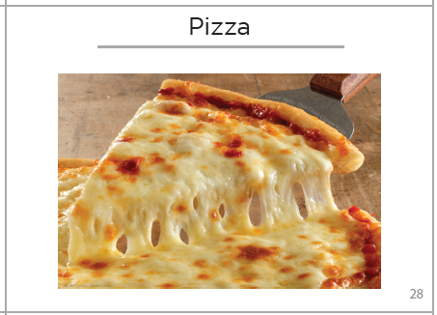

Slide 10
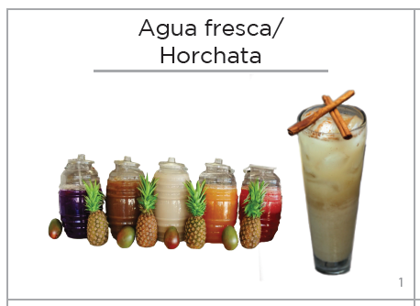

Slide 11
Analysis
Thematic coding of transcripts separately for snack…
Definitions
Contexts
Purposes
Practices
Card sort labels summarized to identify predominant contexts and purpose categories
Card-sort data matrices analyzed for similarities in snack items assigned to each category
Calculation of mean SoFAS values per category
Results compared across racial-ethnic groups

Slide 12
Results: Dimensions of Snack Definition
Time
Proximity to meal
Time of day
Preparation time
Time required to eat (e.g. something quick to eat)
Environment
Location in house
Outside of house
Food’s performance in different environments (e.g. versatility or transportability)
Nutrition/ healthiness
Healthy
Not healthy
Junkfood
Satiety
Fill you up
Not fill you up
Tide/hold over
Size
Size of portion
Size of food
Foods
Types of foods
Qualities of foods (e.g carbs, sugar, high calorie)

Slide 13
Snack Contexts
White (n=17) | #P | Black ( n=23) | # P | Hispanic (n=20) | #P
Home | 13 | Home | 19 | Home | 20
Out/car | 9 | Out/car | 14 | Out/car | 12
Recreational activities | 8 | Grandparent | 10 | School/daycare | 11
School/daycare | 8 | School/daycare | 10 | Recreational activity | 9
Other family/friends | 6 | Other family/friends | 8 | Other family/friends | 8
Grandparent | 1 | Recreational activities | 6 | Grandparent | 6
 |  | Doctor | 2 | Restaurant | 3
 |  | Restaurant | 2 | Doctor | 3
 |  | Dad | 2 | Church | 1
 |  |  |  | Dad | 1
#P= number of participants
Notes:
Parents reported a wide range of snacking contexts (e.g. home, car, doctor’s offices etc.) that varied in the types of snacks offered and practices employed.
Main contexts are home, out/car, school/daycare, recreational activities, grandparent (AA and H), other/family, friends

Slide 14
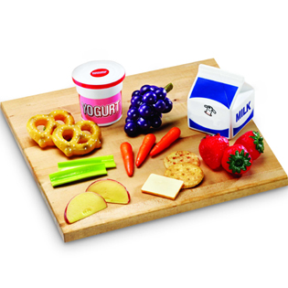
Snack foods by context
Moderate agreement for snacks given at home (66%)
Highest SoFAS contexts:
Restaurant (B and H)
Other family/friends (B and H),
Recreational activities (W and H)
Grandparent (H and W)
Lowest SoFAS contexts:
School/daycare (B and W)
Out/car (W and H)
Church and Dad (H)
Recreational (B)

Slide 15
Snack Purposes
White (n=17) | #P | Black (n=23) | #P | Hispanic (n=20) | #P
Hungry or thirsty | 7 | Reward | 15 | Child asks-wants it-craves-tv | 13
Health | 6 | Hold over | 11 | Reward | 11
Child asks-wants it-craves-tv | 6 | Child asks-wants it-craves | 9 | Holdover | 9
Distraction-bribe-stop or prevent bad behavior | 5 | Distraction-bribe-stop or prevent bad behavior | 7 | Hungry or thirsty | 7
Treat | 5 | Hungry or thirsty | 7 | Routine | 8
Routine | 4 | Out | 6 | Playing-social activity | 4
Special event/ occasion | 4 | Routine | 3 | Health | 4
Playing-social activity | 4 | Playing-social activity | 3 | Special event/ occasion | 3
Hold over | 2 | Special event/ occasion | 3 | Distraction-bribe-stop or prevent bad behavior | 2
Reward | 2 | Treat | 3
#P= number of participants
Notes:
A unique- out, health least mentioned
H unique- craves for child asks, distraction least mentioned
W unique – social activity, treat, reward least mentioned, low on holdover

Slide 16
Snack foods by purpose
Very low agreement within and across groups for foods included in almost all purpose categories. (0-20%)
Moderate level of agreement among white parents for snacks given for hunger/thirst (37%) and treat (39%)
Highest SoFAS categories:
Treat
Reward
Holdover (H)
Special event/occasion (W)
Lowest SoFAS categories:
Health
Routine
Hungry or thirsty
Holdover (W)

Slide 17
Snack-Related Feeding Practices
Uninvolved/no monitoring
No Rules
Feeding in response to social context
Feeding in response to physical context
Food is love
Permissive
Reward behavior
Behavioral management
Keep child quiet or occupy
Parent-driven feeding
Parent Surveillance
Restricted accessibility of snacks
Pressure to eat
Fear based reasoning
Coercive Control
Structure
Availability of healthy food
Accessibility of healthy food
Limit setting
Monitoring
Planning and Routines
Autonomy Support
Parent role modeling
Assisted Learning
Responsive feeding
Praise and encouragement

Slide 18
Conclusions
Findings provide insight into parents’ child snack definitions, contexts, purposes, and practices
Integrating card sorting with qualitative interviewing provided a holistic understanding of parents’ concepts of child snacking that is important for development of successful healthy snacking promotion efforts.
Efforts currently underway to develop a quantitative survey instrument to assess snack-related feeding practices

