Slide 1
Fat or Low-fat?
Anwar T. Merchant ScD, MPH, DMD
Department of Epidemiology and Biostatistics

Slide 2
Do you know?
The decline in heart disease in the US from 1981-2000 was
77% due to new medical treatment, 19% lifestyle, 4% unknown.
35% due to new medical treatment, 54% lifestyle, 11% unknown
47% due to new medical treatment, 44% lifestyle, 9% unknown
Low fat diet reduces heart disease by
60%
30%
15%
Not at all

Slide 3
Do you know?
What percent of heart disease can be prevented by eating a healthy diet, exercising regularly, and not smoking?
54%
32%
24%
What percent of health professionals follow this advice?
65%
31%
13%

Slide 4
Substitute 1% energy from carbohydrate with equivalent saturated fat
Mensink RP, Zock PL, Kester AD, Katan MB. Effects of dietary fatty acids and carbohydrates on the ratio of serum total to HDL cholesterol and on serum lipids and apolipoproteins: a meta-analysis of 60 controlled trials. Am J Clin Nutr. 2003 May;77(5):1146-55.

Slide 5
Substitute 1% energy from carbohydrate with equivalent monounsaturated fat
Mensink RP, Zock PL, Kester AD, Katan MB. Effects of dietary fatty acids and carbohydrates on the ratio of serum total to HDL cholesterol and on serum lipids and apolipoproteins: a meta-analysis of 60 controlled trials. Am J Clin Nutr. 2003 May;77(5):1146-55.

Slide 6
Substitute 1% energy from carbohydrate with equivalent polyunsaturated fat
Mensink RP, Zock PL, Kester AD, Katan MB. Effects of dietary fatty acids and carbohydrates on the ratio of serum total to HDL cholesterol and on serum lipids and apolipoproteins: a meta-analysis of 60 controlled trials. Am J Clin Nutr. 2003 May;77(5):1146-55.

Slide 7
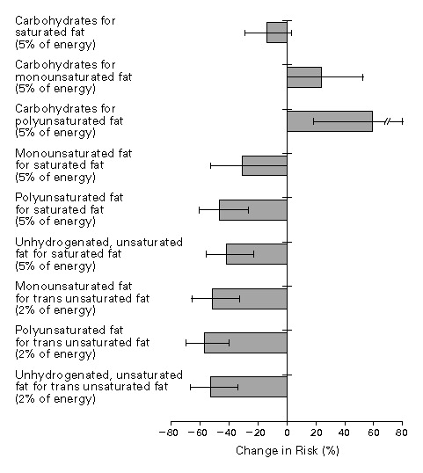
Hu FB et al. N Engl J Med 1997;337:1491-1499.
Estimated Percent Changes in the Risk of Coronary Heart Disease Associated with Isocaloric Substitutions of One Dietary Component for Another.
Notes:
Figure 2. Estimated Percent Changes in the Risk of Coronary Heart Disease Associated with Isocaloric Substitutions of One Dietary Component for Another. The I bars represent 95 percent confidence intervals.

Slide 9
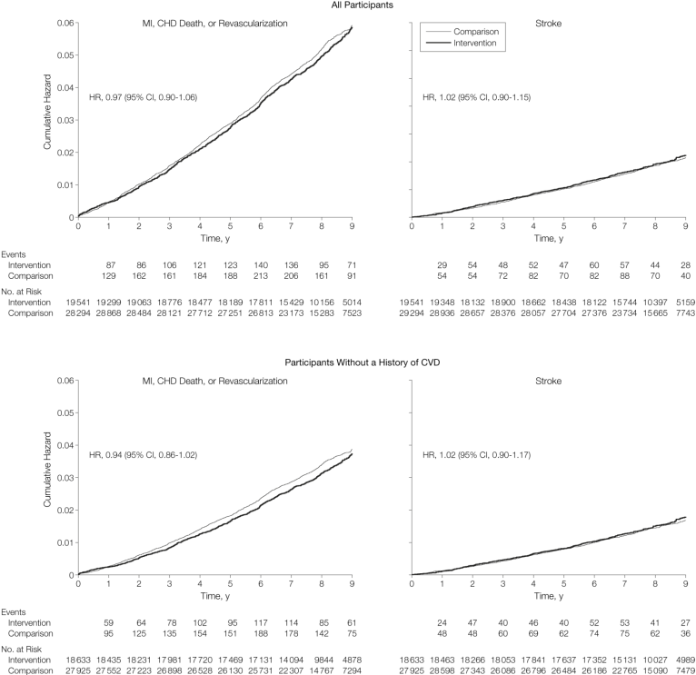
From: Low-Fat Dietary Pattern and Risk of Cardiovascular Disease: The Women's Health Initiative Randomized Controlled Dietary Modification Trial
JAMA. 2006;295(6):655-666. doi:10.1001/jama.295.6.655
Figure Legend:
CHD indicates coronary heart disease; CI, confidence interval; HR, hazard ratio; MI, myocardial infarction.
Date of download: 4/16/2013
Copyright © 2012 American Medical Association. All rights reserved.

Slide 10
PREDIMED study
7447 men and women at high risk of CVD (diabetes or at least 3 risk factors)
3 groups: 2 Mediterranean diets – olive oil and nuts – and control (low-fat diet)
Intervention: dietary advice at baseline and quarterly thereafter
Midway control group also received dietary advice about low-fat diet at the same frequency
No restriction on caloric intake or physical activity

Slide 11
PREDIMED study: diet after 12 months
Zazpe et al J Am Diet Assoc. 2008 Jul;108(7):1134-44;

Slide 12
Change in % energy Mediterranean (olive oil) vs control
Zazpe et al J Am Diet Assoc. 2008 Jul;108(7):1134-44;

Slide 13
Change in % energy Mediterranean (nut) vs control
Zazpe et al J Am Diet Assoc. 2008 Jul;108(7):1134-44;

Slide 14
Effect of intervention at 12 months, PREDIMED
Zazpe et al J Am Diet Assoc. 2008 Jul;108(7):1134-44;

Slide 15
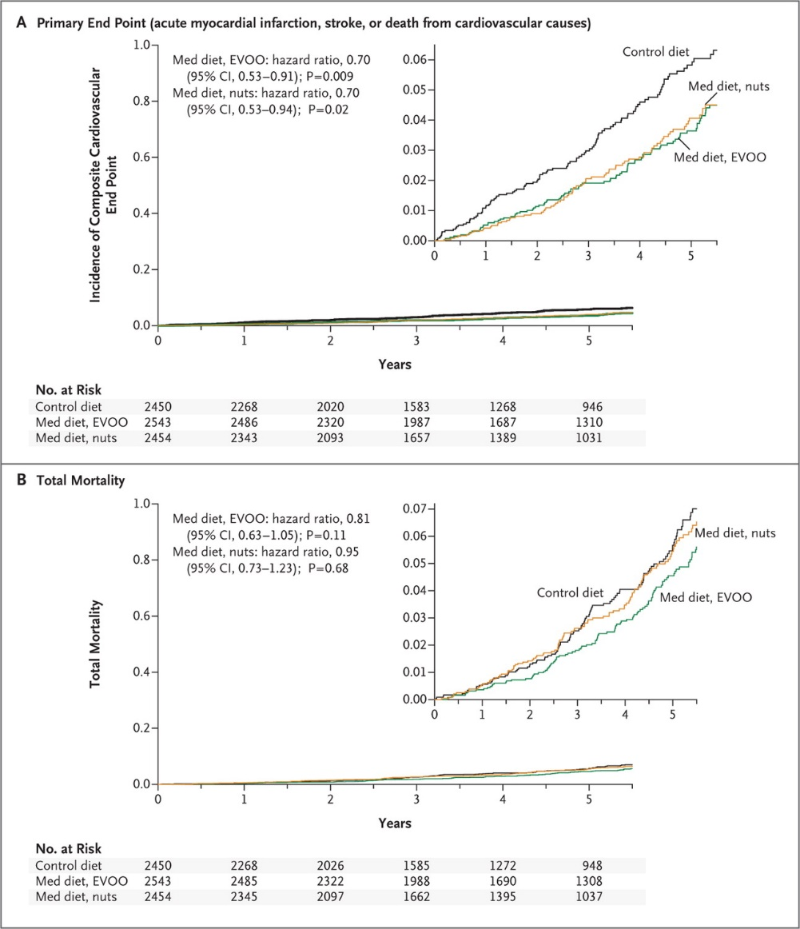
Estruch R et al. N Engl J Med 2013;368:1279-1290.
Kaplan–Meier Estimates of the Incidence of Outcome Events in the Total Study Population.
Notes:
Figure 1. Kaplan–Meier Estimates of the Incidence of Outcome Events in the Total Study Population. Panel A shows the incidence of the primary end point (a composite of acute myocardial infarction, stroke, and death from cardiovascular causes), and Panel B shows total mortality. Hazard ratios were stratified according to center (Cox model with robust variance estimators). CI denotes confidence interval, EVOO extra-virgin olive oil, and Med Mediterranean.

Slide 16
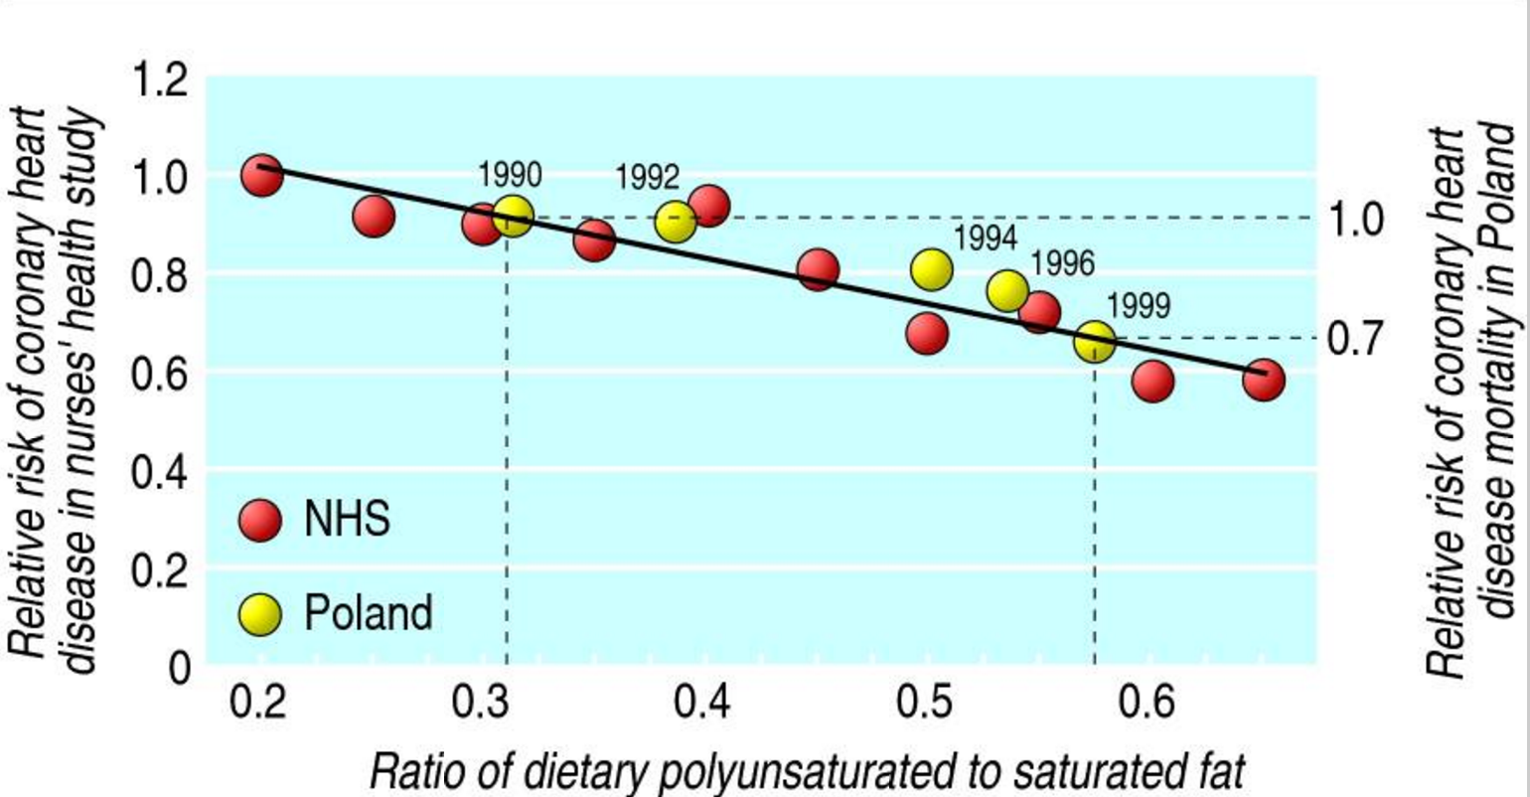

Slide 17
CVD trends in Finland
Energy from saturated fat: 22% to 13%
Polyunsaturated fat
Fruits and vegetables
Salt
Smoking
Vartiainen et al

Slide 18
Fig 2 Summary most adjusted relative risks for saturated fat intake and all cause mortality, CHD mortality, CVD mortality, total CHD, ischemic stroke, and type 2 diabetes.
Russell J de Souza et al. BMJ 2015;351:bmj.h3978
©2015 by British Medical Journal Publishing Group
Notes:
Fig 2 Summary most adjusted relative risks for saturated fat intake and all cause mortality, CHD mortality, CVD mortality, total CHD, ischemic stroke, and type 2 diabetes. All effect estimates are from random effects analyses. P value is for Z test of no overall association between exposure and outcome; P_{het} is for test of no differences in association measure among studies; I² is proportion of total variation in study estimates from heterogeneity rather than sampling error

Slide 19
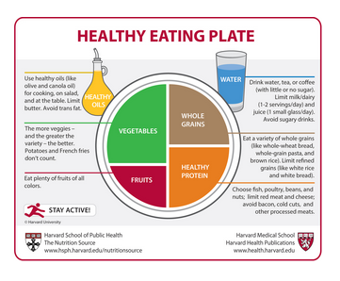
Summary

