Slide 1
Key Findings from the Midlands Farmer Survey
77% of farmers are interested in selling through outlets they do not currently use.
88% of farmers were not GAP certified, with many not knowing what GAP was.
62% of farmers surveyed are Certified SC Grown. Other than 'Word of Mouth', Certified SC Grown was the #1 way that farmers marketed themselves.
Over the past 5 years.....
50% of farmers have seen their profits increase.
67% of farmers have seen an increase in their number of customers.
58% of farmers have increased their production.
Notes:
The Midlands Farmer Survey was conducted from fall 2013 through summer 2014. The lack of comprehensive farm lists in the region was a hurdle to gathering data and communicating with farmers. The initial survey of local, food-producing farmers indicated that many farmers are not regularly communicating with each other, potential customers, or agricultural organizations. 77% of Midlands food-producing farmers were interested in connecting with more customers and selling through outlets they do not currently use. Food literacy is a hurdle for these farmers' potential customers with many consumers not knowing what a food system is or where to buy food locally. Sustainable Midlands’ Midlands Food Alliance formed September 2014 from motivated farmers, distributors, consumers and chefs who want to solve this problem.

Slide 2
The Mission of the Midlands Food Alliance is to advocate and educate for an equitable, sustainable, localized food system in the Midlands of South Carolina.

Slide 3
-Developed a Print and Digital Local Farm and Food Guide
-Organized Potlucks in regions throughout the Midlands to bring together farmers, chefs, and eaters who care about supporting local food production
-Represented Midlands farmers at agriculture and planning meetings in South Carolina
-Was awarded a Farmers' Market and Local Food Promotion Program titled
Bridging the Gap: Consumers and Farmers to assist the group in mapping the Midlands food system, supporting agritourism efforts through coordinating and hosting a farm tour, and starting a Local Food campaign.
Notes:
The group is organizing the Midlands Farm Tour to build a base of local food supporters while stewarding connections between farmers, food entrepreneurs, agencies, and Midlands consumers. The goals are to educate the public on the existence of and accessibility to our local food producers and to promote these farms to customers they have not yet reached. The first tour is set to take place May 21st of 2016 and continue annually as a major marketing and promotional opportunity for farms.
According to South Carolina Department of Agriculture’s Making Small Farms Into Big Business report, the key to supporting the expansion of food producing farms “will be building loyalty among South Carolina consumers at the household level to purchasing locally grown products. One key to ensuring consumer loyalty to South Carolina products is to ensure that each ultimate consumer can identify the farm where the food they buy was produced.” The Midlands Farm Tour will be a tool for the Midlands Food Alliance to build a larger, loyal customer base for our food producing farmers. The tour will be used as a tool to connect local producers with chefs, retailers, distributors, schools, government agencies that work with farmers on a regular basis, and with each other.
The report further stated that “the potential impact if every South Carolina resident purchased $5 of food each week directly from a farmer in the state would be about $1.2 billion”, yet “many farmers selling direct to state consumers report that they have to explain to their customers what a carrot looks like when it comes out of the field, since many have never seen one before.” The Midlands Farm Tour will educate Midlands consumers about their food system with the goal of keeping more food dollars in our region and our state. According to the USDA, in South Carolina’s food deserts and Low Supermarket Access Areas, there are over $300 million in grocery store leakage, or money spent on groceries outside of these communities annually. Our area includes twenty level 1 and 2 food deserts. Midlands Farm Tour participants will be asked to sign a pledge committing $10.00 of their weekly food budget directly to local food-producing farms. Pledge commitments are considered upheld through purchases made at farmers markets, directly from the farm, or from local markets carrying a farm’s product.
The Local Food Pledge Campaign that coincides with the Midlands Farm Tour is: Do you agree we all should build a food system that provides a sustainable living for farmers and farm-workers, where all residents have access to healthy and affordable food, and our natural resources are valued?
Then SIGN the LOCAL FOOD PLEDGE: I pledge to spend at least $10 weekly on foods produced in South Carolina and support my county and city leadership in prioritizing local food production.

Slide 4
“Food Policy Councils foster communication and civic action at the grassroots. They’re a chance for people to shape, from the bottom up, the nature of a system that can seem distant and bewildering, even as it affects so much of their lives. Achieving food democracy and social justice is a key part of any food policy council’s mission.” - Doing Food Policy Councils Right: A Guide to Development and Action by Michael Burgan and Mark Winne

Slide 5
Building Capacity through Community Organizing Certificate Program
Benedict College’s Social Work Field Preparation Course
PASOs
Notes:
This certificate program is designed to bring diverse groups of people together to identify organizing opportunities and develop strategies collectively to transform food systems through community organizing and advocacy.

Slide 6
Building Capacity through Community Organizing Certificate Program
Session Topics
Uncovering Our Values: Introduction
Picture This
Community Organizing 101
Creating Healthy Communities through Advocacy
Messaging & Framing Your Campaign
Strategizing vs. Planning
Notes:
Uncovering Our Values: Introduction
Participants will discover, reflect, clarify and articulate the commonly held values of the community group and gain a deeper understanding of the implications of the mission and vision statements of their work.
Picture This
Participants will spend 1 week taking photos of their food system. Participants will identify opportunities for improvement and reach consensus on next steps for working collectively towards food systems change in their community.
Community Organizing 101
This training will provide participants with a framework for understanding the basic principles of community organizing and how these methods can be used to create food systems change and build the capacity of their coalition.
Creating Healthy Communities through Advocacy
This training is designed to help build the capacity of community groups to engage in effective local and state advocacy around food systems change and other issues in which their community is involved.
Messaging & Framing Your Campaign
Participants will understand how issues are being portrayed in the media and learn about the benefits of creating change through messaging during campaigns using collective action framing.
Strategizing vs. Planning
Participants will understand the difference between a plan and a strategy.

Slide 7
Year 4 BCCO Participants
55 Participants across 4 groups
Benedict College Department of Social Work Field Preparation Course
Campaign: Creating a Campus Food Pantry
PASOs @ Arnold School of Public Health
Campaign: Flood Recovery/Victim Assistance
Campaign: 5, 2,1,0
USC College of Social Work Advocacy for Social and Economic Justice Course
Campaign: Food Insecurity in SC
Summer Feeding Program in Sumter, SC
Allen University Department of English Food Justice and Food Futures Course
Campaign: AU I Rise Organic Community Garden

Slide 8
The Organic Helpers
MISSION: The Organic Helpers fight for change in our local food system while creating social change within our communities. VISION: To create a food system where all future generations experience and value fresh, local, and organic fruits, vegetables, and meats.
Campaigns
Community Kitchen
Community Garden
Safe Routes to Chester High School
Safe Neighborhoods
https://vimeo.com/147356708

Slide 9
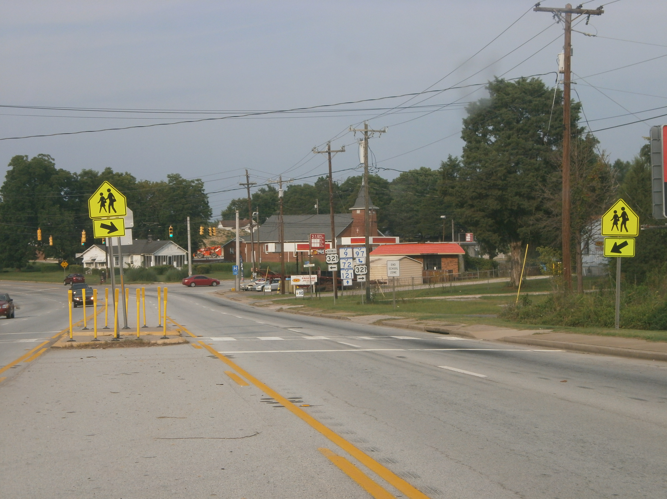
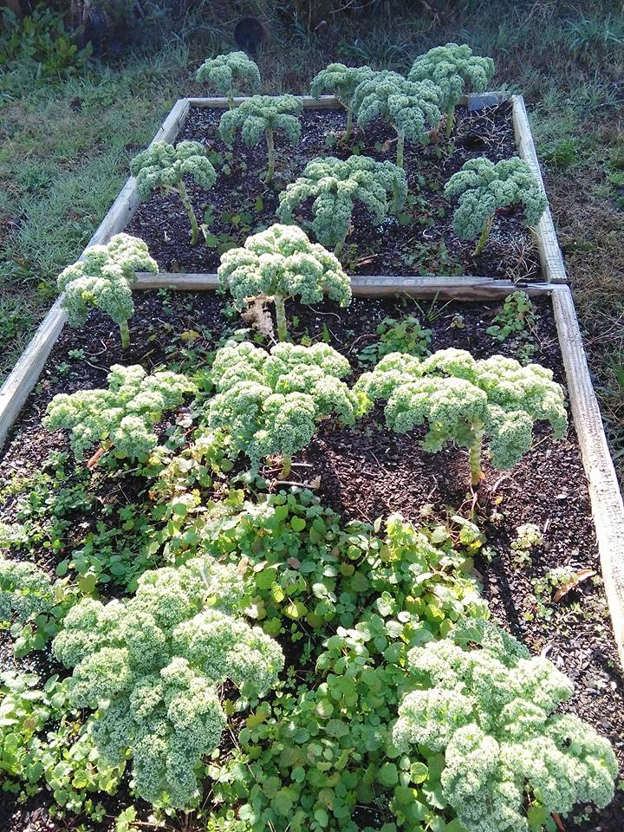
The Organic Helpers
RESULTS OF SAFE ROUTES CAMPAIGN
Partnership was formed between city government, community organizations, community members, and faith based organizations
Sidewalk development
Lower speed limits near student crossing areas and the school
Addition of speed bumps near school crosswalks and bus stop pickup locations
Improvement of lighting along walking routes
RESULTS FROM COMMUNITY GARDEN
Garden formed through a partnership between local government, faith-based, organizations, and community-based organizations
16 raised beds have been built
Weekly donations from the harvest are provided to the local food pantry where 30 families (between 50-75 individuals) are served

Slide 10
End Child Hunger SC
Mission: To build awareness, increase community capacity, and create a coordinated effort to address child hunger in South Carolina.
Campaigns:
Improve the Summer Food Service Program in the Midlands
Increase Afterschool Program Sites
Encourage more qualifying schools to opt-in into Community Eligibility Provision (C.E.P.)

Slide 11
Recommendations from the Midlands Summer Food Service Program Interviews
To provide more activities and programming for summer food service program sites to create a more fun experience for youth.
To develop a system that transports meals to sites if sponsors do not have the capacity to deliver meals to sites.
To increase the number of sites located in neighborhoods and/or use transportation to take youth to sites.
To enhance outreach efforts of the program that take advantage of traditional and non-traditional methods to increase the amount of parents and caregivers that are aware about the program.

Slide 12
End Childhood Hunger SC Week October 25-31, 2015

