Slide 1
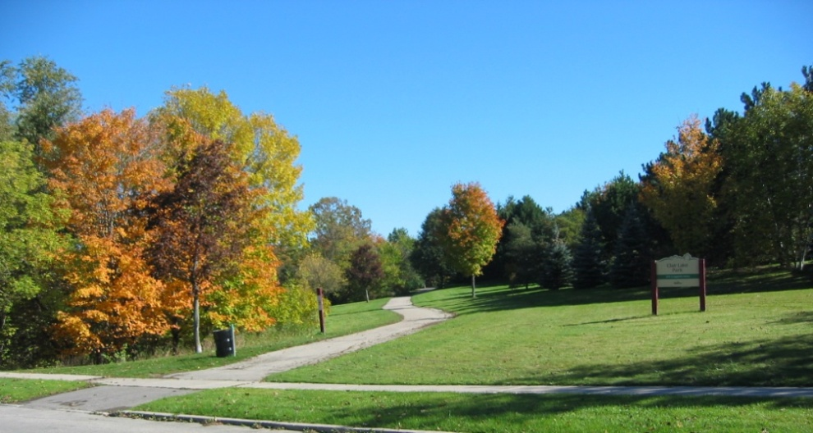
Equal access for all? Environmental Justice Perspectives on the Built Environment and Active Living
Andrew T. Kaczynski, PhD
Department of Health Promotion, Education & Behavior
Arnold School of Public Health
University of South Carolina
1
USC Center for Research in Nutrition and Health Disparities – November 30, 2012

Slide 2
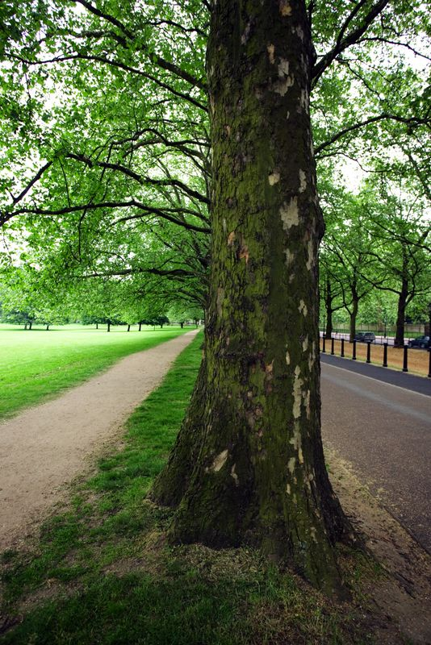
Presentation Outline
Overview of the built environment, parks, environmental justice and physical activity
Kansas City Parks and Physical Activity Project
  Park Environments and Physical Activity pilot study
  Development of a Community Stakeholder Park Audit Tool project
  Kansas City Neighborhood and Park Study
The Healthy Young People Empowerment (HYPE) Project
  Questions and discussion
Notes:
PHS 635
2

Slide 3

Social Ecological Models of Health Behavior
Intrapersonal
  knowledge, skills, attitudes, behaviors of potential participants
Interpersonal
  relationships with family members, friends,
  co-workers, etc.
Organizational/Institutional
  schools, workplaces, etc.
Community
  community agencies
  (e.g., churches, recreation providers)
  environmental factors
  (e.g., sidewalks, urban design, etc.)
Policy
  laws/regulations that promote positive or discourage negative actions
Intrapersonal
Interpersonal
Self
Organizational/Institutional
Community
Policy
McLeroy, K.R., Bibeau, D., Steckler, A., Glanz, K. (1988). An ecological perspective on health promotion programs. Heath Education Quarterly, 15, 351-377.
Notes:
PHS 635
3

Slide 4
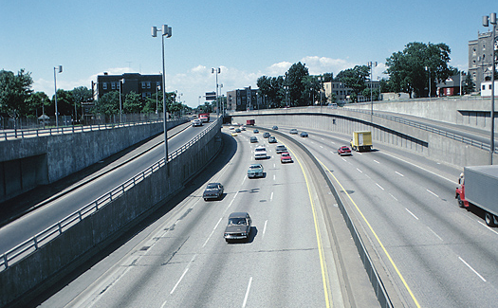
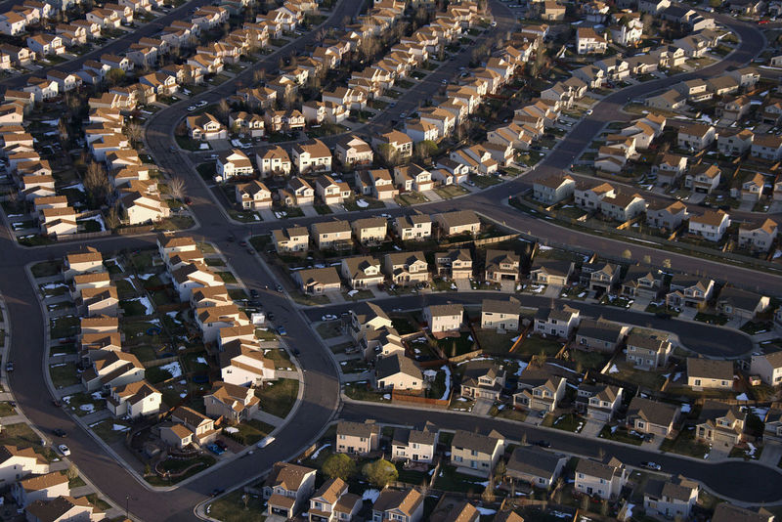
Built Environment and Health
“Most of the communities where Americans live are important contributors to current public health problems. Simultaneously, they can also be the source of important solutions to these problems”.
Frank, L. D., Engelke, P. O., & Schmid, T. L. (2003). Health and community design: The impact of the built environment on physical activity. Washington, DC: Island Press.
Notes:
PHS 635
4

Slide 5
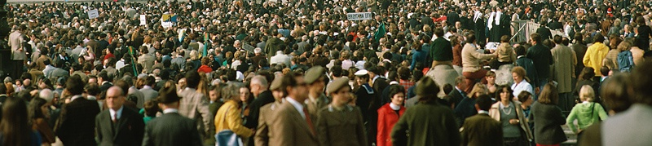
Why Target the Built Environment?
Large numbers of people affected
Relatively permanent effects
Impacts active living behaviors, not just exercise-related physical activity
More strongly related to moderate than vigorous physical activity
Endorsements from Institute of Medicine, CDC, American Academy of Pediatrics
Sallis, J. F., Cervero, R., Ascher, W. W., Henderson, K., Kraft, M.K., & Kerr, J. (2006). An ecological approach to creating active living communities. Annual Review of Public Health, 27, 297-322.
Notes:
PHS 635
5

Slide 6
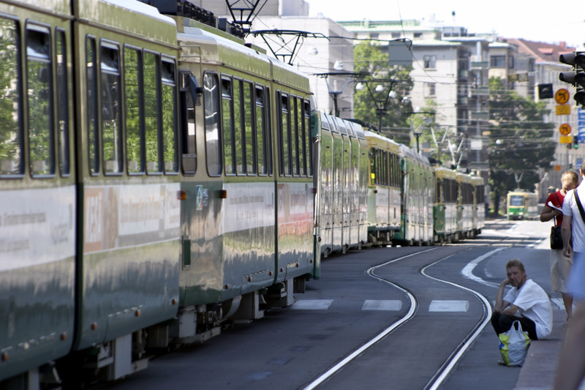
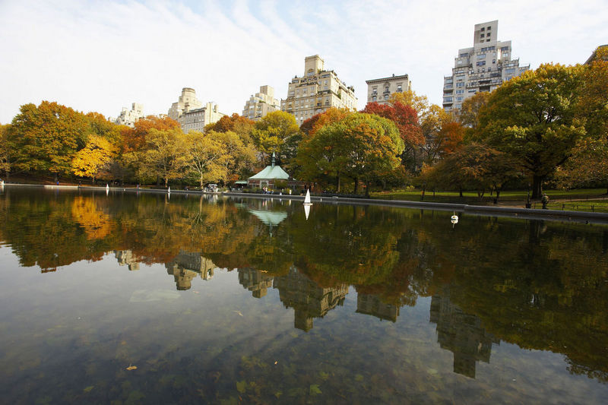
Environmental Influences on Active Living
Housing mix (Population Density)
Land use mix (Diversity)
Street connectivity (Design)
Sidewalks
Public transportation
Neighbourhood connectedness
Aesthetics
Safety (from crime, traffic)
Parks, trails, recreation facilities
Notes:
PHS 635
6

Slide 7
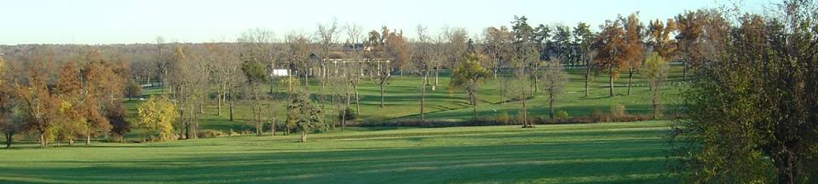
Parks as Important Community Physical Activity Resources
Parks offer numerous economic, social, health, and environmental benefits
Most local and state governments have some form of agency that oversees public open space
  Legislated, ubiquitous, low-cost ‘green infrastructure’
Increasing interest among researchers and practitioners in the fields of parks and recreation management and public health in how parks contribute to population-level physical activity promotion
Some have argued that much of the gains in physical activity are likely to occur in people’s leisure time
Parks provide important “behavior settings” (Wicker, 1987) in communities for both physical and social activity among residents of all ages
Bedimo-Rung, A.L., Mowen, A.J., & Cohen, D.A. (2005). The significance of parks to physical activity and public health: A conceptual model. American Journal of Preventive Medicine, 28(2S2), 159-168.
Notes:
PHS 635
7

Slide 8
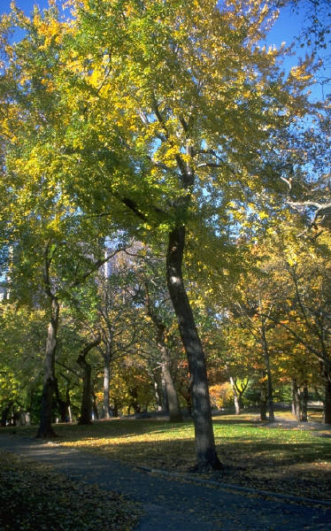
Overview of Parks and Physical Activity Research
Living closer to park space is associated with increased PA among adults & youth (e.g., Cohen et al., 2006; Giles-Corti et al., 2005; Kaczynski & Henderson, 2007; Pate et al., 2008)
Systematic observation protocols and user surveys have been used to document that approximately 40-90% of park users are active during their visits (e.g., Cohen et al., 2007; Floyd et al., 2008; Kaczynski et al., 2011)
Park features & other characteristics may be just as important as proximity in encouraging neighborhood & park-based PA (e.g., Colabianchi et al., 2008, 2011; Kaczynski et al., 2008, 2009; Sugiyama et al., 2010; Timperio et al., 2008; Veitch et al., 2011)
  Number & types of features
  Quality of park and features (e.g., renovations)
  Ease of accessing the park from surrounding neighborhood
Park availability & park features and quality are generally worse in low income and/or high-minority areas (e.g., Crawford et al., 2008; Estabrooks et al., 2003; Moore et al., 2008; Gordon-Larsen et al., 2006)

Slide 9
Environmental Justice¹
According to the U.S. Environmental Protection Agency, EJ involves:
  fair treatment and meaningful involvement of all people regardless of race, colour, national origin, or income with respect to the development, implementation, and enforcement of environmental laws, regulations,
  and policies
  everyone enjoys the same degree of protection from environmental and health hazards and equal access to the decision-making process to have
  a healthy environment in which to live, learn, and work
Deprivation Amplification²
Persons with fewer personal resources that support physical activity (e.g., income, knowledge, etc.) tend to reside in areas that are more deprived of neighborhood physical activity resources (e.g., sidewalks, parks)
Taylor, W.C., Poston, W.S.C., Jones, L., & Kraft, M.K. (2006). Environmental justice: Obesity, physical activity, and health eating. Journal of Physical Activity and Health, 3(S1), 30-54.
2. Macintyre, S. (2007). Deprivation amplification revisited: Or, is it always true that poorer places have poorer access to resources for healthy diets and physical activity? International Journal of Behavioural Nutrition and Physical Activity, 4(32), 32-38.
Notes:
PHS 635
9

Slide 10
Neighborhood Perceptions and Neighborhood Physical Activity
Are perceptions of neighborhood walkability associated with the level of physical activity (PA) engaged in within one’s neighborhood?
People reporting some PA in their neighborhood had more positive perceptions on most dimensions than people reporting no PA in their neighborhood (see graph)
However, neighborhood scores not different between those reporting some neighborhood PA and those reporting a lot
Neighborhood gets people “off the couch”?
Kaczynski, A.T. (2010). Neighborhood walkability perceptions: Associations with amount of neighborhood-based physical activity by intensity and purpose. Journal of Physical Activity and Health, 7, 3-10.
Notes:
PHS 635
10

Slide 11
Interaction of Self-Efficacy and Walkability on Physical Activity
Few studies have examined the interaction of psychosocial and environmental variables in predicting physical activity
Do neighborhood walkability and self-efficacy have an interactive effect on physical activity? Does this relationship differ for men vs. women, healthy weight vs. overweight individuals? For example:
  If a person has high self-efficacy, can they overcome the limitations of living in an ‘unwalkable’ neighborhood?
  If a low self-efficacy person lives in a highly walkable neighborhood, does that ‘level the playing field’?
Participants split into four groups and examined number of minutes of neighborhood physical activity

Slide 12
Interaction of Self-Efficacy and Walkability on Physical Activity (full sample)
High walkability/high self efficacy group had the highest levels of neighborhood physical activity
Similar physical activity for high SE/low walkability and low SE/high walkability
Kaczynski, A.T., Robertson-Wilson, J., & Decloe, M.D. (2012). Interaction of self-efficacy and neighborhood walkability on physical activity. Journal of Physical Activity and Health, 9(2), 208-217.

Slide 13
Interaction of Self-Efficacy and Walkability on Physical Activity (by gender)
Walkability-PA relationship did not differ by self-efficacy among males
Walkability more important among women with low self-efficacy
Kaczynski, A.T., Robertson-Wilson, J., & Decloe, M.D. (2012). Interaction of self-efficacy and neighborhood walkability on physical activity. Journal of Physical Activity and Health, 9(2), 208-217.

Slide 14
Interaction of Self-Efficacy and Walkability on Physical Activity (by BMI group)
Walkability-PA relationship did not differ by self-efficacy among healthy weight adults
Walkability more influential on PA among overweight/obese persons with low self-efficacy
Kaczynski, A.T., Robertson-Wilson, J., & Decloe, M.D. (2012). Interaction of self-efficacy and neighborhood walkability on physical activity. Journal of Physical Activity and Health, 9(2), 208-217.

Slide 15
Presentation Outline
Overview of the built environment, parks, environmental justice and physical activity
Kansas City Parks and Physical Activity Project
  Park Environments and Physical Activity pilot study
  Development of a Community Stakeholder Park Audit Tool project (RWJF-ALR)
  Kansas City Neighborhood and Park Study
The Healthy Young People Empowerment (HYPE) Project
  Questions and discussion
Notes:
PHS 635
15

Slide 16
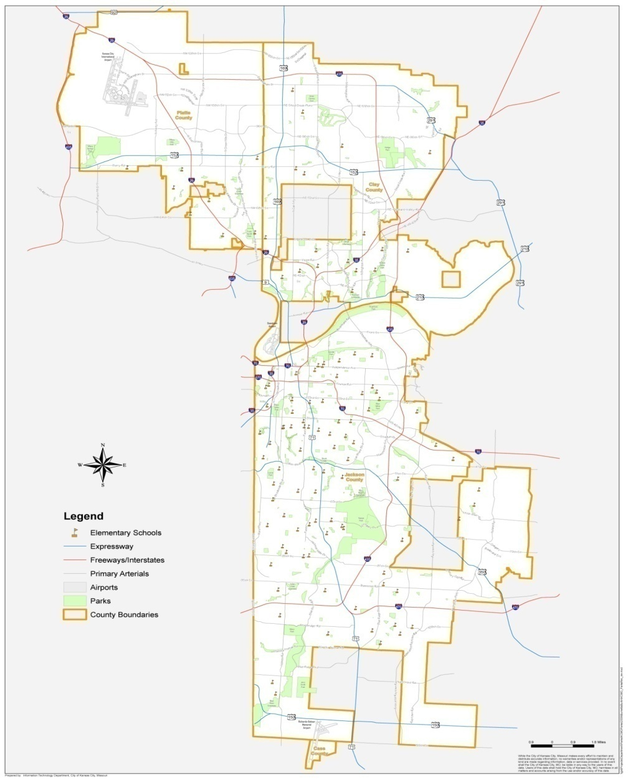
KC Park Environments and Physical Activity Study
Kansas City, Missouri
Diverse population:
  18% children
  61% White, 31% Black
  7% Hispanic
  Median income: $39,230
318 square miles
Total of 219 parks
Pilot study in 4 parks in central area of KC that contained a variety of features and amenities
Two methods: observation and survey
Data collected in July and August 2009
Notes:
PHS 635
16

Slide 17
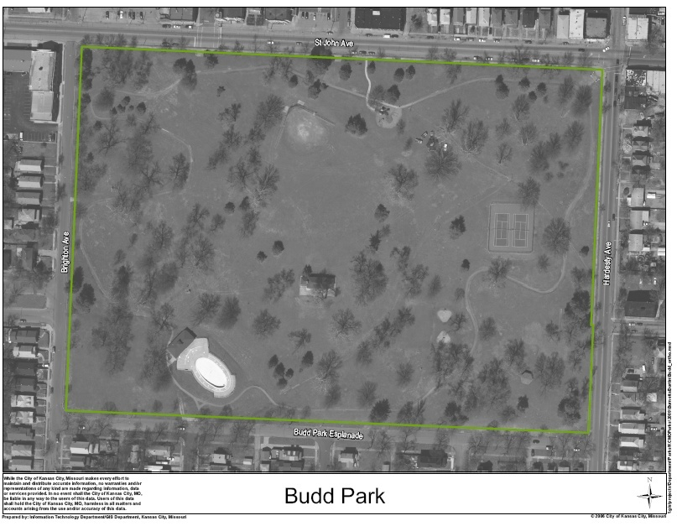
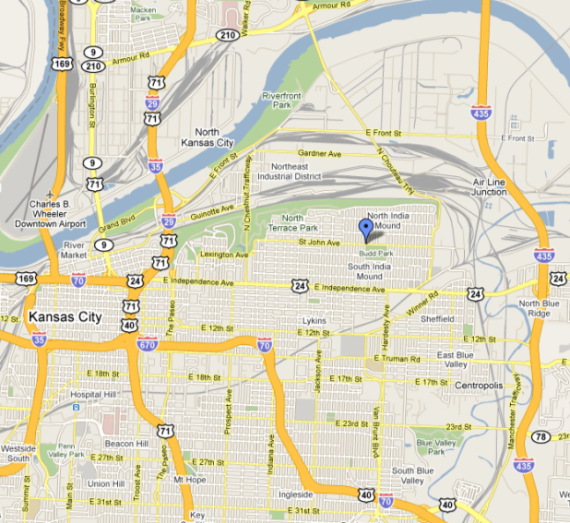
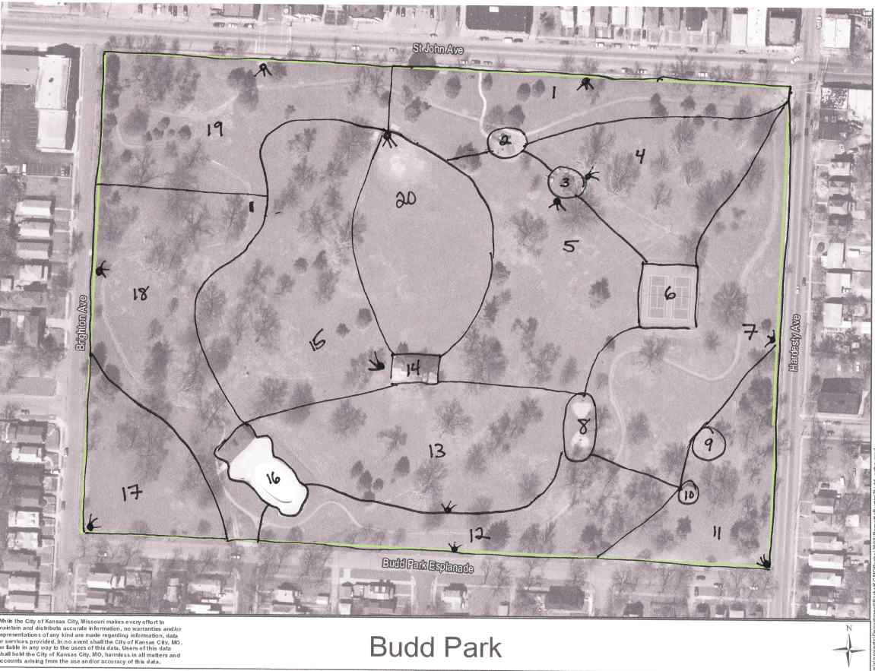
Budd Park
26.4 acres
20 target areas
Notes:
PHS 635
17

Slide 18
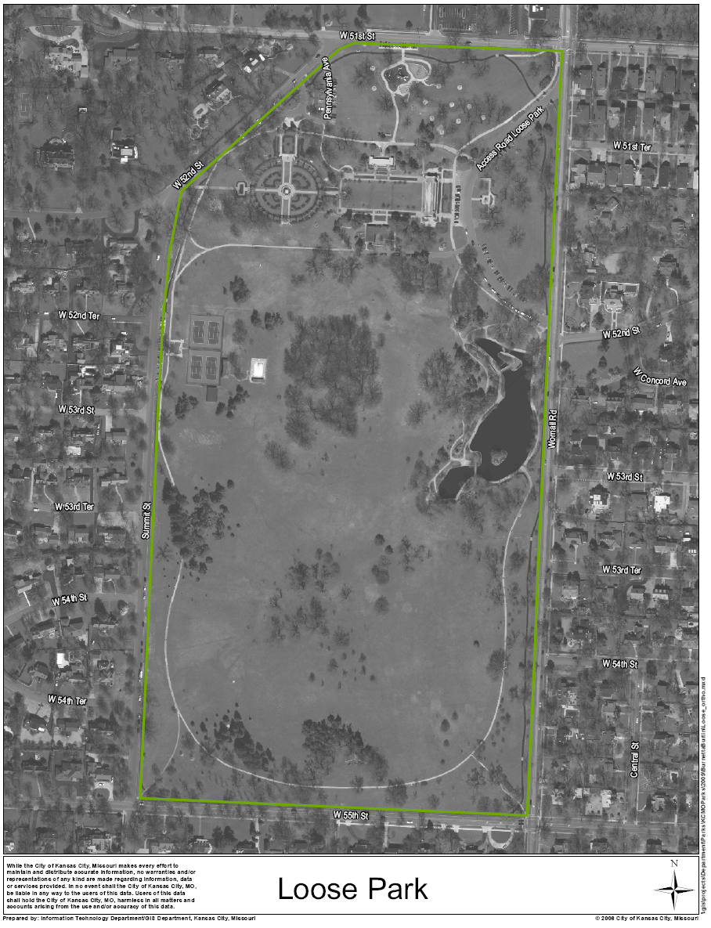
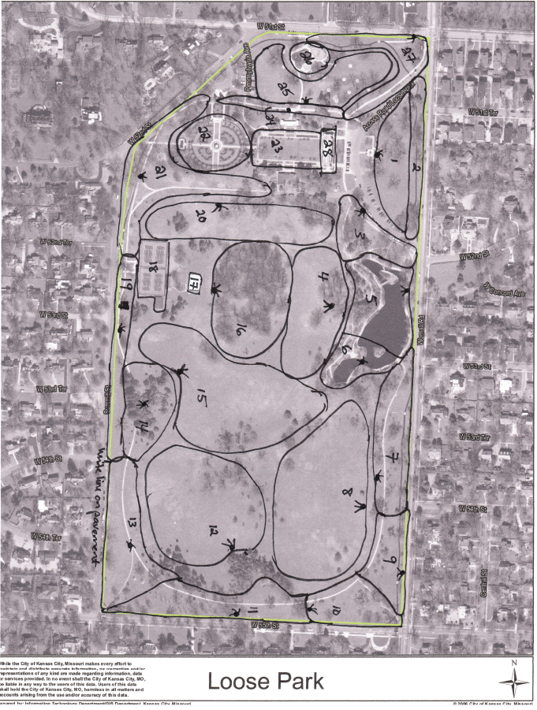
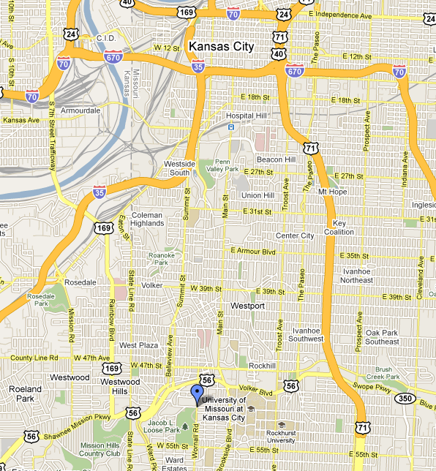
Jacob Loose Memorial Park
74.1 acres
28 target areas
Notes:
PHS 635
18

Slide 19
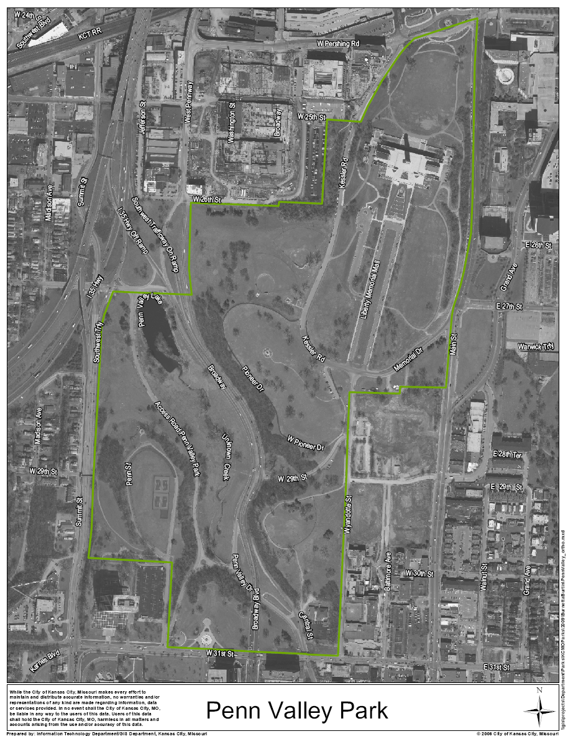
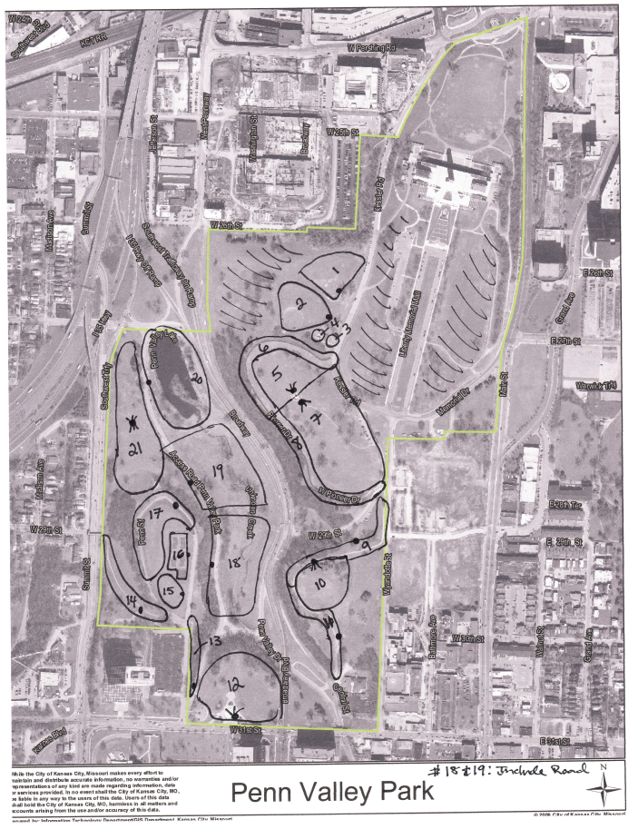
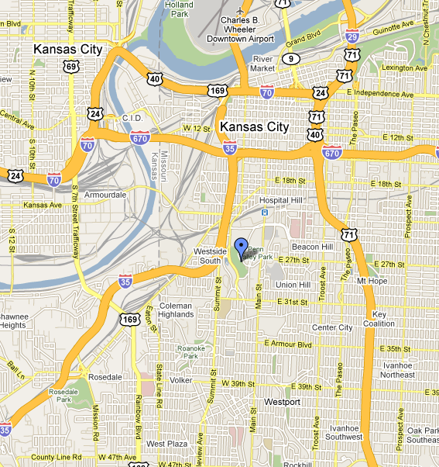
Penn Valley Park
129.6 acres
21 target areas
Notes:
PHS 635
19

Slide 20
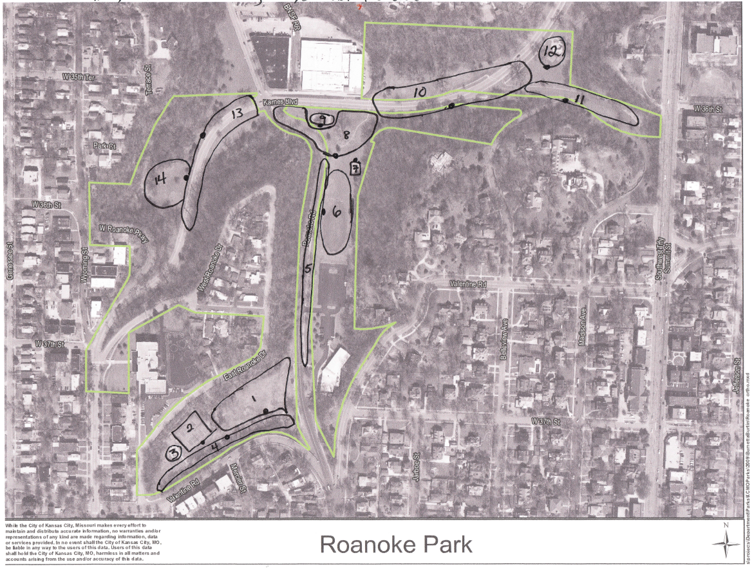
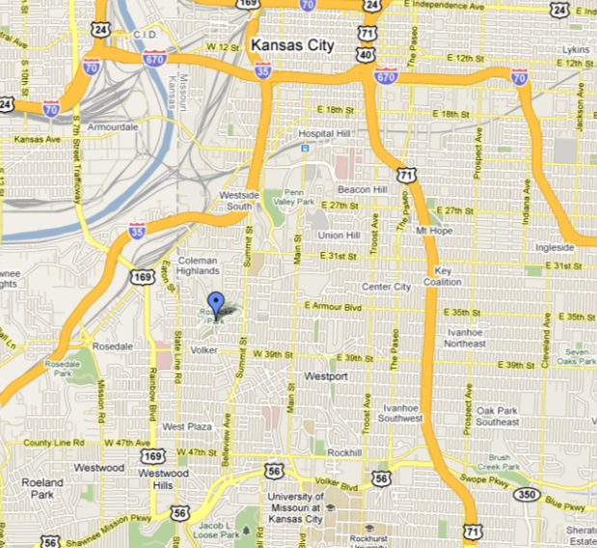
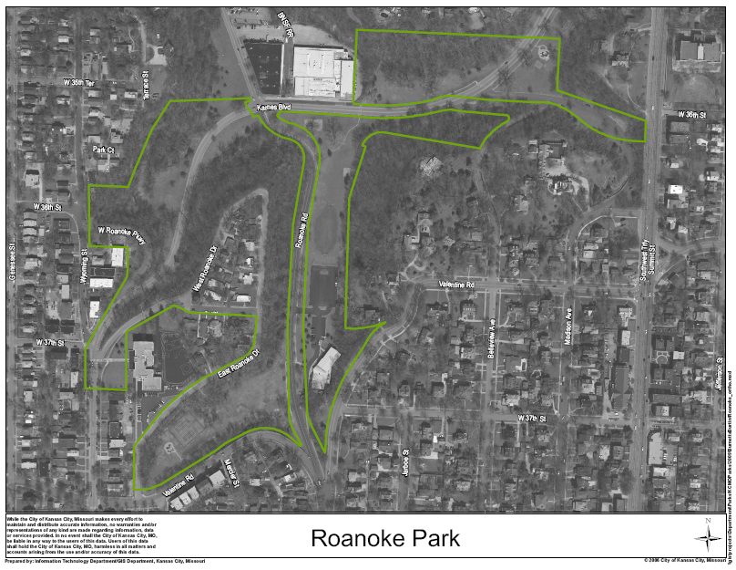
Roanoke Park
37.6 acres
14 target areas
Notes:
PHS 635
20

Slide 21
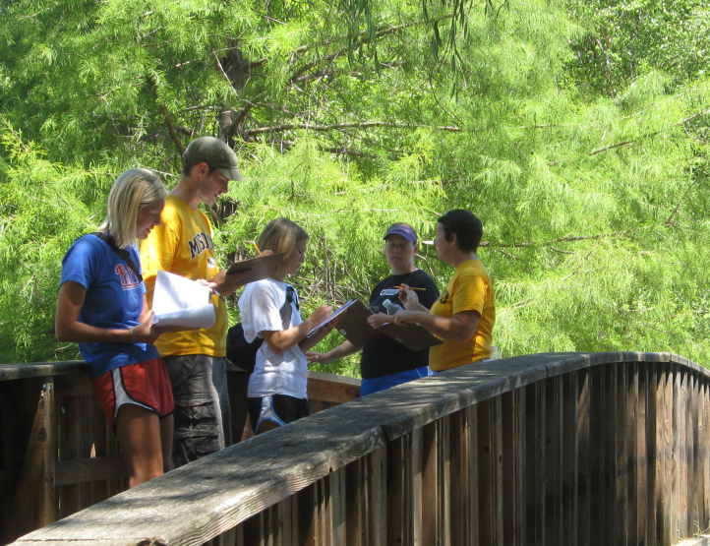

KC Park Environments and Physical Activity Study – Methods
SOPARC – System for Observing Play and Recreation in Communities
(McKenzie et al., 2006)
Parks divided into definable, observable target areas
  Total of 83 target areas
  Wide range of areas: open space, trails, playgrounds, sports courts and fields, picnic shelters, dog park, skate park, pool
Systemic observation and sampling protocol:
  Total of 39 hours per park
  Friday, Saturday, Sunday only (Floyd et al., 2008)
  Full 13 hour day (7 am-8 pm) spread across two weekends
  Total of 39 scans per target area and 3125 total target area scans
Notes:
PHS 635
21

Slide 22
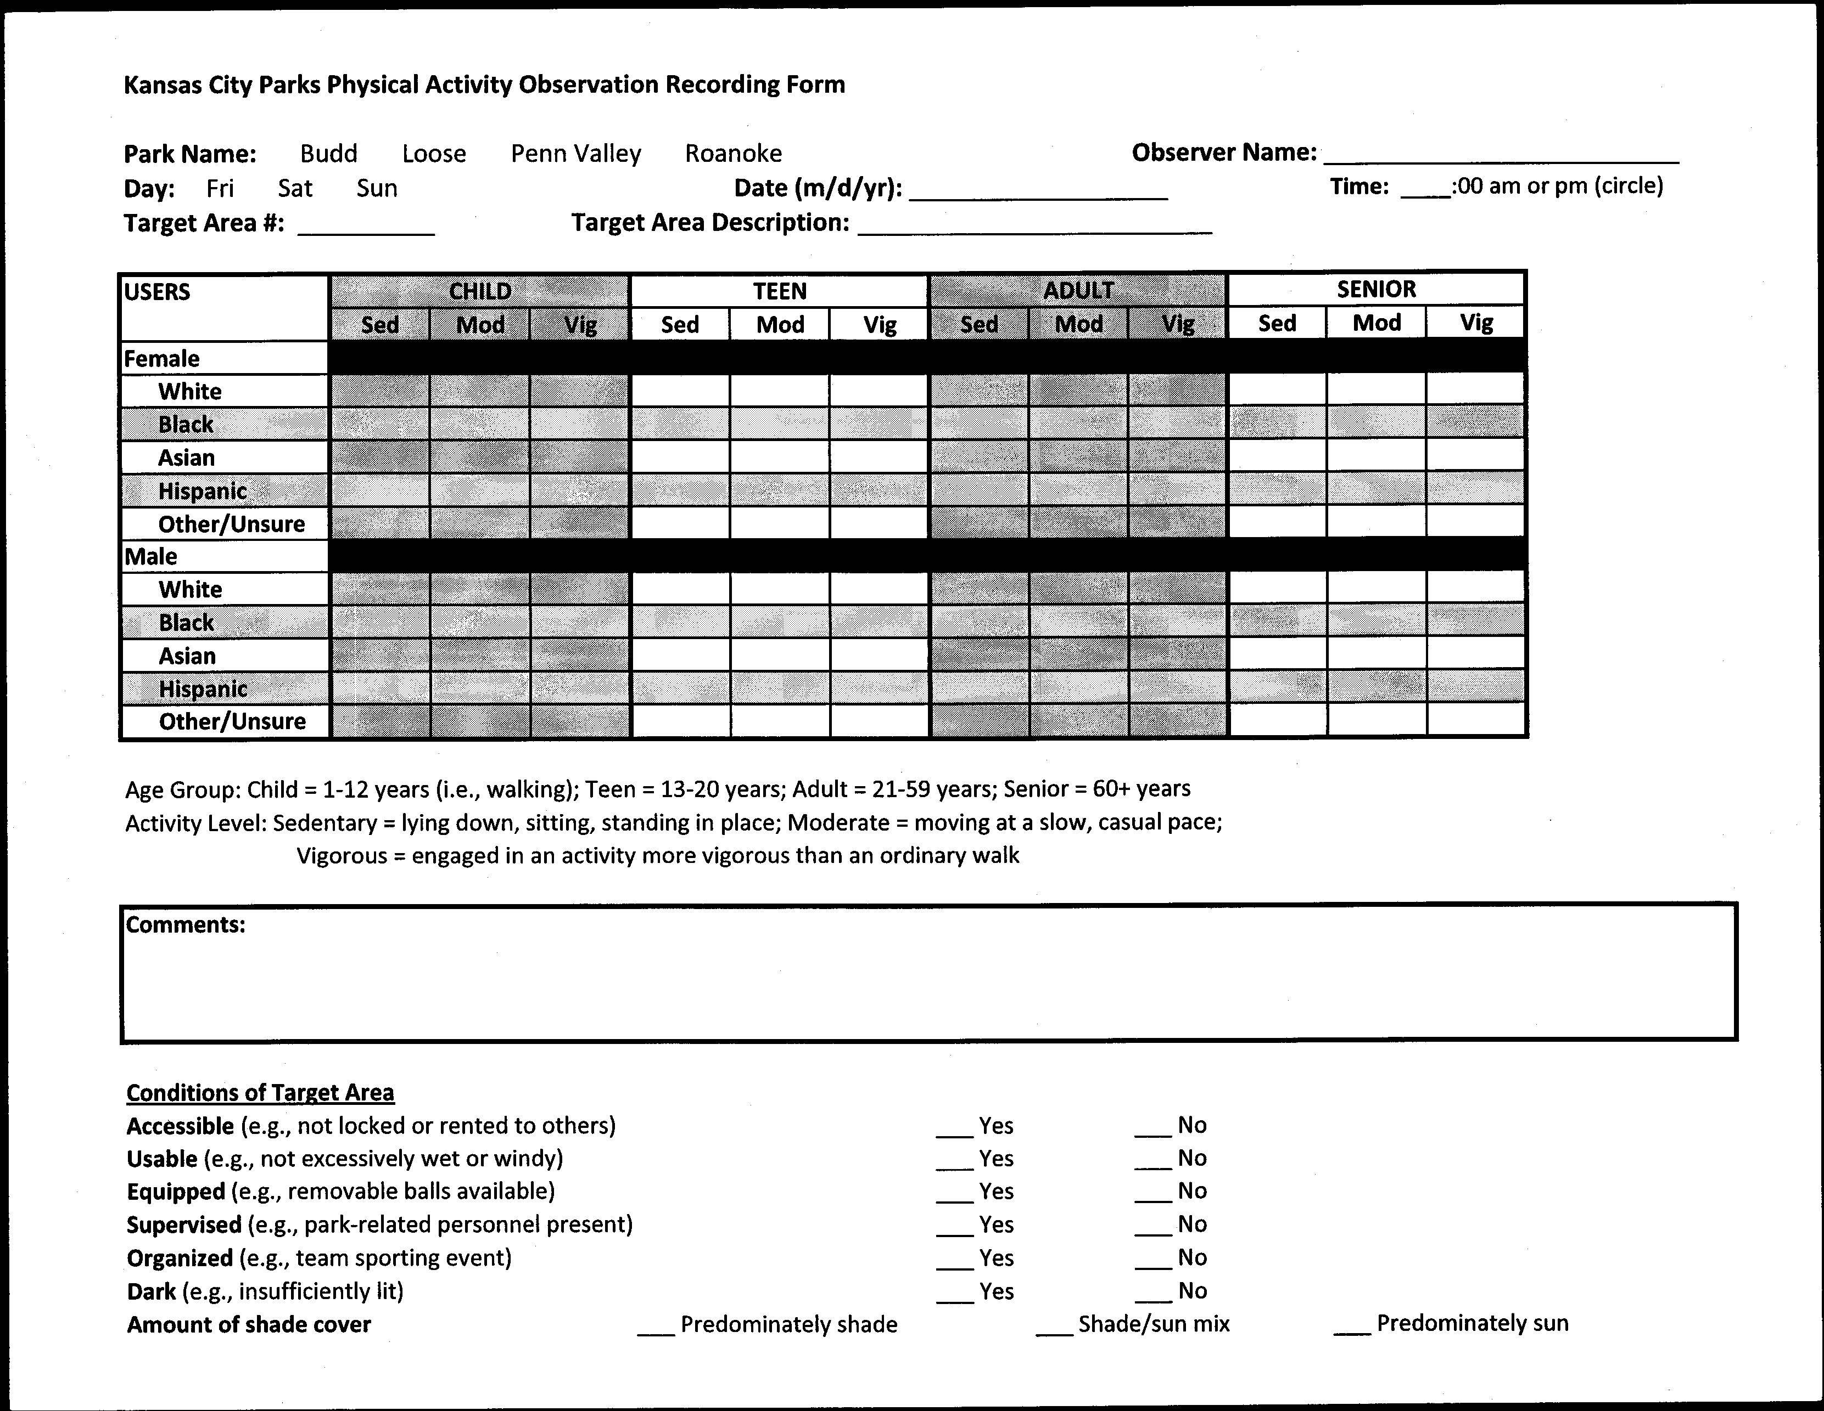
SOPARC – System for Observing Play and Recreation in Communities
  Reliable & validated method to observe the physical activity behaviors of park users (McKenzie et al., 2006)
  Systematic scans rotating
  through park target areas from the start of each hour
  Modified standard observation form to record age, gender, race, and intensity level simultaneously for each user in the target area
  Two days of classroom and on-site training with 4 data collection staff
  Inter-observer reliabilities =0.84-0.98
Notes:
PHS 635
22

Slide 23
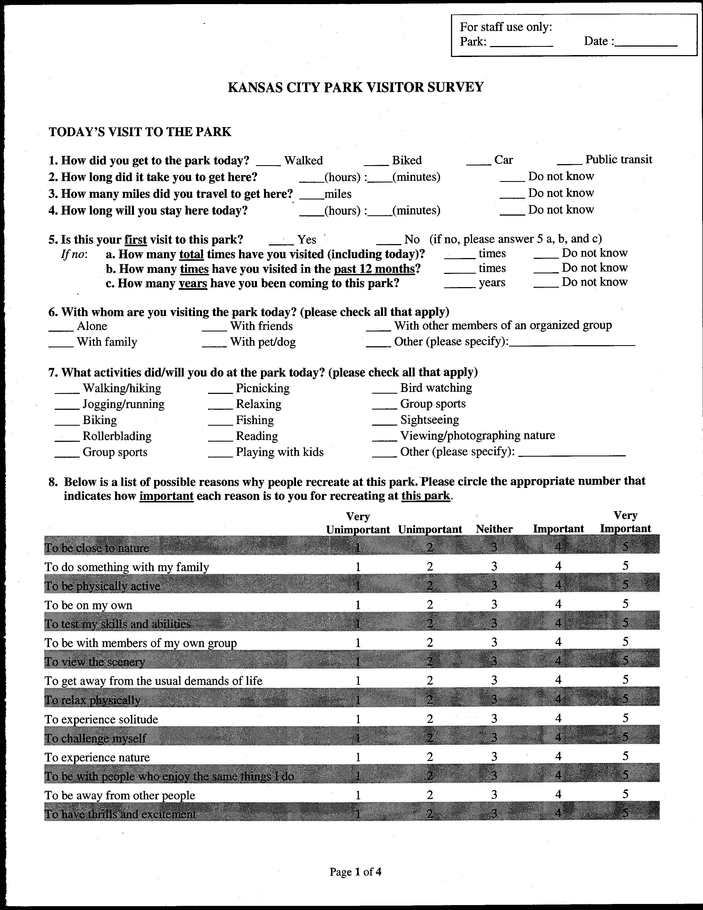
Park Visitor Survey
Combination of existing and developed questions and scales to capture behaviors and influences related to park-based physical activity
  Motivations for park visit
  Place attachment
  Level of physical activity during park visit
  Importance of site attributes for physical activity participation
  Constraints to park-based physical activity
  Socio-demographic characteristics (including address)
  Sampled park users by systematically moving through target areas
    474 valid completed surveys (60.5% response rate)
Notes:
PHS 635
23

Slide 24
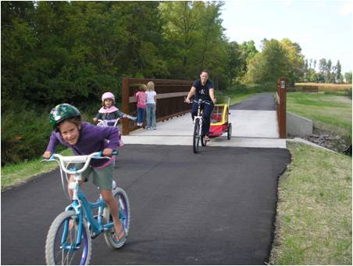
Sample Research Questions
Are there differences in the physical activity intensity levels of park visitors according to gender, race, and age?
Does the physical activity of park visitors vary across park settings?
Are certain park attributes perceived as more important for physical activity participation by different groups?
Notes:
24
PHS 635
24

Slide 25
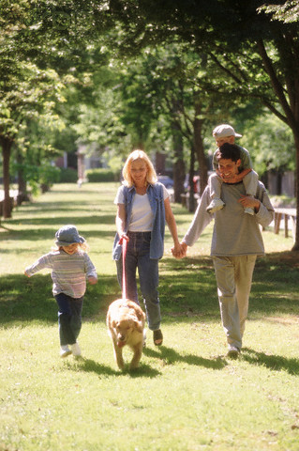
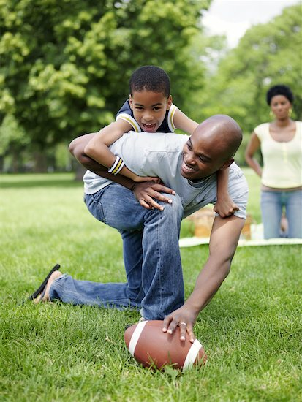
Variations in Park PA Intensity by Gender and Race Across Age Groups
Four groups of observed users created:
  Male/White n=2675 (30.2%)
  Male/Non-White n=1551 (17.5%)
  Female/White n=2939 (33.2%)
  Female/Non-White n=1447 (16.3%)
    Female/Non-White used as reference group
Logistic regression used to examine whether park users in certain gender/race groups were more likely to be observed engaging in moderate-to-vigorous physical activity (MVPA) rather than sedentary activity
Tests conducted separately for the four different SOPARC-defined age groups:
  child (2-12 yrs), teen (13-20 yrs), adult (21-59 yrs), senior (60+ yrs)
Notes:
PHS 635
25

Slide 26
Variations in Park PA Intensity by Gender and Race Across Age Groups
Children (2-12 years)
N=1857 observations
Male/White users significantly more likely to be observed in MVPA than female/non-white users (OR=1.46, CI=1.12-1.91)
Kaczynski, A.T., Wilhelm Stanis, S.A., Hastmann, T., & Besenyi, G.M. (2011). Variations in observed park physical activity intensity level by gender, race, and age: Individual and joint effects. Journal of Physical Activity and Health, 8(S2), 150-161.
Notes:
PHS 635
26

Slide 27
Variations in Park PA Intensity by Gender and Race Across Age Groups
Teens (13-20 years)
N=495 observations
Male/White users significantly less likely to be observed in MVPA than female/non-white users (OR=0.49, CI=0.28-0.95)
Female/White users significantly less likely to be observed in MVPA than female/non-white users (OR=0.50, CI=0.29-0.89)
Kaczynski, A.T., Wilhelm Stanis, S.A., Hastmann, T., & Besenyi, G.M. (2011). Variations in observed park physical activity intensity level by gender, race, and age: Individual and joint effects. Journal of Physical Activity and Health, 8(S2), 150-161.
Notes:
PHS 635
27

Slide 28
Variations in Park PA Intensity by Gender and Race Across Age Groups
Adults (21-59 years)
N=5798 observations
Male/White users significantly more likely to be observed in MVPA than female/non-white users (OR=1.45, CI=1.23-1.72)
Female/White users significantly more likely to be observed in MVPA than female/non-white users (OR=1.36, CI=1.15-1.61)
Kaczynski, A.T., Wilhelm Stanis, S.A., Hastmann, T., & Besenyi, G.M. (2011). Variations in observed park physical activity intensity level by gender, race, and age: Individual and joint effects. Journal of Physical Activity and Health, 8(S2), 150-161.
Notes:
PHS 635
28

Slide 29
Variations in Park PA Intensity by Gender and Race Across Age Groups
Older Adults (60+ years)
N=462 observations
Male/White users significantly more likely to be observed in MVPA than female/non-white users (OR=4.23, CI=1.78-10.35)
Female/White users significantly more likely to be observed in MVPA than female/non-white users (OR=3.15, CI=1.23-7.72)
Kaczynski, A.T., Wilhelm Stanis, S.A., Hastmann, T., & Besenyi, G.M. (2011). Variations in observed park physical activity intensity level by gender, race, and age: Individual and joint effects. Journal of Physical Activity and Health, 8(S2), 150-161.
Notes:
PHS 635
29

Slide 30
Does Youth Physical Activity Level Vary Across Park Areas?
Compared the mean level of energy expenditure (METs) per observed youth visitor across the five most used target areas
Total of 2451 youth visitors observed:
  49.7% male; 50.3% female
  78.9% child; 21.2% teen
  50.2% White; 49.8% non-White
Top Target Areas Used by Youth
Besenyi, G.M., Kaczynski, A.T., Wilhelm Stanis, S.A., & Vaughan, K.B. (in press). Demographic variations in observed energy expenditure across park activity areas. Preventive Medicine.

Slide 31
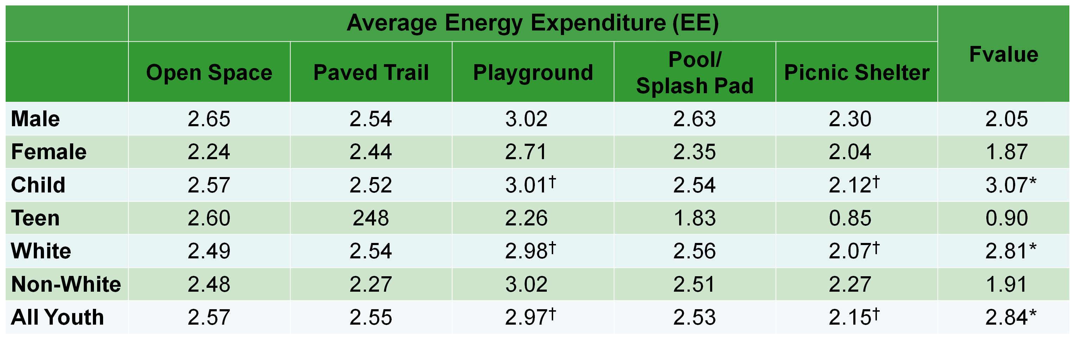
Does Youth Physical Activity Level Vary Across Park Areas?
*p<.05; † Indicates mean energy expenditure was significantly different (p < .05) between target areas for observed users in that group (reading across rows)
For each significant ANOVA, post hoc tests indicated that playgrounds had greater mean EE than picnic shelters
Besenyi, G.M., Kaczynski, A.T., Wilhelm Stanis, S.A., & Vaughan, K.B. (in press). Demographic variations in observed energy expenditure across park activity areas. Preventive Medicine.

Slide 32
Do Adult Physical Activity Levels Vary Within Park Areas?
Compared the likelihood of engaging in MVPA within specific park activity areas
  Males vs. Females
  Whites vs. non-Whites
6401 adults observed:
  48.5% Male; 51.5% Female
  68.4% White; 31.6% Non-White
  44.6% MVPA; 55.4% sedentary
Top Target Areas Used by Adults
Playgrounds
10%
Kaczynski, A.T., Wilhelm Stanis, S.A., Besenyi, G.M., & Child, S. (in press). Differences in youth and adult physical activity by gender and race/ethnicity within park settings. Preventing Chronic Disease.

Slide 33
Does Adult Physical Activity Differ Within Park Activity Areas?
User Characteristic |  | All Areas | Paved Trail | Open Space | Playground | Picnic Shelter | Tennis Court
Male^{i} | OR | 1.07 | 0.99 | 1.30ª | 1.14 | 1.52 | 1.06
 | 95% CI | (0.97-1.18) | (0.84-1.16) | (1.02-1.66) | (0.75-1.74) | (0.90-2.59) | (0.63-1.77)
White^{ii} | OR | 1.32^{b} | 1.20ª | 0.91 | 1.19 | 0.36^{b} | 0.81
 | 95% CI | (1.19-1.48) | (1.01-1.45) | (0.71-1.17) | (0.78-1.83) | (0.21-0.62) | (0.51-1.30)
^{i} Reference category is Female
^{ii} Reference category is Non-White
ª p < .05
^{b} p <.01
Across all areas, males not more likely than females to be observed engaged in MVPA
Kaczynski, A.T., Wilhelm Stanis, S.A., Besenyi, G.M., & Child, S. (in press). Differences in youth and adult physical activity by gender and race/ethnicity within park settings. Preventing Chronic Disease.

Slide 34
Does Adult Physical Activity Differ Within Park Activity Areas?
User Characteristic |  | All Areas | Paved Trail | Open Space | Playground | Picnic Shelter | Tennis Court
Male^{i} | OR | 1.07 | 0.99 | 1.30ª | 1.14 | 1.52 | 1.06
 | 95% CI | (0.97-1.18) | (0.84-1.16) | (1.02-1.66) | (0.75-1.74) | (0.90-2.59) | (0.63-1.77)
White^{ii} | OR | 1.32^{b} | 1.20ª | 0.91 | 1.19 | 0.36^{b} | 0.81
 | 95% CI | (1.19-1.48) | (1.01-1.45) | (0.71-1.17) | (0.78-1.83) | (0.21-0.62) | (0.51-1.30)
^{i} Reference category is Female
^{ii} Reference category is Non-White
ª p < .05
^{b} p <.01
Across all areas, Whites more likely than non-Whites to be observed engaged in MVPA
Kaczynski, A.T., Wilhelm Stanis, S.A., Besenyi, G.M., & Child, S. (in press). Differences in youth and adult physical activity by gender and race/ethnicity within park settings. Preventing Chronic Disease.

Slide 35
Does Adult Physical Activity Differ Within Park Activity Areas?
User Characteristic |  | All Areas | Paved Trail | Open Space | Playground | Picnic Shelter | Tennis Court
Male^{i} | OR | 1.07 | 0.99 | 1.30ª | 1.14 | 1.52 | 1.06
 | 95% CI | (0.97-1.18) | (0.84-1.16) | (1.02-1.66) | (0.75-1.74) | (0.90-2.59) | (0.63-1.77)
White^{ii} | OR | 1.32^{b} | 1.20ª | 0.91 | 1.19 | 0.36^{b} | 0.81
 | 95% CI | (1.19-1.48) | (1.01-1.45) | (0.71-1.17) | (0.78-1.83) | (0.21-0.62) | (0.51-1.30)
^{i} Reference category is Female
^{ii} Reference category is Non-White
ª p < .05
^{b} p <.01
Males more active than females in open spaces
Kaczynski, A.T., Wilhelm Stanis, S.A., Besenyi, G.M., & Child, S. (in press). Differences in youth and adult physical activity by gender and race/ethnicity within park settings. Preventing Chronic Disease.

Slide 36
Does Adult Physical Activity Differ Within Park Activity Areas?
User Characteristic |  | All Areas | Paved Trail | Open Space | Playground | Picnic Shelter | Tennis Court
Male^{i} | OR | 1.07 | 0.99 | 1.30ª | 1.14 | 1.52 | 1.06
 | 95% CI | (0.97-1.18) | (0.84-1.16) | (1.02-1.66) | (0.75-1.74) | (0.90-2.59) | (0.63-1.77)
White^{ii} | OR | 1.32^{b} | 1.20ª | 0.91 | 1.19 | 0.36^{b} | 0.81
 | 95% CI | (1.19-1.48) | (1.01-1.45) | (0.71-1.17) | (0.78-1.83) | (0.21-0.62) | (0.51-1.30)
^{i} Reference category is Female
^{ii} Reference category is Non-White
ª p < .05
^{b} p <.01
Whites more likely than non-Whites to be active on trails
Kaczynski, A.T., Wilhelm Stanis, S.A., Besenyi, G.M., & Child, S. (in press). Differences in youth and adult physical activity by gender and race/ethnicity within park settings. Preventing Chronic Disease.

Slide 37
Does Adult Physical Activity Differ Within Park Activity Areas?
User Characteristic |  | All Areas | Paved Trail | Open Space | Playground | Picnic Shelter | Tennis Court
Male^{i} | OR | 1.07 | 0.99 | 1.30ª | 1.14 | 1.52 | 1.06
 | 95% CI | (0.97-1.18) | (0.84-1.16) | (1.02-1.66) | (0.75-1.74) | (0.90-2.59) | (0.63-1.77)
White^{ii} | OR | 1.32^{b} | 1.20ª | 0.91 | 1.19 | 0.36^{b} | 0.81
 | 95% CI | (1.19-1.48) | (1.01-1.45) | (0.71-1.17) | (0.78-1.83) | (0.21-0.62) | (0.51-1.30)
^{i} Reference category is Female
^{ii} Reference category is Non-White
ª p < .05
^{b} p <.01
Whites less likely than non-Whites to be active around picnic shelters
Kaczynski, A.T., Wilhelm Stanis, S.A., Besenyi, G.M., & Child, S. (in press). Differences in youth and adult physical activity by gender and race/ethnicity within park settings. Preventing Chronic Disease.

Slide 38
Importance of Park Site Attributes by Race/Ethnicity
Do visitors’ ratings of the importance of park site attributes for park-based physical activity vary by race/ ethnicity?
Several park site attributes rated more important by Black and Hispanic visitors compared to White visitors
Site Attributes | Race/Ethnicity (Mean)¹ |  |  | F Value
 | Black | Hispanic | White
Cleanliness | 4.49ª | 4.51ª | 4.02^{b} | 9.75***
Parking | 4.26ª | 4.23ª | 3.88^{b} | 5.64**
Restrooms | 4.16^{a,b} | 4.28ª | 3.85^{b} | 5.54**
Lighting | 4.14^{a,b} | 4.30ª | 3.83^{b} | 7.39***
Playgrounds | 4.13ª | 4.20ª | 3.36^{b} | 18.46***
Picnic areas | 4.05ª | 4.18ª | 3.46^{b} | 14.14***
Sport fields | 3.86ª | 3.94ª | 3.09^{b} | 19.93***
Being near water | 3.87ª | 3.92ª | 3.51^{b} | 5.34**
1. 5-pt scale, controlling for age and gender; *p<.01, **p<.05, ***p<.001; ^{a,b}Means significantly different at p<.05
Wilhelm Stanis, S.A., & Kaczynski, A.T. (under review). Important park site attributes for physical activity: Differences in respondent perceptions by race/ethnicity, gender, and age. Manuscript submitted for publication.
Notes:
PHS 635
38

Slide 39
Presentation Outline
Overview of the built environment, parks, environmental justice and physical activity
Kansas City Parks and Physical Activity Project
  Park Environments and Physical Activity pilot study
  Development of a Community Stakeholder Park Audit Tool project
  Kansas City Neighborhood and Park Study
The Healthy Young People Empowerment (HYPE) Project
  Questions and discussion
Notes:
PHS 635
39

Slide 40
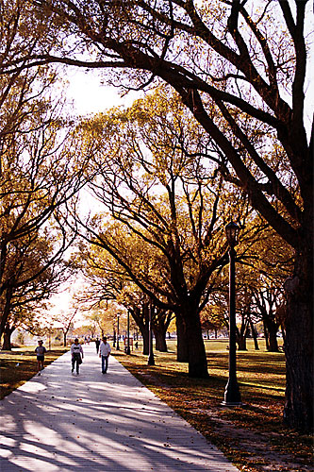
Need for a Community Stakeholder Park Audit Tool
Developing activity-friendly neighborhoods, including better parks, requires:
  an accurate understanding of the current state of resources, and
  the involvement and support of multiple constituencies
“Simplified observational measures of parks … can be created from existing measures. Creating practical measures for community groups should be a goal for researchers” (Brownson et al., 2009, p. 120)
“The incorporation of reliable observational measures into health advocacy efforts should be encouraged to provide an evidence base for advocacy” (p. 120)
Helps to facilitate meaningful involvement element of environmental justice (Floyd et al., 2009)

Slide 41
Summary of Existing Park Audit Tools
                Several park audit tools previously developed – each has its own strengths and weaknesses
                Varying lengths and coverage of important dimensions
                Most glaring limitation is the lack of development and testing of existing tools with diverse community stakeholders
Audit Tool | Use Setting | Length | Park Quality | Youth- Oriented | Developed with stakeholders | Tested with stakeholders
BRAT-DO | Parks | 16 pages, 181 items | Yes | No | Some | No
EAPRS | Parks | 47 pages, 646 items | Yes | Somewhat | Some | No
PARA | Varied resources | 1 page, 49 items | Limited | No | No | No
POST | Parks, ovals | 2.5 pages, 88 items | Limited | No | Some | No
SHAPE | Parks | 1 page, 20 items | Yes | No | Some | No

Slide 42
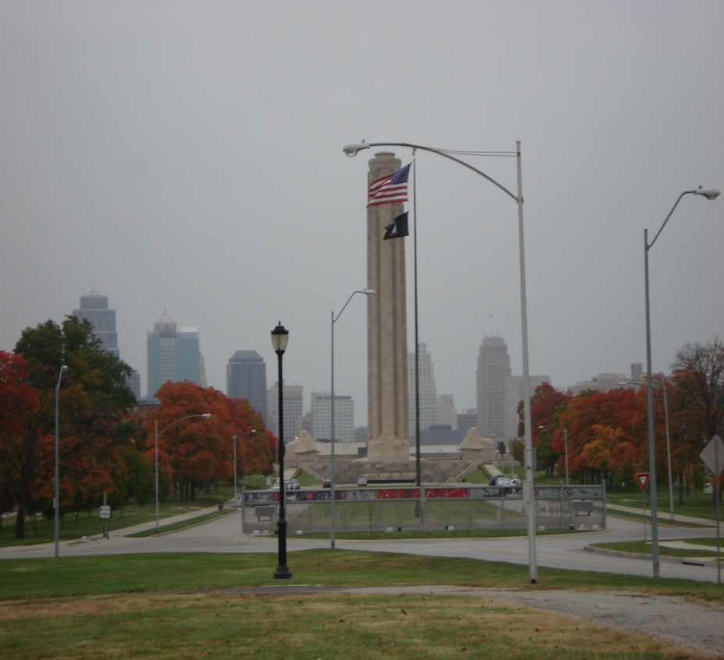
Park Audit Tool Development Study – Purpose, Stages, Setting, Participants
Study purpose: To develop a user-friendly park audit tool that has been developed, tested, and disseminated with diverse community stakeholders
Study stages (Feb 2010 to March 2011):
  Review of existing instruments
  Planning workshop with community stakeholders
  Development of park audit tool
  Training workshop with community stakeholders
  Testing of park audit tool
  Evaluation workshop with community stakeholders
  Dissemination of park audit tool
Study participants:
  34 representatives from public health, planning, youth agencies, legislators, parks and recreation, private sector, park users and non-users, teens, etc.
Kaczynski, A.T., Wilhelm Stanis, S.A., & Besenyi, G.M. (2012). Development and testing of a community stakeholder park audit tool. American Journal of Preventive Medicine, 42(3), 242-249.
Notes:
PHS 635
42

Slide 43
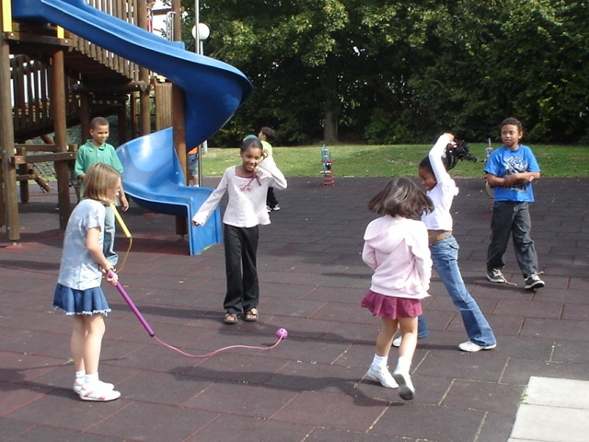
Workshop 1 – Developing a Revised Park Audit Tool
Pre-Workshop:
  Review of domains/items within existing park and neighborhood audit tools
Workshop 1 – Roundtable discussions with stakeholders
  What is important to consider regarding an audit tool focusing on park-based physical activity?
  What is important to consider regarding an audit tool focusing on youth activities in parks?
  What is important to consider regarding a user-friendly audit tool?
  Evaluation of strengths and weaknesses of existing park tools
  Post-Workshop:
    Three key informant interviews with researchers familiar with parks and physical activity and/or the use of audit tools with community members
    Data from all steps transcribed and analyzed by multiple coders
Notes:
PHS 635
43

Slide 44

Community Park Audit Tool (CPAT)
6 pages
4 sections:
  Park Information
  Access and Surrounding Neighborhood
  Park Activity Areas
  Park Quality and Safety
Concerned with presence/absence and ‘useability’ and ‘condition’ of most park elements
Mostly yes/no responses, but also some items with three options, as well as checklists and spaces for comments
Instructions contained within tool or items themselves
Guidebook available with additional details and definitions
Notes:
44
PHS 635
44

Slide 45
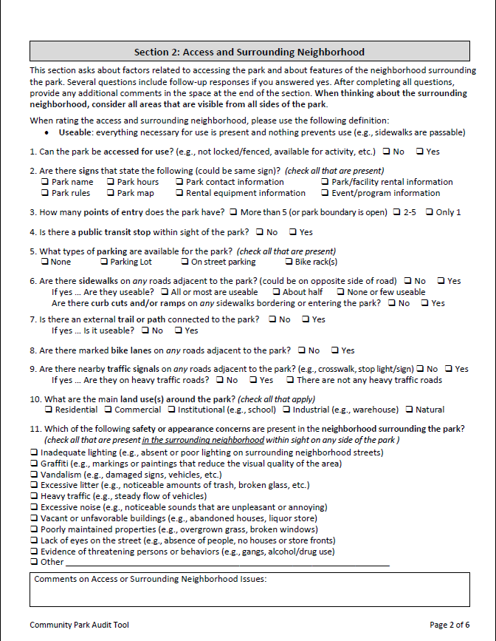
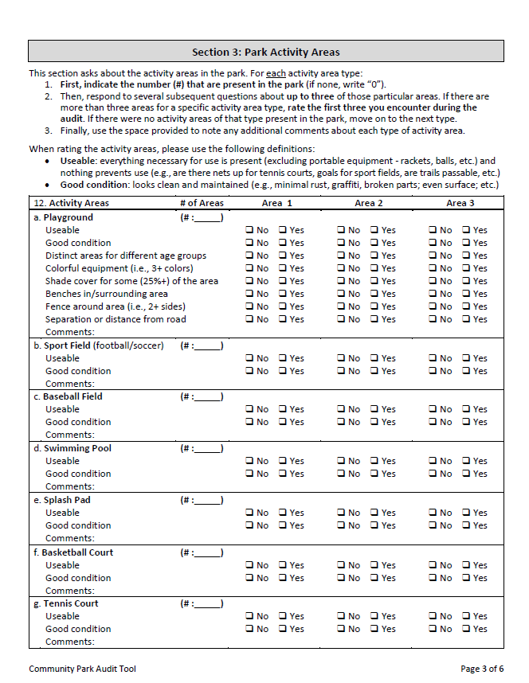
Community Park Audit Tool (CPAT) – pages 2 and 3
Notes:
45
PHS 635
45

Slide 46
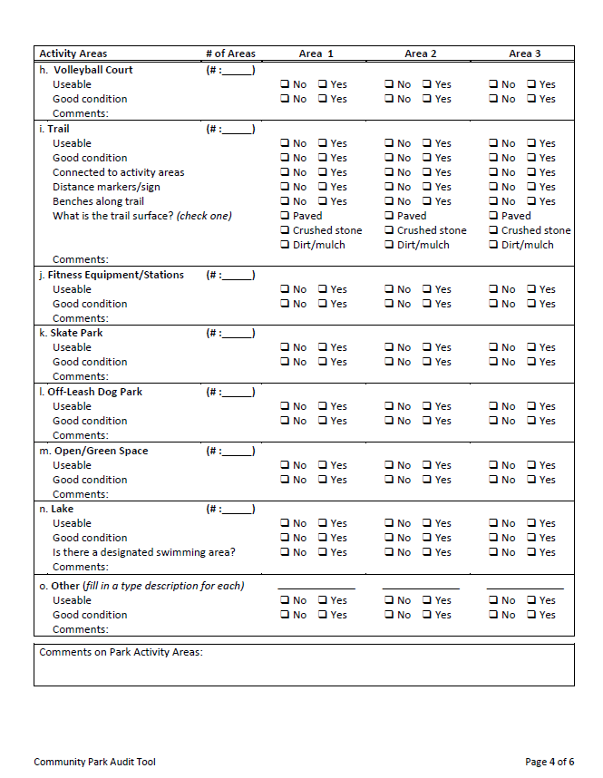
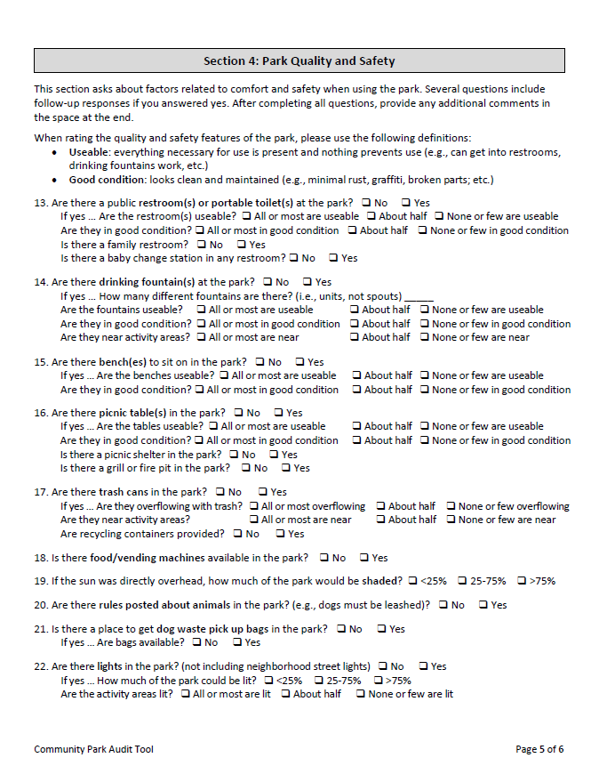
Community Park Audit Tool (CPAT) – pages 4 and 5
Notes:
46
PHS 635
46

Slide 47

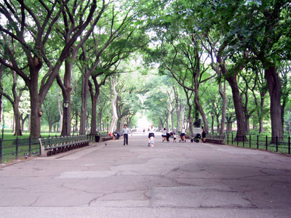
Community Park Audit Tool (CPAT) – page 6
Notes:
47
PHS 635
47

Slide 48
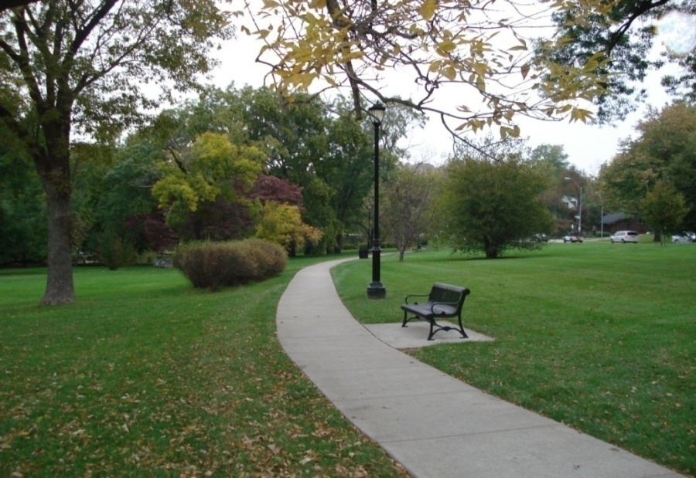
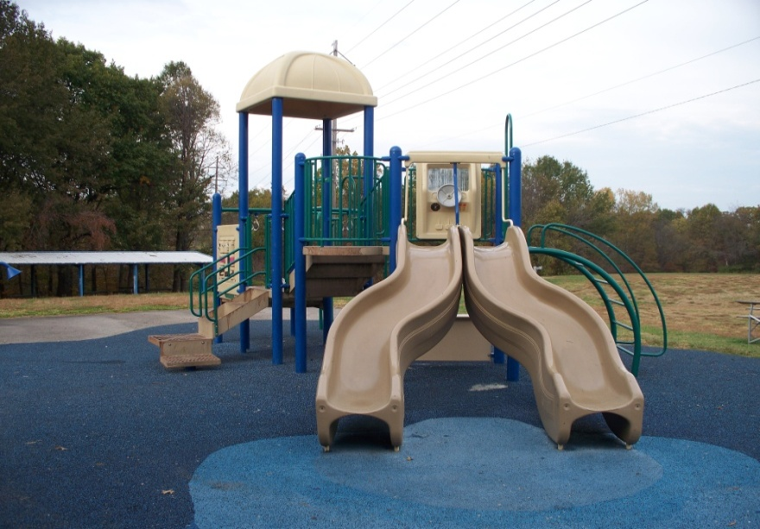
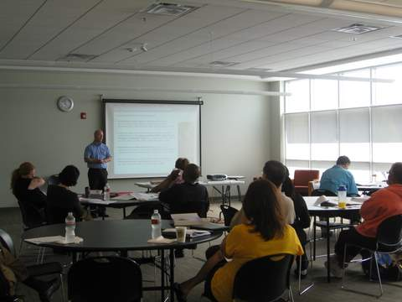
Workshop 2 – Audit Tool Training
Reviewed the CPAT elements at a second half-day workshop
Practiced in a local park for 30 minutes
Discussed confusion/ideas for revisions
Tool modified and sent out again for final feedback before testing stage
Notes:
PHS 635
48

Slide 49
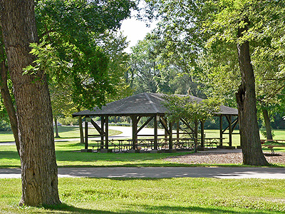
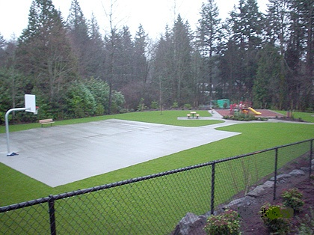
Audit Tool Testing
Selected 66 parks stratified on several dimensions:
  North, central, or south district
  Available facilities (e.g., playground)
  2009 maintenance rating
  Median income of park’s census tract
  Percentage non-White within tract
Pairs of stakeholders randomly assigned to each other and to 3-12 parks each
  Auditors paid $20/hr
Park audits conducted independently during September-October 2010
Pairs of audits completed for 59 parks
  1.1 to 193.2 acres
  10-65 minutes per audit (mean=32 min)
Kaczynski, A.T., Wilhelm Stanis, S.A., & Besenyi, G.M. (2012). Development and testing of a community stakeholder park audit tool. American Journal of Preventive Medicine, 42(3), 242-249.
Notes:
PHS 635
49

Slide 50
CPAT Inter-rater Reliability
Reliability of 10 items could not be assessed due to less than three pairs of ratings
Vast majority of the items had acceptable kappas and/or percent agreement
Kappa Value | # of items | # of items in row with % agreement > 70%
Not available/applicable | 56 | 55
0.60 or above | 55 | 55
0.40-0.59 | 13 | 12
Less than 0.40 | 8 | 6
Less reliable items were related to subjective or temporally-variable park attributes such as noise, shade, and lighting
Some items retained and modified given their theoretical significance for park-based physical activity
Kaczynski, A.T., Wilhelm Stanis, S.A., & Besenyi, G.M. (2012). Development and testing of a community stakeholder park audit tool. American Journal of Preventive Medicine, 42(3), 242-249.

Slide 51
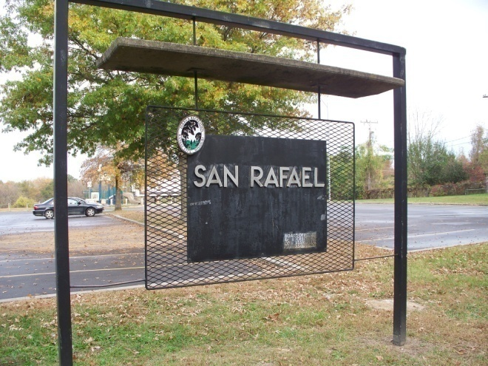
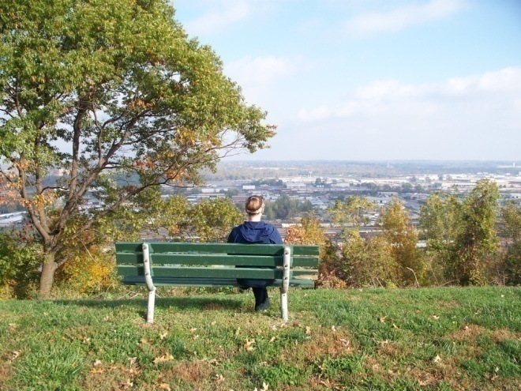
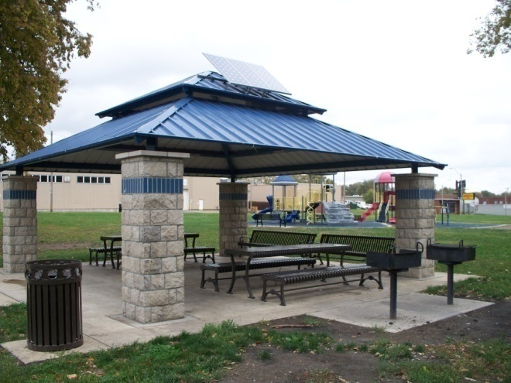
Workshop #3 – Debriefing and Dissemination
Stakeholders provided feedback and input on:
Their experience using the CPAT to audit parks around Kansas City
How best to disseminate the CPAT for future use
How to improve the process of developing and using the CPAT in other communities
Suggestions have been incorporated into modifications to the CPAT and guidebook, as well as future dissemination and training activities.

Slide 52
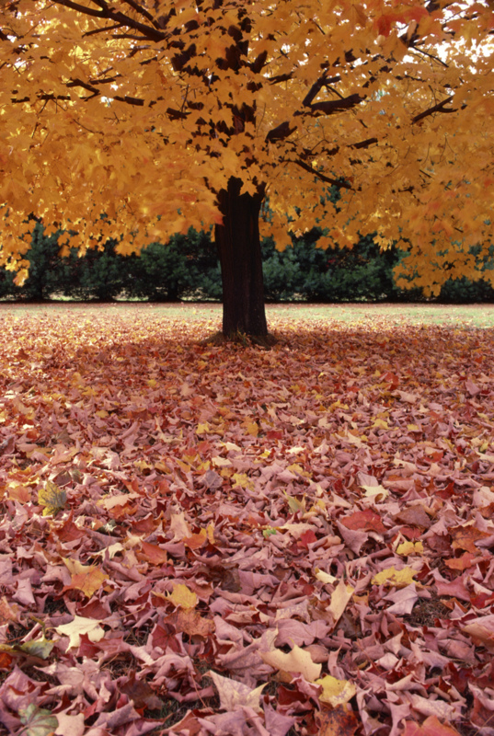
Process-Related Outcomes Among Stakeholders
Networking and community building
  “[The CPAT] provides a nice vehicle for engaging grassroots citizens and constituents in a reasonably manageable process by which to assess parks and what they offer.”
Awareness and knowledge
  “I personally have gained greater awareness of and appreciation for the range and types of variation in parks available.”
  86% of stakeholders reported their perceptions of the importance of both the built environment and parks for promoting physical activity had improved ‘moderately’ or ‘a lot’ over the course of the project
Planning and advocacy support
  “The CPAT can be a valuable resource for many organizations, specifically for me – a community collaborative working to prevent childhood obesity. This tool can help us inform families of places to be active, could help us identify areas of need related to physical activity, help guide our planning process, and help provide information to support advocacy efforts.”

Slide 53
Presentation Outline
Overview of the built environment, parks, environmental justice and physical activity
Kansas City Parks and Physical Activity Project
  Park Environments and Physical Activity pilot study
  Development of a Community Stakeholder Park Audit Tool project
  Kansas City Neighborhood and Park Study
The Healthy Young People Empowerment (HYPE) Project
  Questions and discussion
Notes:
PHS 635
53

Slide 54
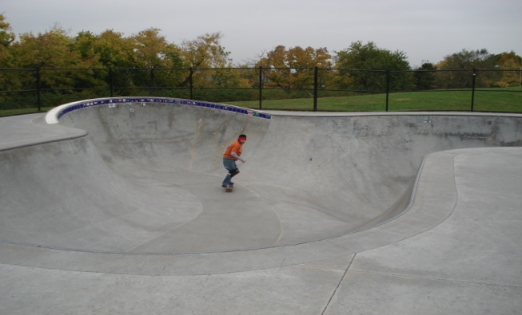
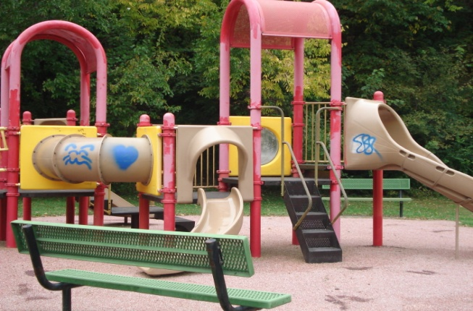
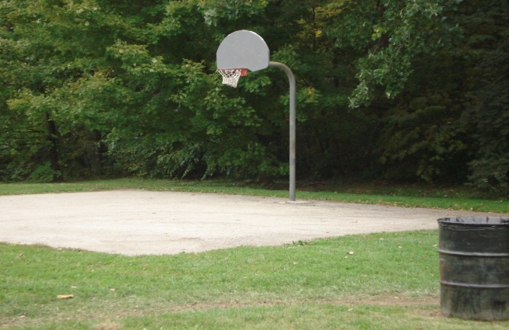
Kansas City Neighborhood and Park Study
How do the attributes of parks and surrounding neighborhoods influence the physical activity, park use, and health of children and adults?
Survey of 893 households from 123 census tracts
  Neighborhood and park perceptions
  Physical activity and park use for adult and child
  BMI and health status data
  Demographic characteristics
Crime and census demographic data for all tracts
GIS calculations of distance, number, and size of parks within ¼ mile, ½ mile, and 1 mile
Detailed audits of 146 parks within 1 mile of households – diverse mix of sizes, facilities, amenities, quality, neighborhood, etc.
Notes:
PHS 635
54

Slide 55
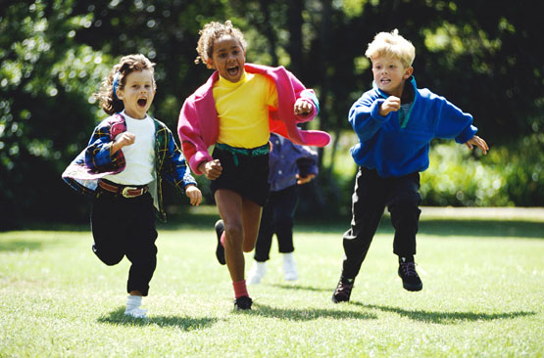

Kansas City Neighborhood and Park Study
Youth with a park within ½ mile from home significantly more likely to meet PA recommendations (OR=2.59, 95% CI=1.24-5.41)
  Especially true for female youth (OR=3.27, 95% CI=1.08-9.94)
  Likewise, youth with more parks and a greater amount of park space within 1 mile from home are significantly more likely to meet recommendations
Besenyi, G.M., Kaczynski, A.T., Wilhelm Stanis, S.A., Bergstrom, R., & Vaughan, K.B. (under review). Association of park proximity and park features with youth physical activity. Manuscript submitted for publication.
Notes:
PHS 635
55

Slide 56


Kansas City Neighborhood and Park Study
Youth with a playground within ½ mile from home were 2.5x more likely to meet PA recommendations
Certain proximal park amenities also related to greater physical activity (e.g., shade, transit stop nearby, traffic signal on adjacent street, etc.)
Besenyi, G.M., Kaczynski, A.T., Wilhelm Stanis, S.A., Bergstrom, R., & Vaughan, K.B. (under review). Association of park proximity and park features with youth physical activity. Manuscript submitted for publication.
Notes:
PHS 635
56

Slide 57

Parks and Environmental Justice in KC
    Does the availability of park space, features, and quality differ according to census tract income level and racial composition?
    Does the presence of a nearby park (or certain park features) mitigate the effects (physical activity, BMI, cancer, CVD, etc.) of living in a low income or high racial minority area?
Vaughan, K.B., Kaczynski, A.T., Wilhelm Stanis, S.A., Besenyi, G.M., Bergstrom, R., & Heinrich, K.M. (in press). Exploring the distribution of park availability, features, and quality across Kansas City, Missouri by income and race/ethnicity: An environmental justice investigation. Accepted for publication in Annals of Behavioral Medicine.
Notes:
PHS 635
57

Slide 58

Parks and Environmental Justice in KC
  Greater number of parks in low income areas of Kansas City, Missouri
    May be a function of greater mixed land use planning that is more common in older developments
  Parks in low income areas significantly less likely to have playgrounds
  Parks in low income areas contained significantly more quality concerns (e.g., litter, graffiti)
Vaughan, K.B., Kaczynski, A.T., Wilhelm Stanis, S.A., Besenyi, G.M., Bergstrom, R., & Heinrich, K.M. (in press). Exploring the distribution of park availability, features, and quality across Kansas City, Missouri by income and race/ethnicity: An environmental justice investigation. Accepted for publication in Annals of Behavioral Medicine.

Slide 59

‘Access’ to Parks and Park Use and Physical Activity
Parks are important behavior settings for physical activity (PA) (Bedimo-Rung et al., 2005; Kaczynski & Henderson, 2007)
Behavioral models of PA and the environment posit that PA is influenced by attributes of the origin, the destination, the area around the origin and destination, and the route between these two points (Lee & Moudon, 2004; Sugiyama et al., 2012)
Several studies have established that the features of parks are important for PA (Kaczynski et al., 2008; Giles-Corti et al., 2005; Sugiyama et al., 2010)
However, few studies have considered elements related to accessing the park (e.g., Kaczynski et al., 2010), even though these are conceptually significant for park-related PA (Bedimo-Rung et al., 2005)
Kaczynski, A.T., Koohsari, M.J., Wilhelm Stanis, S.A., Bergstrom, R., & Sugiyama, T. (in press). Association of street connectivity and road traffic speed with park usage and park-based physical activity. American Journal of Health Promotion.

Slide 60
‘Access’ to Parks and Park Use and Physical Activity
To examine how ease of access to parks was associated with park use and park-based PA
Four related research questions:
  Is greater street connectivity in one’s neighborhood associated with an increased likelihood of using neighborhood parks?
    Is greater street connectivity in one’s neighborhood associated with an increased likelihood of engaging in park-based PA?
    Is slower traffic speed on the route to one’s closest park associated with an increased likelihood of using neighborhood parks?
    Is slower traffic speed on the route to one’s closest park associated with an increased likelihood of engaging in park-based PA?

Slide 61
‘Access’ to Parks and Park Use and Physical Activity
Street Connectivity
  Number of intersections with 3 or more segments per hectare within a 1 km road network buffer from participant’s home address
Traffic Speed
  Would the participant have to travel on or cross a road with a speed limit greater than 35 mph (56 km/h) to reach their closest park?
Park Use
  Within the last month (i.e., last 30 days), did you visit a park? (Walker et al., 2009)
Park-based PA
  Number of reported minutes spent being physically active in park in a usual week
Kaczynski, A.T., Koohsari, M.J., Wilhelm Stanis, S.A., Bergstrom, R., & Sugiyama, T. (in press). Association of street connectivity and road traffic speed with park usage and park-based physical activity. American Journal of Health Promotion.

Slide 62

‘Access’ to Parks and Park Use and Physical Activity
More connected neighborhood
Less connected neighborhood

Slide 63
Results – Street Connectivity
Compared to participants in the lowest intersection density quartile:
  Participants in the third and fourth quartiles were more likely to have visited a park in the past month
  Participants in the highest quartile were more likely to engage in park-based PA
 | Park Use |  | Park-Based Physical Activity
Park Access Variable | OR | 95% CI | OR | 95% CI
Street Connectivity
Highest quartile | 2.13 | 1.29-3.53 | 2.34 | 1.17-4.83
Third quartile | 1.76 | 1.13-2.74 | 1.41 | 0.66-3.05
Second quartile | 1.16 | 0.73-1.83 | 0.88 | 0.41-1.88
Lowest quartile | 1.00 |  | 1.00
Traffic Speed
Low | 1.47 | 1.05-1.92 | 1.10 | 0.67-1.82
High | 1.00 |  | 1.00
Kaczynski, A.T., Koohsari, M.J., Wilhelm Stanis, S.A., Bergstrom, R., & Sugiyama, T. (in press). Association of street connectivity and road traffic speed with park usage and park-based physical activity. American Journal of Health Promotion.

Slide 64
Results – Traffic Speed
Compared to participants who had to travel on or cross a high traffic speed road on the route to their closest park:
  Participants with low traffic speed routes to parks were more likely to have used a park in the past month
 | Park Use |  | Park-Based Physical Activity
Park Access Variable | OR | 95% CI | OR | 95% CI
Street Connectivity
Highest quartile | 2.13 | 1.29-3.53 | 2.34 | 1.17-4.83
Third quartile | 1.76 | 1.13-2.74 | 1.41 | 0.66-3.05
Second quartile | 1.16 | 0.73-1.83 | 0.88 | 0.41-1.88
Lowest quartile | 1.00 |  | 1.00
Traffic Speed
Low | 1.47 | 1.05-1.92 | 1.10 | 0.67-1.82
High | 1.00 |  | 1.00
Kaczynski, A.T., Koohsari, M.J., Wilhelm Stanis, S.A., Bergstrom, R., & Sugiyama, T. (in press). Association of street connectivity and road traffic speed with park usage and park-based physical activity. American Journal of Health Promotion.

Slide 65
Presentation Outline
Overview of the built environment, parks, environmental justice and physical activity
Kansas City Parks and Physical Activity Project
  Park Environments and Physical Activity pilot study
  Development of a Community Stakeholder Park Audit Tool project
  Kansas City Neighborhood and Park Study
The Healthy Young People Empowerment (HYPE) Project
  Questions and discussion
Notes:
PHS 635
65

Slide 66

Youth Empowerment/Advocacy
Creating healthy communities will require the interest and participation of multiple partners (Sallis et al., 2006)
Youth voices can be powerful in influencing the priorities and decisions of policymakers (Checkoway et al., 2005; Ribisl et al., 2004)
Engaging youth in advocacy and community change efforts is critical
  positive youth development
  youth empowerment
  civic engagement
  future public leadership
Youth advocacy for obesity prevention has
been called the next wave of social change
for health (Millstein & Sallis, 2011)
Notes:
PHS 635
66

Slide 67


Purpose of HYPE
The Healthy Young People Empowerment (HYPE) Project is designed to enhance the capacity of adolescents to plan, implement, and advocate for community PSE change centered around healthy eating and active living.
Notes:
PHS 635
67

Slide 68
HYPE Partners
CDC, Community Transformation Grants
Healthy South Carolina Initiative
Eat Smart Move More South Carolina
University of South Carolina, Arnold School of Public Health
South Carolina Department of Health and Environmental Control
Notes:
PHS 635
68

Slide 69


HYPE Development Process
Theoretical Foundations
  MATCH model of health promotion
  Positive youth development theories
  Social ecological model framework
Steps
  HYPE collaboration team formed
  ESMMSC hired Youth Empowerment coordinator
  Literature review (theories/youth curriculum)
  Key informant interviews
  HYPE goals/objectives established
  HYPE curriculum phases developed
  Minority advisory board review
Notes:
PHS 635
69

Slide 70

Five Phases of HYPE
Think
Learn
Act
Share
Evaluate
Notes:
PHS 635
70

Slide 71
THINK
Youth are encouraged to THINK about what they know about stereotypes, health disparities, and HE/AL
Youth will participate in group discussions, draw their community HE/AL environment, and interview community members to gain perspective on HE/AL issues
Notes:
PHS 635
71

Slide 72
LEARN
Youth LEARN knowledge and skills around HE/AL, PSE change, and being a Champion for Change
Youth will practice public speaking and leadership skills, learn how to work with the media, and create a project action plan
Notes:
PHS 635
72

Slide 73
ACT
Youth are called to ACT by creating an action plan for successful PSE change for HE/AL in their community
Youth will identify a HE/AL issue, collect and analyze data, determine SMART goals and objectives, identify key players, and create a PSE change action plan
Notes:
PHS 635
73

Slide 74

SHARE
Youth will SHARE their action plan with local stakeholders/ policymakers as well as present at the HYPE Summit
Notes:
PHS 635
74

Slide 75

EVALUATE
Youth will EVALUATE changes created by action plans, review project outcomes, and discuss sustainable strategies
Notes:
PHS 635
75

Slide 76

HYPE Curriculum Structure
60-minute sessions
Once per week
Evidence-based information and activities
  Individual and group-based
  On and off-site
Led by adult facilitators trained by ESMMSC
Two guides:
  Adult Facilitators’ Guide
  Youth Guide
Notes:
PHS 635
76

Slide 77

Current HYPE Pilot Communities
Pilot in 3 selected communities during 2012-2013
  Richland County
  Pickens County
  Fairfield County
Emphasis on program improvement
Project Stages (2012-13) | Sept | Oct | Nov | Dec | Jan | Feb | Mar | Apr | May | Jun | Jul | Aug
Phase One: Think
Phase Two: Learn
Phase Three: Act
Phase Four: Share
Phase Five: Evaluate
Notes:
PHS 635
77

Slide 78

Evaluation of HYPE
Process evaluation
  Program delivery/implementation
  Youth engagement/enjoyment
  Adult/youth interaction
Outcome evaluation
  Youth HE/AL knowledge/awareness
  Youth empowerment/self-efficacy
  Individual/community PSE mobilization
  Policymakers’ attitudes/willingness towards PSE change
Notes:
PHS 635
78

Slide 79

HYPE – Next Steps
Ongoing feedback from Adult Advisory Board
Ongoing feedback from Youth Advisory Board
Implementation of HYPE in 30+ South Carolina communities by 2015
Emphasis on African American youth
Comprehensive evaluation
  control groups
  factors affecting implementation
  individual-level outcomes
  community-level outcomes
Notes:
PHS 635
79

Slide 80



Summary
Built environments, including parks, provide important settings and resources for physical activity, but they can differ dramatically from city to city and neighborhood to neighborhood with respect to their facilities, amenities, quality, and context
Better understanding how environmental factors in diverse communities impact active living and better engaging citizens in evaluating and improving those resources can foster multiple dimensions of health-related environmental justice

Slide 81



Acknowledgements
Dr. Sonja Wilhelm Stanis, Department of Parks, Recreation and Tourism, University of Missouri
Gina Besenyi, PhD student, University of South Carolina
Katy Vaughan, former MPH student, Kansas State University
Stephanie Child, PhD student, University of South Carolina
Kansas City, Missouri Parks and Recreation Department
  Mark McHenry, Director
  Steve Lampone, Deputy Director
Health Care Foundation of Greater Kansas City
Robert Wood Johnson Foundation Active Living Research program
Eat Smart Move More South Carolina
U.S. Coalition on the Value of Play
Notes:
PHS 635
81

Slide 82
Equal access for all? Environmental Justice Perspectives on the Built Environment and Active Living
Andrew T. Kaczynski, PhD
Department of Health Promotion, Education & Behavior
Arnold School of Public Health
University of South Carolina
82
atkaczyn@mailbox.sc.edu

