Slide 1
Prisma Health Employee Assistance Program (EAP) Powered by LifeWorks
Stephanie A. John, MS, LMFT, LAC
Prisma Health Workforce Wellness Manager

Slide 2
The Partnership
Multiple ways Prisma Health and the University of South Carolina School of Medicine Greenville partner…
Examples:
In partnership with Prisma Health, the University of South Carolina School of Medicine Greenville is an ACCME nationally accredited CME Program that seeks to provide quality AMA PRA accredited educational and professional development learning to clinicians within the health system and its affiliated partners.
Affording students of the University of South Carolina School of Medicine Greenville the ability to access Prisma Health’s Employee Assistance Program (EAP) powered by Lifeworks.

Slide 3
Workforce Wellness
Manager- Workforce Wellness
Stephanie John, MS, LMFT, LAC
CARE Coordinator
Zach Dorsch, EdS, MA, LPC
Administrative Assistant
Julie S. Boozer
The objectives of the Workforce Wellness team are to …
1) support the implementation of wellness strategies across the Prisma Health system.
2) assist team members & students as they navigate the resources afforded to them by Prisma Health and the community to support their overall wellbeing.
3) collaborate to assure that resources for team members, students, and loved ones are of high quality, accessible, timely and support the diversity, equity and inclusion efforts of our workforce.

Slide 4
What is an EAP?
An Employee Assistance Program (EAP)
is a benefit program that assists employees with personal problems and/or work-related problems that may impact their job performance, health or mental or emotional well-being.
Notes:
This is not a resource unique to Prisma Health, however it is a benefit that we would like to see team members make use of. Additionally, if you have a friend, family member who is employed, you may want to encourage them to learn if their employer has an EAP. While not all EAPs are the same, it is a resource to make yourself familiar with.

Slide 5
Prisma Health’s EAP is a confidential resource that strives to be accessible to our team members, students, and their loved ones.

Slide 6
Supporting the daily lives of Prisma Health’s team members, students, and families with
Work-Life Services & Counseling
Short-term solution-focused counseling
Life coaching
Financial consultation
Legal consultation & referrals
Child care / elder care resource & referrals
Community resource referrals
And much more!

Slide 7
On-site Counselors
Mei Lin Boykin holds 13 years of experience as a Licensed Professional Counselor with experience in the areas of substance abuse and military personnel. Mei Lin’s approach to counseling provides her clients with compassion, empathy, and encouragement, without judgement, to find solutions within oneself.
Eunice Lehmacher received her master’s in social work in 1996, with an emphasis on counseling adults, Eunice has served as a community mental health counselor, hospice counselor, owner of her own private practice, and caregiver counselor. Currently, Eunice is putting her experience to work at both OMH and Easley Baptist and helps team members with a variety of issues including depression, anxiety, work related stress, parenting, relationships, etc. She has extra training in depression, caregiving issues, dementia, grief and anxiety.
Heather Ravnan has been an EAP counselor for nearly 20 years, after leaving a career in engineering for work that she finds inspiring and fulfilling. She earned a master’s degree in social work at the University of South Carolina. She supports clients in addressing a wide variety of concerns, including but not limited to grief and loss, life transitions, stress management, work/life balance, depressive symptoms, anxiety, and relationship strain.
Kathleen Raschiotto has worked in the EAP field for over 25 years. Kathy enjoys helping clients address problems related to work/life balance and those connected to negotiating conflicts with family members and peers. When a client’s issues create anxiety or depression, she works with them to find better coping mechanisms and learn to take better care of themselves.
Val Smith-Byrd began her career in 1997 as a clinical therapist in behavioral health inpatient and outpatient hospital setting and eventually transitioned to the position of EAP counselor. In addition, she has clinical experience providing home-based mental health treatment to families in the community. Her daily theoretical practice includes solution-focused therapy, CBT and strength-based counseling. Val’s encouragement to others is “ show up for yourself, be honest and do the work, because YOU matter!.”
Rodney Williams has over ten years experience as a professional and addiction counselor. He is also a National Board-Certified Counselor and a Certified Grief and Loss Counselor. Rodney specializes in working with anxiety and depression, grief and loss, workplace and personal stress, communication and conflict, violence, and substance abuse.
Sites closest to this campus:
1020 Grove Road, inside the Center for Health and Occupational Services &
255 Enterprise Blvd Patewood

Slide 8
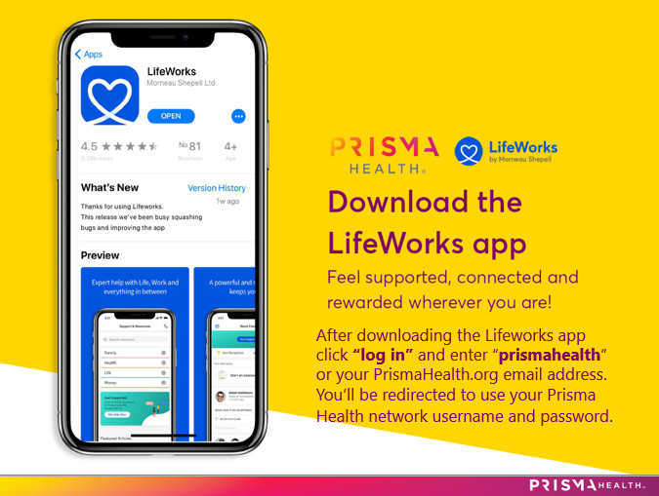
Call toll-free for wellbeing assistance : 877-761-3614

Slide 9
Invite up to 5 family members to use LifeWorks!
Family members can create an account at PrismaHealth.LifeWorks.com or via the free app for a wealth of wellbeing resources.
Download the app and/or go PrismaHealth.LifeWorks.com
Click “log in” and enter “prismahealth” OR your PrismaHealth.org email address.
Go to “Profile” (under your photo) then scroll to choose “Family.”
Type in your loved ones’ email addresses
LifeWorks will send them an email invitation to join.
EAP Counseling is provided at no cost to the team member or family member regardless of insurance coverage.

Slide 10
Confidential access
This is what your loved one would receive via email once you invite them via the app or website

Slide 11
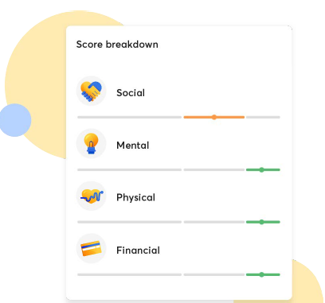
Total Wellbeing Index

Slide 12
Let’s take a look…
Self-guided resources on mindfulness, anxiety, depression, relationships, separation, elder care, parenting advice, death and grief, and many more areas of wellness. Get help quitting smoking or becoming healthier. Life coaching. Discounts on gift cards. Legal resources. Webinars. Perks and shopping discounts. Fitness coaching. Advice on family needs, child support, money matters and work life. Divorce counseling. Learn to better handle your finances. And so much more!

Slide 13
Frequently Asked Questions
What does a student or team member need to do to make an appointment?
The quickest and easiest way to make an appointment with EAP is to call 877-761-3614 or by using the First Chat feature on the Lifeworks App. You will be asked a few simple questions, such as contact information and reason for visit, and then look at the schedule to find the first available appointment based on the student / team member’s preference: in person, virtually, date, time, language, etc. We have counselors on site at some of our Prisma Heath locations as well as throughout the community.
What types of counseling is provided through EAP?
Prisma Health’s EAP powered by Lifeworks can help team members, students, and their loved ones with stress at school, work, life transitions, family concerns, grief, abuse, addiction and more. In cases where a higher level of care is needed and is more than what our Master’s Level Clinicians and Counselors can provide, referrals will be made to the appropriate resources. Please note EAP does not cover the cost of services referred.
Can significant others and/or family members access EAP services?
Yes, in supporting student and team member wellbeing we understand the wellness of those we love is important. The quickest and easiest way for a loved one to make an appointment with EAP is to call 877-761-3614. If the student / team member chooses, the student / team member can invite up to 5 family members to create an account on Lifeworks' online platform to have access to the website and app.
Is my EAP benefit tied to my insurance?
Your EAP benefit is not tied to insurance. EAP Counseling is provided at no cost to the student, team member, or family member regardless of insurance coverage.
For more information about EAP, LifeWorks or the LifeWorks app, visit Connect or contact Stephanie.John@PrismaHealth.org.

Slide 14
What’s next?
Check out the resources available via website, app, and phone!
1. Visit PrismaHealth.LifeWorks.com website
click “log in” and enter “prismahealth” OR your PrismaHealth.org email address. Use your Prisma Health network username and password.
2. Download the LifeWorks app
After downloading, click “log in” and enter “prismahealth” OR your PrismaHealth.org email address. You may be prompted by Ping ID to authenticate when using your personal device. Use your Prisma Health network username and password.
3. Call toll-free for wellbeing assistance 877-761-3614
Have the phone number in your contacts for ease of use.
If you have any trouble accessing, please feel free to contact
Stephanie John, MS, LMFT, LAC Manager-Workforce Wellness
stephanie.john@prismahealth.org, 803-296-5973

Slide 15
Critical Incident Response
What is
your role?

Slide 16
If you are notified of a critical incident:
(Examples: campus shooting, natural disaster, etc.)
Contact Stephanie John, Manager of Workforce Wellness, at 803-296-5973 office / 803-298-0679 cell or Stephanie.John@prismahealth.org
If no immediate response, call 877-761-3614 to schedule the trauma team response, 24/7.
Be ready to provide:
Date, description and location of incident
Proposed response/service/intervention needed
Date, time and location of response desired
Contact person for the request
Onsite contact for the response
If the response can be managed by our onsite counselors and resources, those arrangements will be made as an initial response.

Slide 17
What questions do you have?

Slide 18
Thank you!
Questions, suggestions, insights and concerns always welcome!
Stephanie A. John, MS, LMFT, LMFT-S, LAC
Direct Office: 803-296-5973
Fax: 803-296-5061
Stephanie.John@prismahealth.org

Slide 19
Thanks!
Stephanie A. John, MS, LMFT(S), LAC
Manager-Workforce Wellness Prisma Health
Stephanie.john@prismahealth.org

