Slide 1
Creating Coherence Across the Curriculum: Finding Evidence of Vertically Integrated High-Impact Student Transition Programs
Jennifer R. Keup
Director, National Resource Center for FYE&SIT
keupj@mailbox.sc.edu

Slide 2
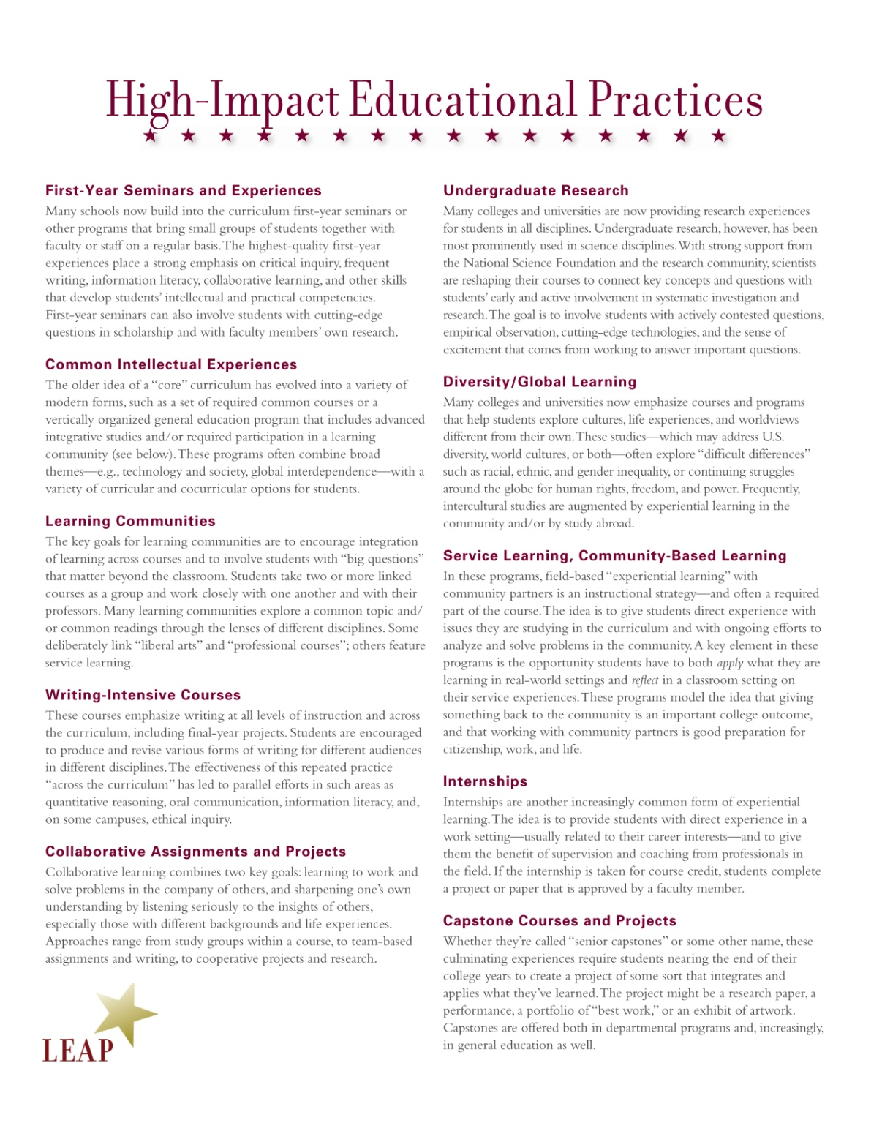
Notes:
.

Slide 3
Introduction & Objectives
GAP: Literature on HIPs and student success has focused on each year, transition point, or intervention as a separate unit.
PURPOSE: Exploring the connections between HIPs toward the creation of a comprehensive and integrated institutional approach to supporting undergraduate students.

Slide 4
Introduction & Objectives
RATIONALE: Integrated approaches would:
Increase the relevance, accessibility, and effectiveness of institutional support structures for students
Streamline the delivery of services and create economies of scale
Respond to the call to treat HIPs “as a set of effective tools rather than as discrete experiences…to conceptualize the collective impact [of] these practices.” (Finley & McNair, 2013)

Slide 5
Conceptual Framework
”Foundations of Excellence” for the first-year and transfer experience (Barefoot, Gardner, Cutright, et al., 2005)
Undergraduate curriculum
Vertical and horizontal alignment in curriculum coherence, learning standards, and educational progression
Instructional scaffolding

Slide 6
Methods: Data
2012-2013 National Survey of First-Year Seminars (NSFYS) (N = 896)
90% with a FYS
Most common: Extended orientation type of FYS
2014 National Survey of Sophomore-Year Initiatives (NSSYI) (N=778)
47% with a program intentional targeted to second-year students
Most common: Academic advising 2016 National

Slide 7
Methods: Data
2016 National Survey of Senior Capstone Experiences (NSSCE) (N = 383)
95% with a capstone
Most common: Discipline-based capstone course
Limitations
Survey items tended to focus on primary HIP method
Not the same group of institutions

Slide 8
Methods: Analyses
Comparable questions across surveys
PURPOSE: 14 items on HIP objective
STRUCTURE: 1 on length of time on campus, 1 on proportion of students reached, 1 on administrative unit overseeing the HIP, and 3 on leadership of the HIP
ASSESSMENT: 2 items on assessment methods
Comparative & descriptive analyses

Slide 9
Results: Purpose
Retention & academic skills misaligned [-]
Personal development & student-faculty interaction equal & of moderate importance [+]
Financial & information literacies were equal but of low importance [n/a]

Slide 11
Results: Structure
HISTORICAL DURATION [+]: The % of the respective HIPs that had been in place for “3 to 10 years” was very similar (41% to 42.7%)
STUDENT REACH [+]: Majority of institutions report that at least 80% of their target student populations participate in the initiatives and senior capstone experiences and first-year seminars have even higher rates of student engagement

Slide 13
Results: Assessment
HISTORY [+]: Approximately half or more of the institutions responding to the surveys indicate that they have conducted assessment of the initiative
METHODS [-]: Several assessment methods were employed for each initiative, but similar patterns of use of assessment methods across high-impact practices did not emerge

Slide 14
Conclusions
Potential for developmental alignment of purpose across HIPs
Common historical duration and student reach provide structural foundation for connection
Administrative oversight is most substantial “fixed” limitation; requires collaboration
Type/method of assessment is a fundamental (but fixable) constraint on alignment across HIPs

